Slide 2
ARVAND PHARMED
November 16, 2023
State-of-the-Art Science:
Ticagrelor in ACS
Abdullah Amirfarhangi, MD.
Interventional Cardiologist.

Slide 3
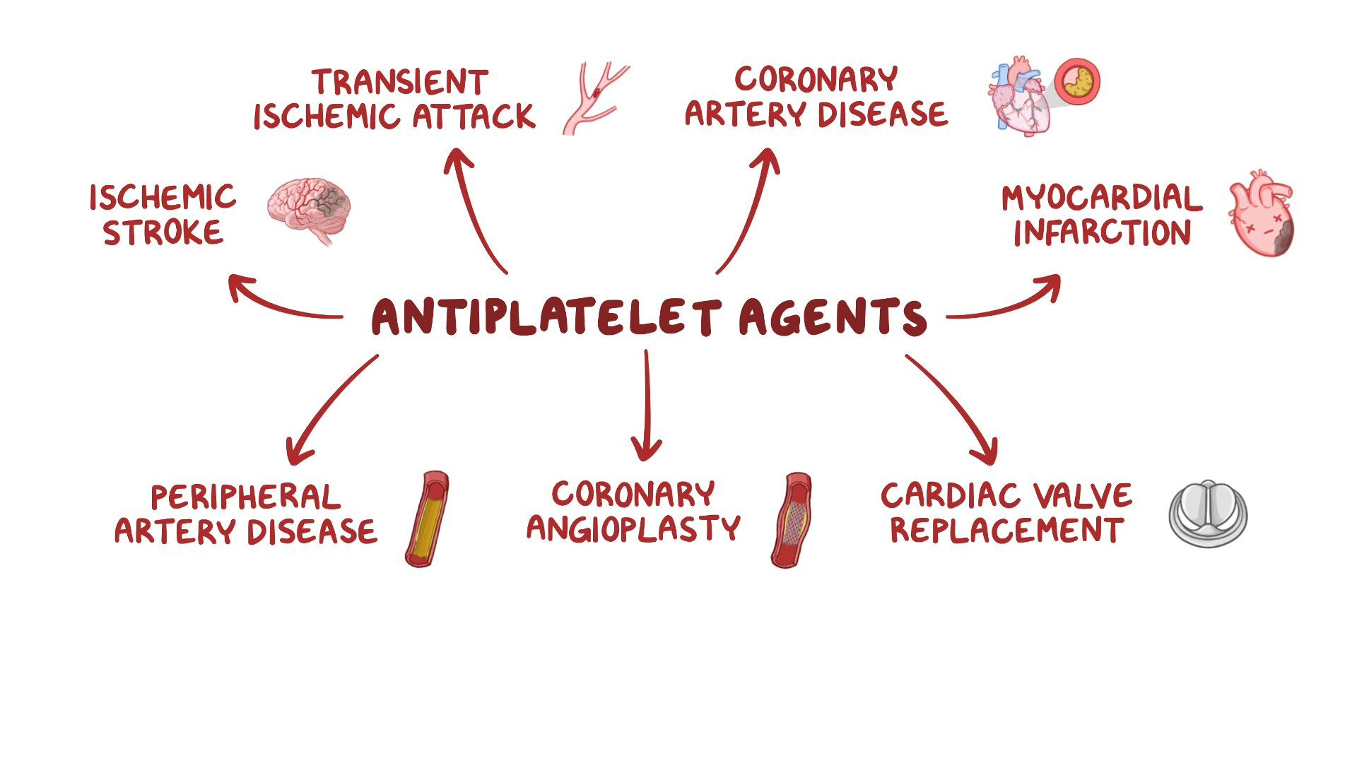

Slide 4
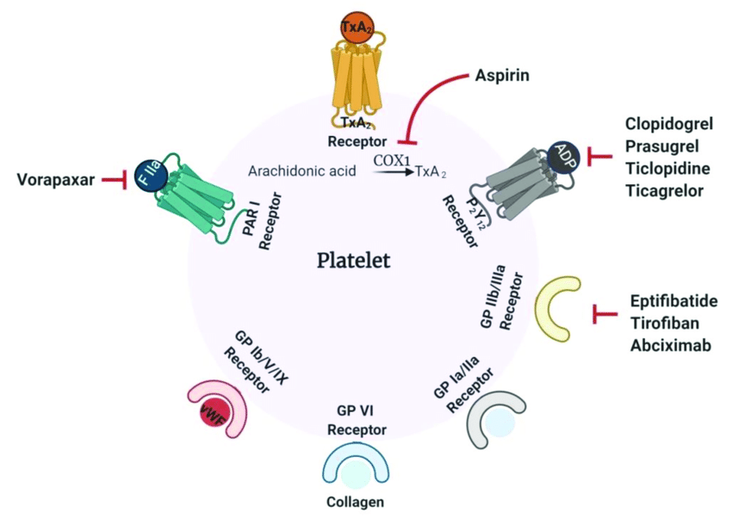

Slide 5
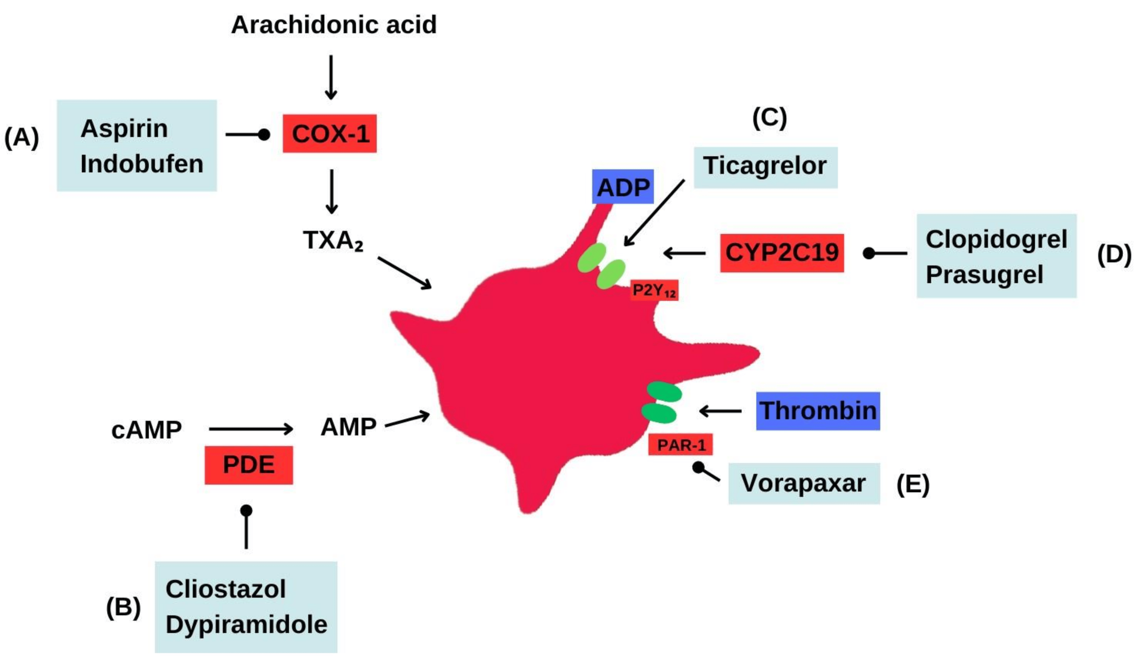

Slide 6
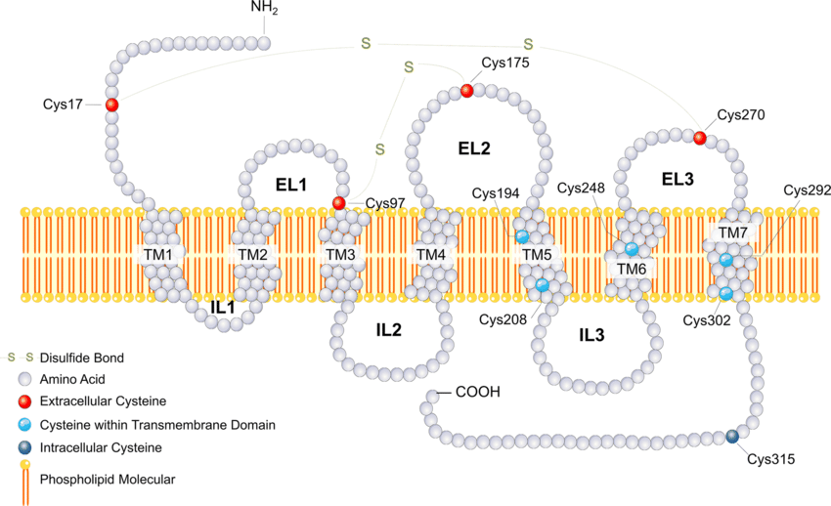

Slide 7
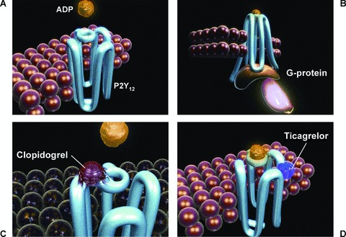

Slide 8
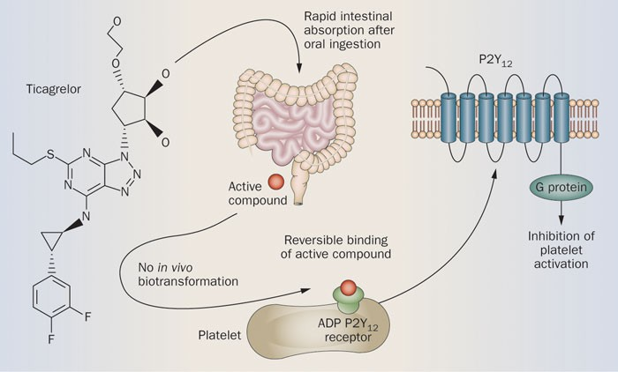

Slide 11
PLATO

Slide 15
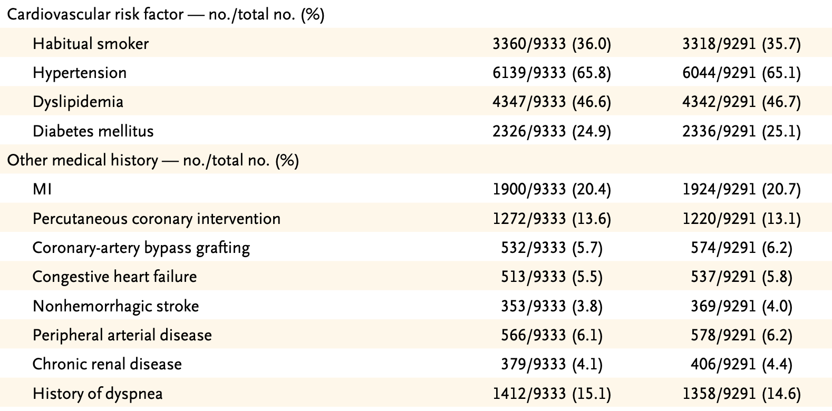

Slide 17
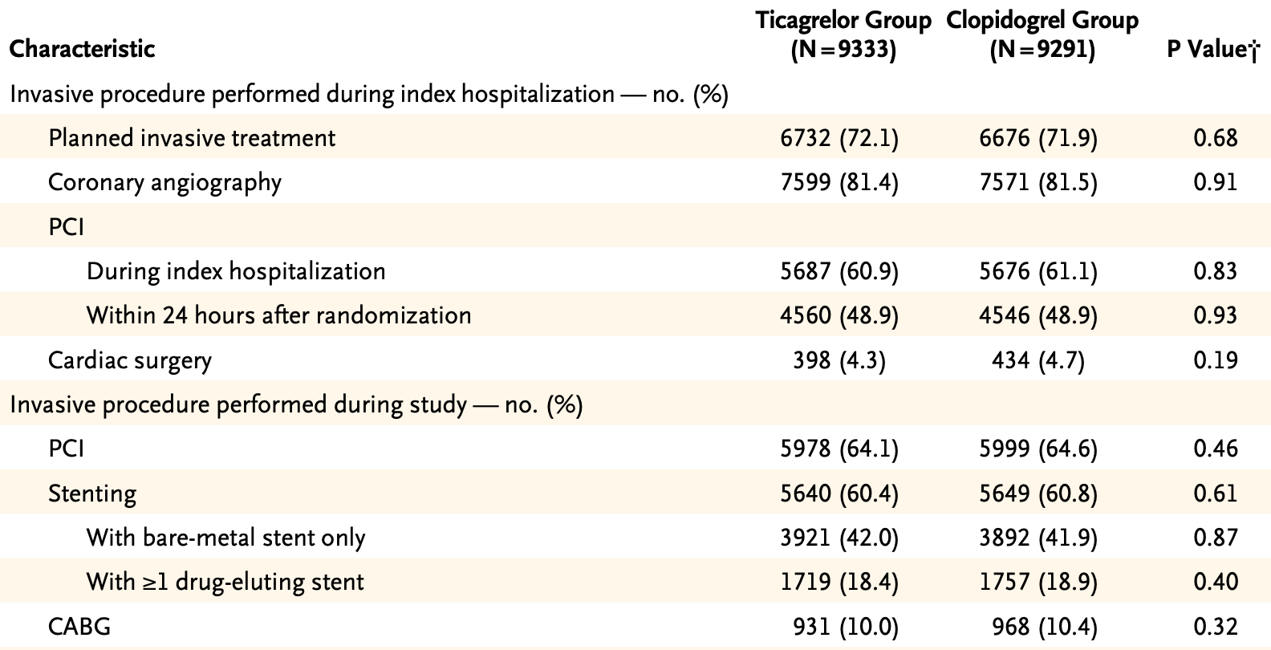

Slide 18
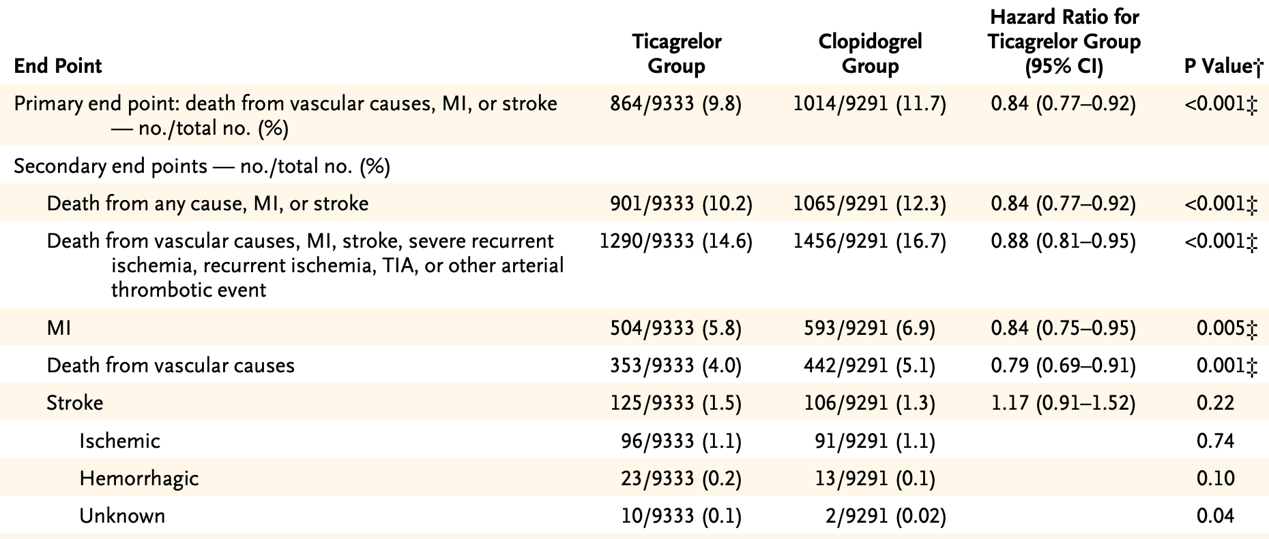

Slide 20
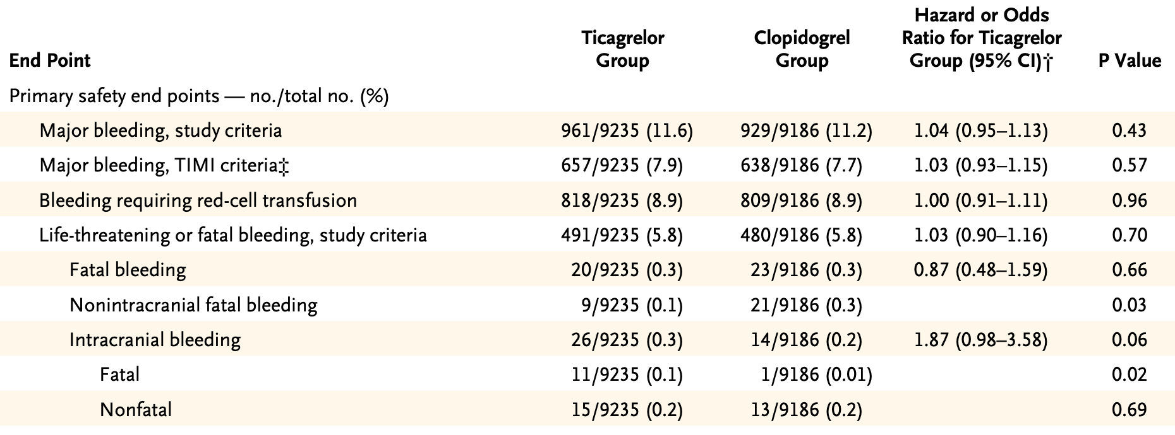

Slide 25
PEGASUS

Slide 28
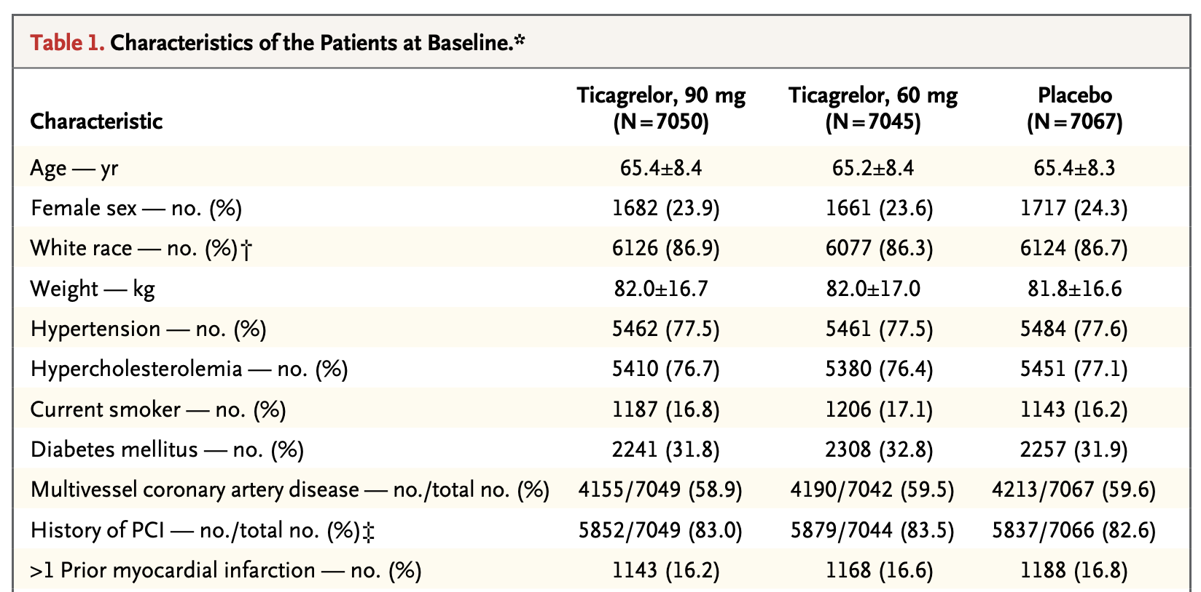

Slide 30
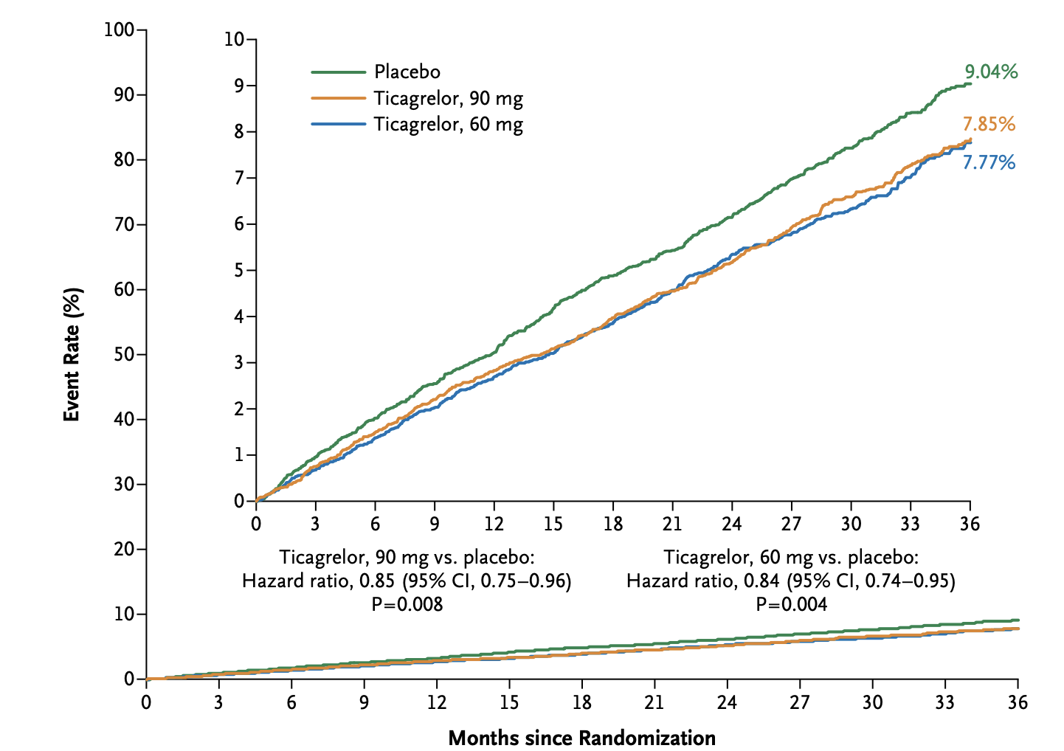

Slide 31
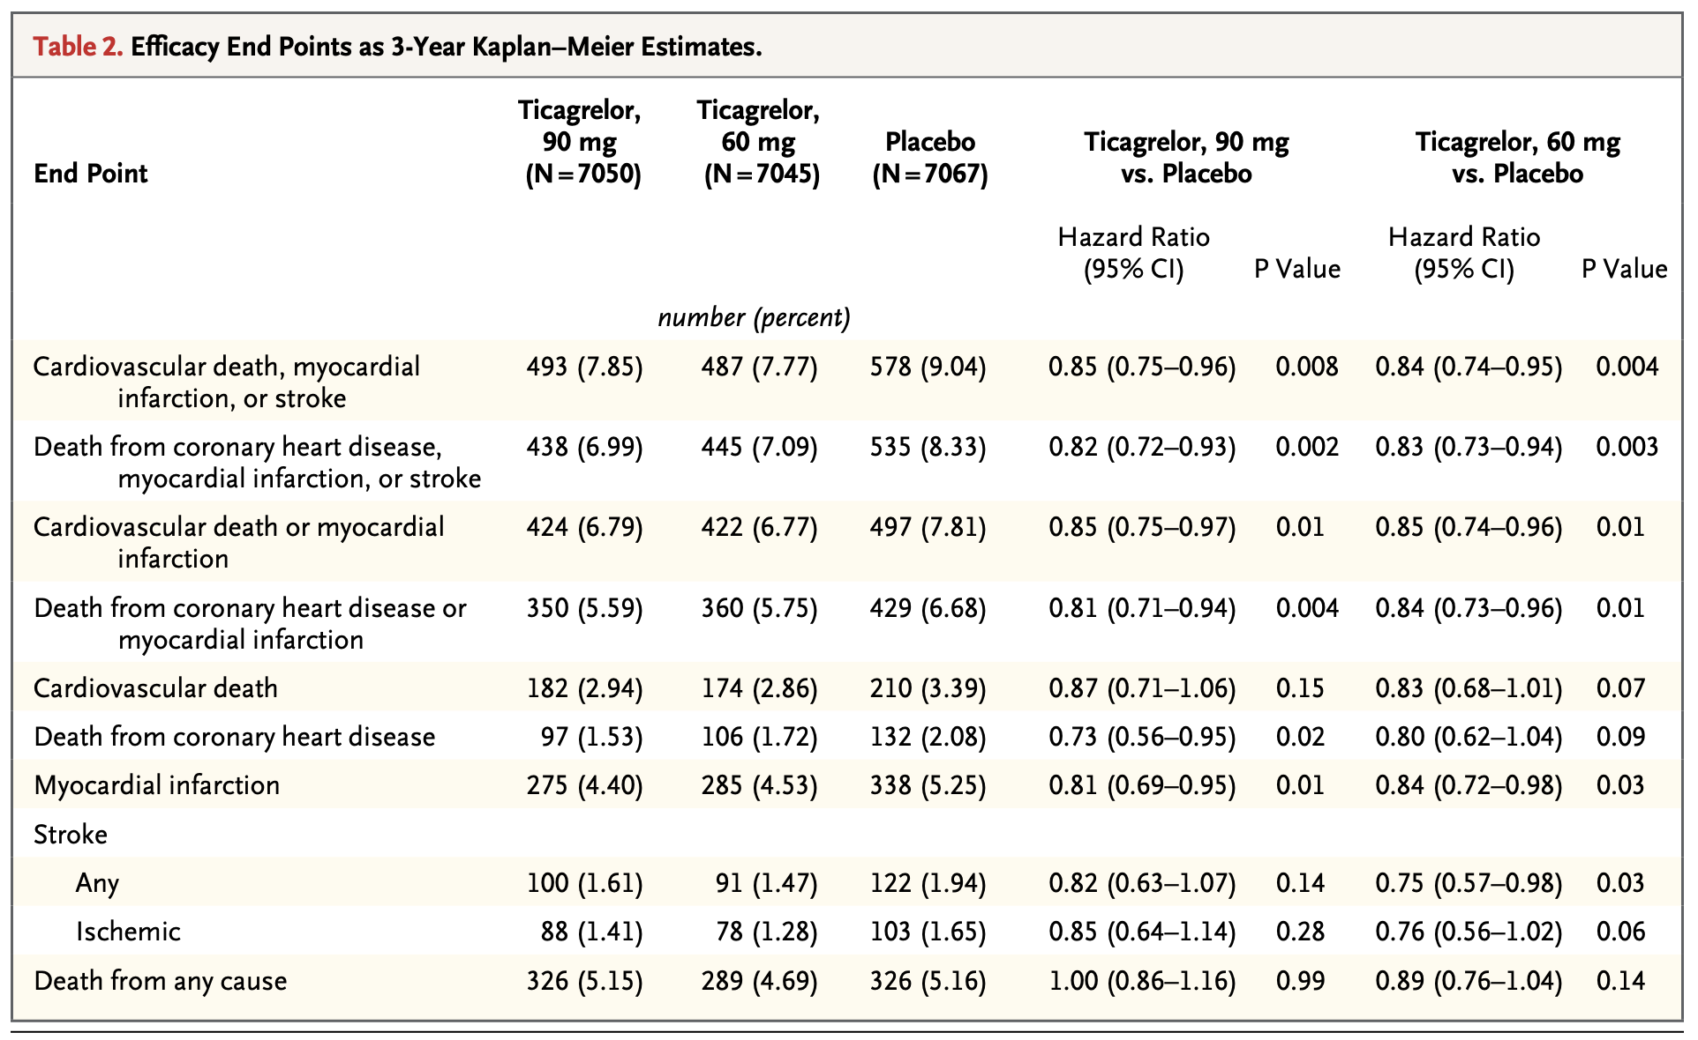

Slide 32
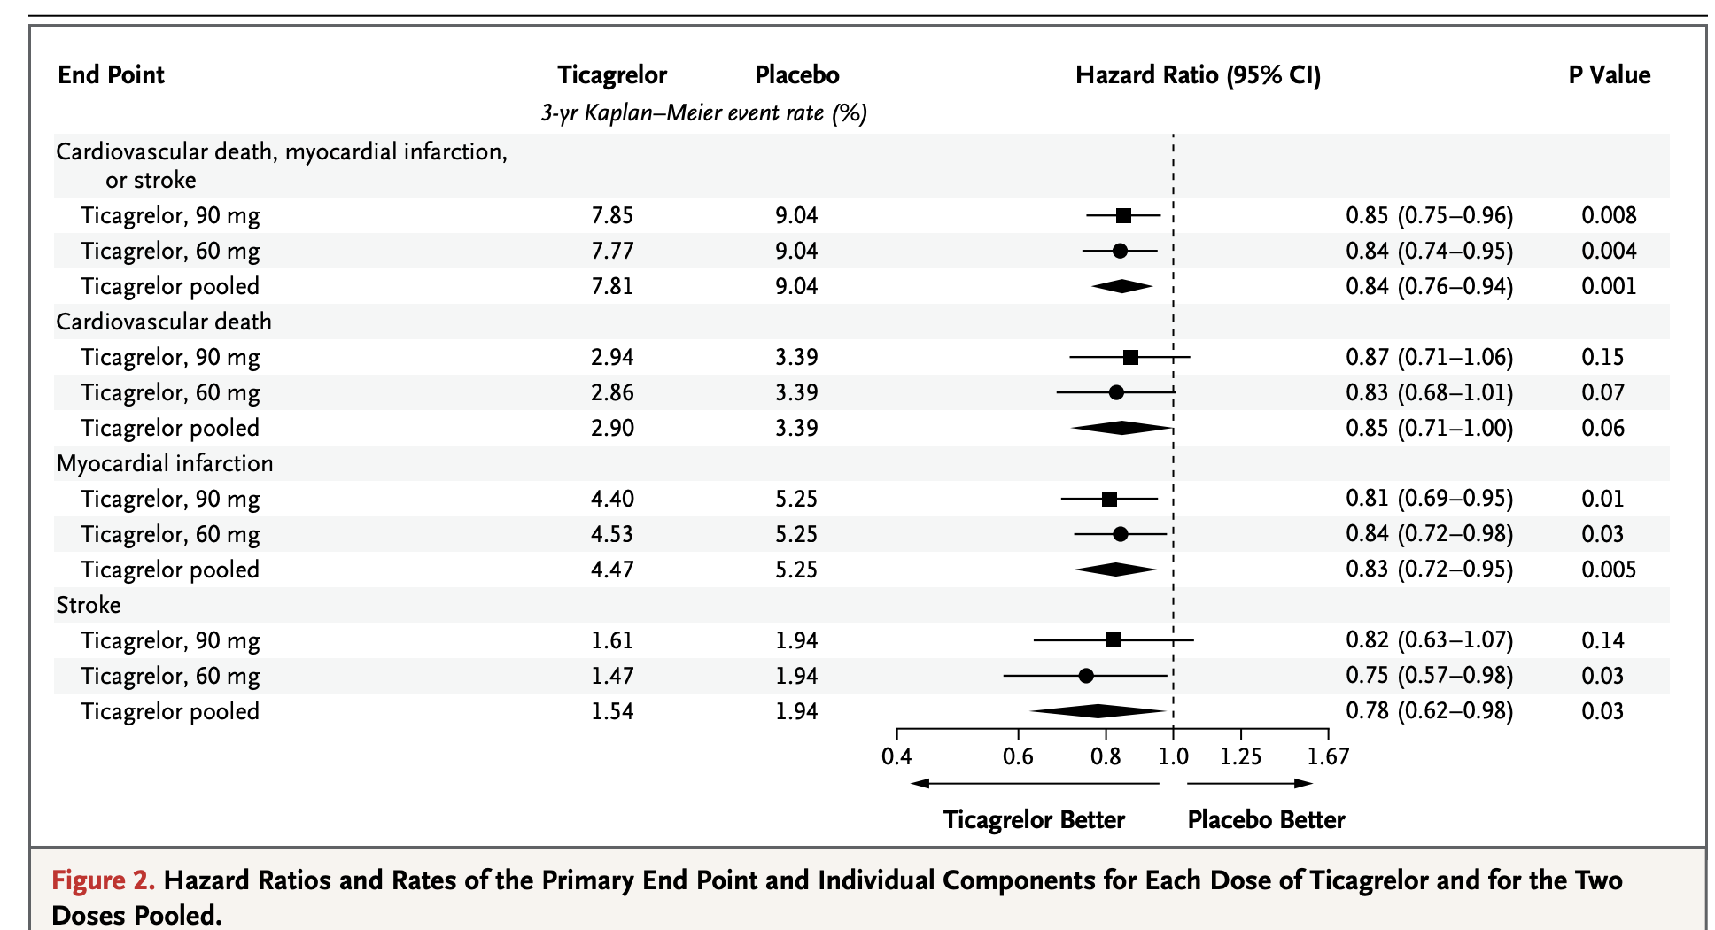

Slide 33
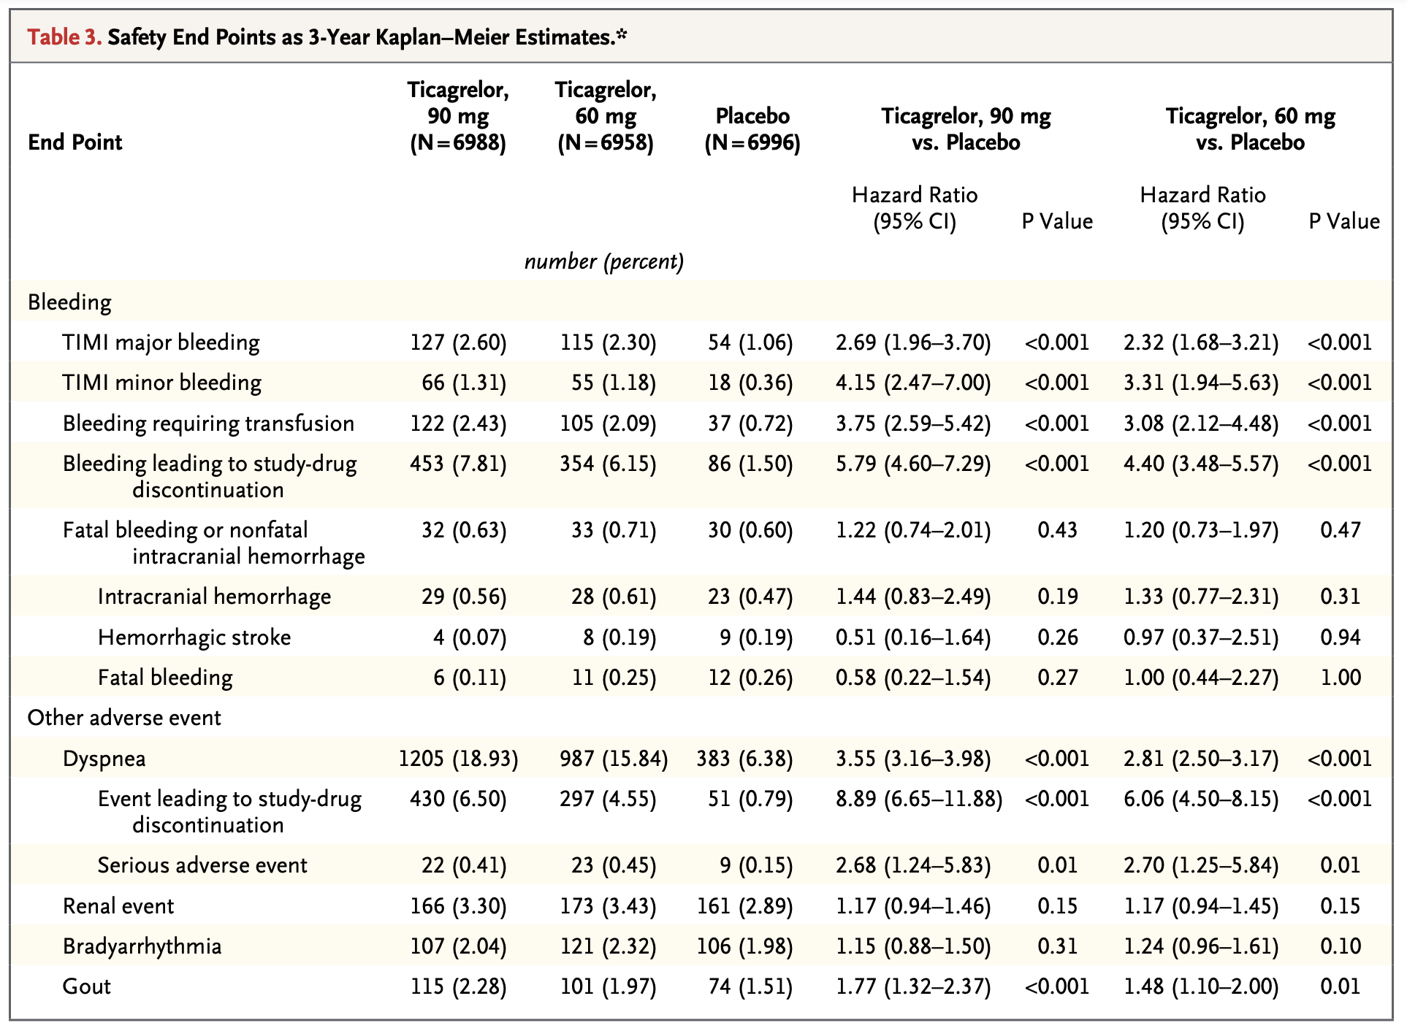

Slide 34
THEMIS Trial

Slide 37
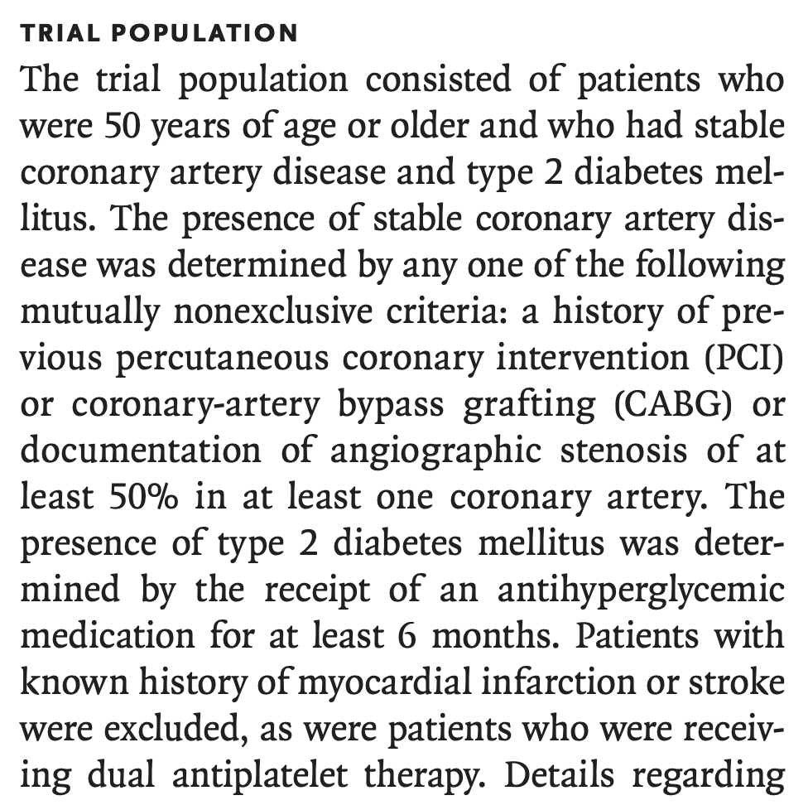

Slide 38
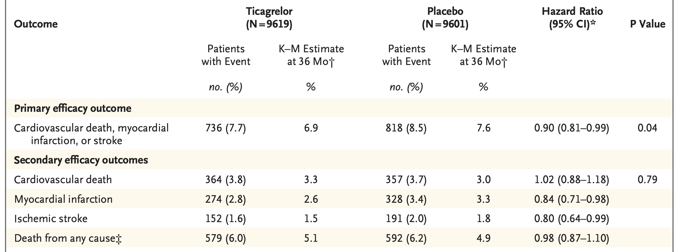

Slide 39
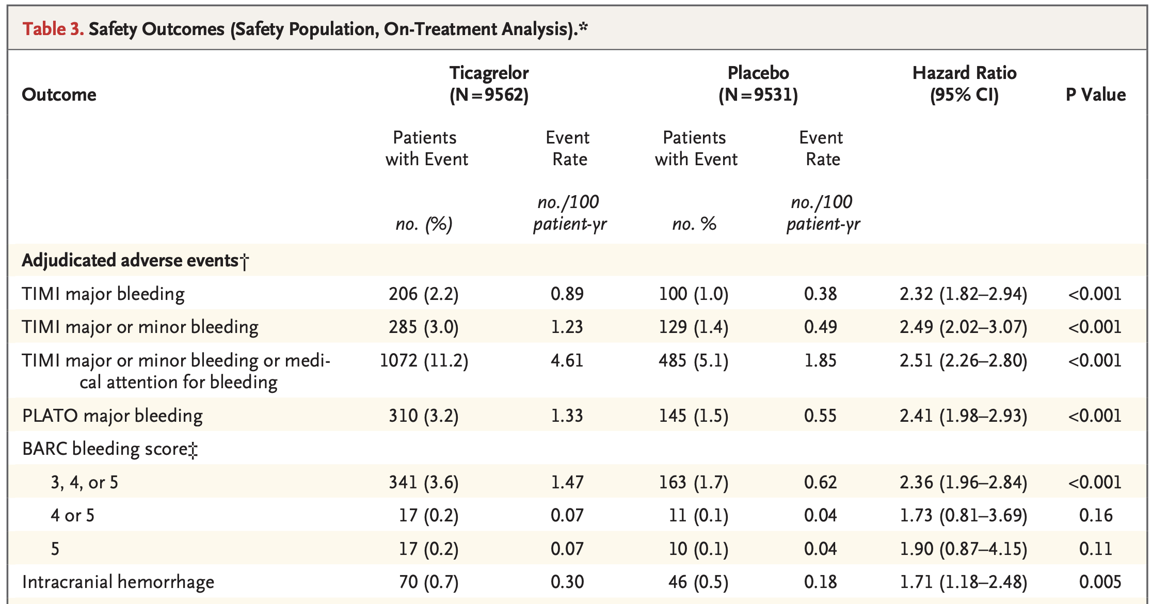

Slide 41
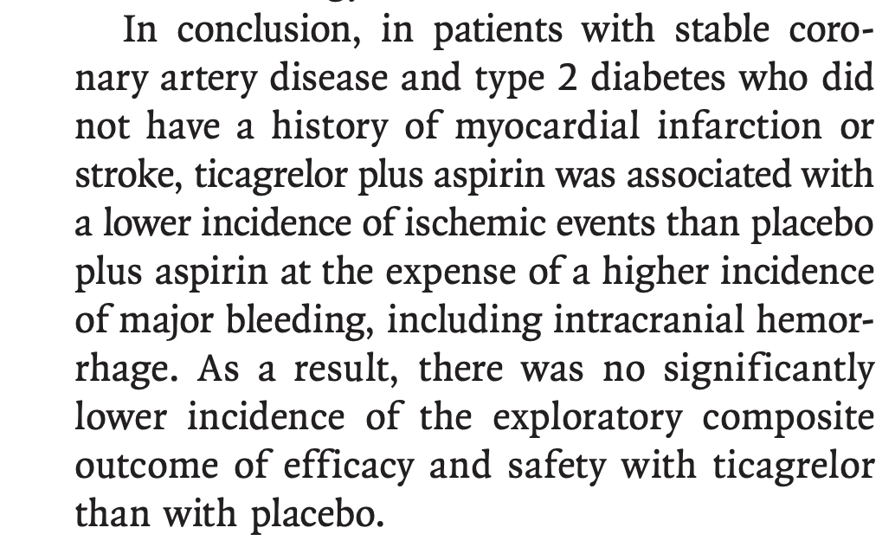

Slide 43
Why bleeding is important?
Associations among mortality, bleeding, and DAPT duration
Mechanistic underpinnings of why

Slide 44
“
Some RCTs and meta-analyses have suggested that longer DAPT after DES implantation may be associated with increased rates of all-cause mortality compared with shorter DAPT, driven by increased noncardiac mortality not offset by reduced cardiac mortality with longer DAPT.

Slide 45
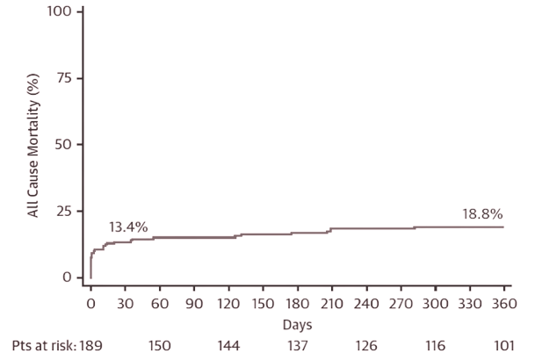
Meta-analysis of 12 RCTs
Mortality after the occurrence of bleeding
Kaplan-Meier estimates of within one month
13.4%
Kaplan-Meier estimates of within one year
18.8%
Conclusion
Most deaths occurred within 1 month of the episodes of bleeding.
Palmerini T, et al. Bleeding-Related Deaths in Relation to the Duration of Dual-Antiplatelet Therapy After Coronary Stenting. J Am Coll Cardiol. 2017

Slide 46
Nutshell
Bleeding might influence mortality through several mechanisms, including:
Direct bleeding-related deaths
Lowering the threshold for:
Ischemia
heart failure
Arrhythmias
Bad effect of red blood cell transfusions and other blood products
Discontinuation of DAPT and other beneficial medications

Slide 47
PREMIER study
Registry of 2,498 patients with acute MI.
Wang TY. Antiplatelet therapy use after discharge among acute myocardial infarction patients with in-hospital bleeding. Circulation. 2008
Main Idea
Elaboration
Patients with bleeding during hospital admissions were less likely to be on:
Aspirin, Thienopyridines, Statins, angiotensin-converting enzyme inhibitors, & Betablockers even 1 year after the episodes of bleeding
The late mortality associated with an episode of bleeding may be related: not only to the interruption of antiplatelet therapy
but also, to discontinuation of other medications known to improve the prognosis of patients with coronary artery disease.

Slide 48
ADAPT-DES study
The incidence, predictors, and prognostic impact of post-discharge bleeding (PDB) after PCI
1
2
3
4
Among 8,582 “all-comers” who underwent successful PCI with DES, PDB occurred in 535 of 8,577 hospital survivors (6.2%) at a median time of 300 days.
Gastrointestinal bleeding (61.7%) was the most frequent source of PDB.
Post-discharge bleeding and MI was strongly associated with 2-year mortality (HR: 5.03 and HR: 1.92, respectively).
PDB had an effect size greater than that of post-discharge MI.
Généreux P. et al. Incidence, Predictors, and Impact of Post-Discharge Bleeding After Percutaneous Coronary Intervention. J Am Coll Cardiol. 2015

Slide 49
Short term DAPT

Slide 50
 | TWILIGHT |  |  | TICO
Study Design | Randomized, double-blind, multicenter |  |  | Randomized, open label, single center
Patients | 7,119 |  |  | 3, 056
Population | High-risk patients aged ≥18 years undergoing PCI with ≥1 DES placement (No STEMI) |  |  | ACS patients undergo BP-SES implantation (All ACS)
Treatment Groups | Ticagrelor DAPT (Ticagrelor 90 mg BID + ASA 81-100 mg QD) | Ticagrelor Monotherapy (Ticagrelor 90 mg BID + Placebo) |  | Ticagrelor DAPT (Ticagrelor 90 mg BID + ASA 81-100 mg QD) | Ticagrelor Monotherapy (Ticagrelor 90 mg BID + Placebo)
Duration of Therapy | From month 3 to month 15 |  |  | ∼12 months
Primary Composite Efficacy Endpoint | Clinically relevant (BARC type 2, 3, or 5) bleeding during months 3-15 |  |  | NACE within 12 months of the index procedure

Slide 51
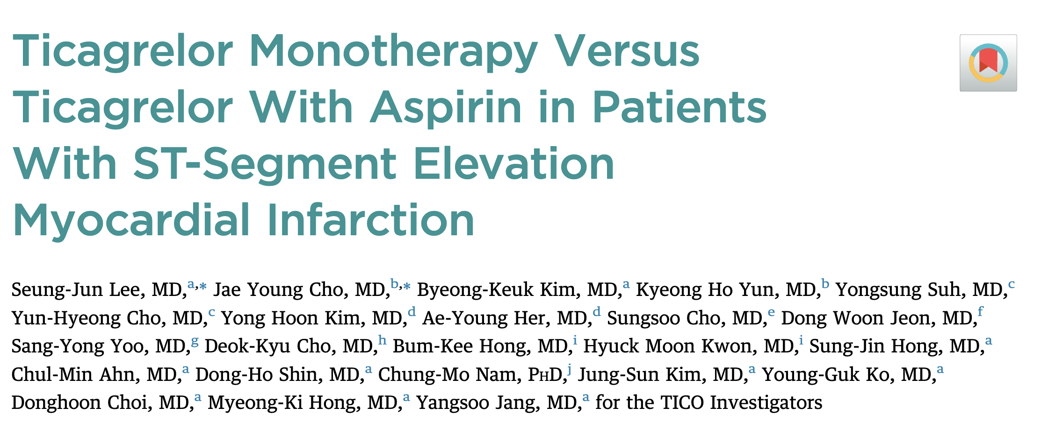

Slide 59
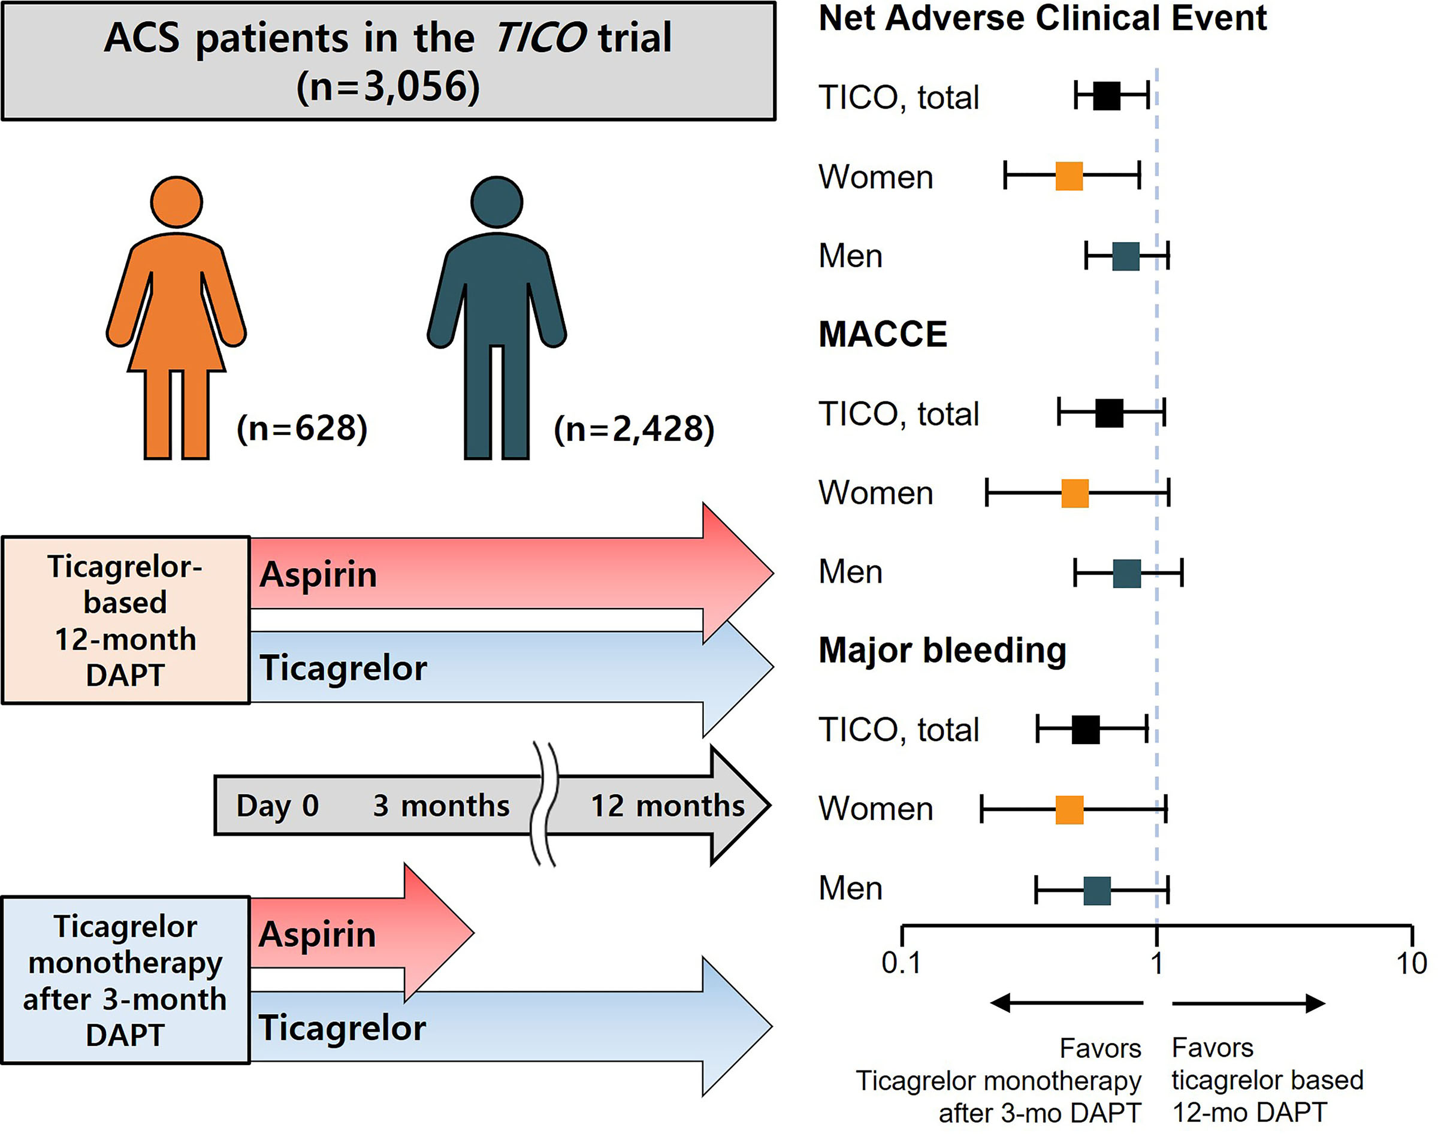

Slide 60
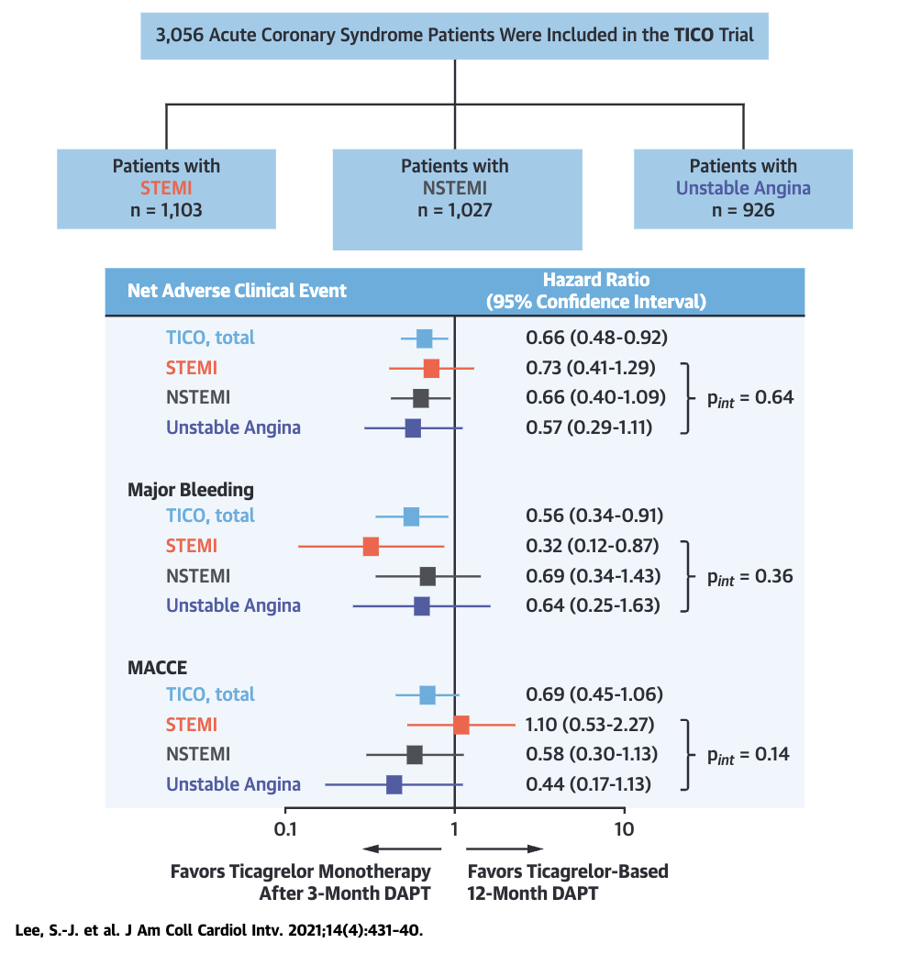

Slide 68
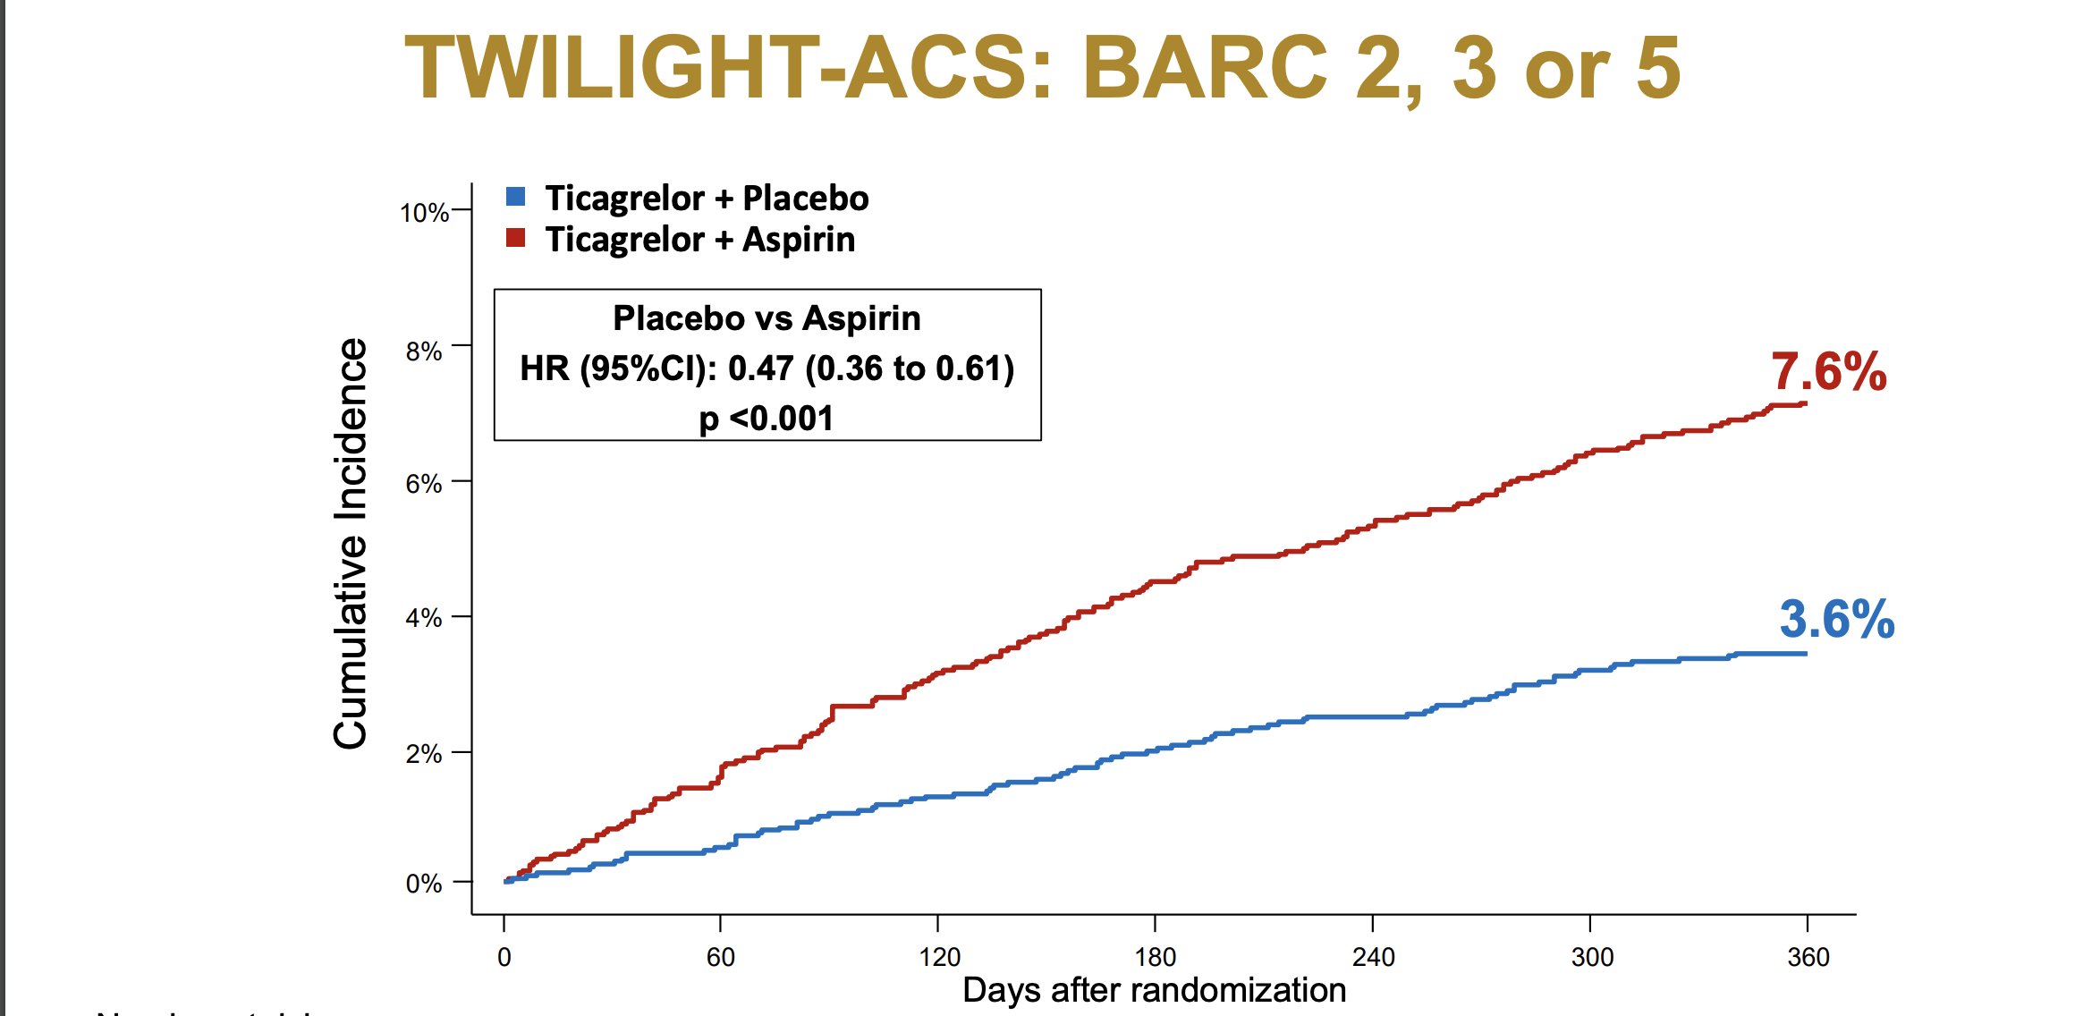

Slide 72
Meta-analysis of 5 RCTs
MACCE
Feng WH. P2Y12 Inhibitor Monotherapy versus Conventional Dual Antiplatelet Therapy in Patients with Acute Coronary Syndrome after Percutaneous Coronary Intervention: A Meta-Analysis. Pharmaceuticals (Basel). 2023

Slide 73
Meta-analysis of 5 RCTs
Major and minor bleeding

Slide 74
Meta-analysis of 5 RCTs
NACE

Slide 75
Down titration to less potent drugs

Slide 76
TALOS

Slide 78
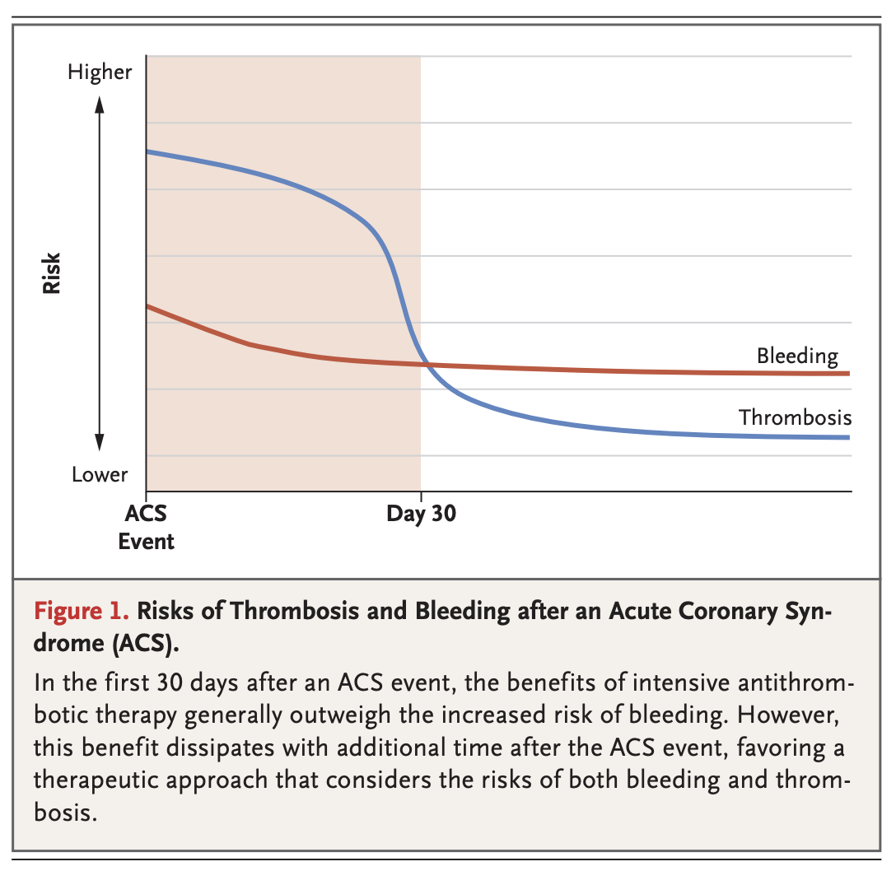

Slide 88
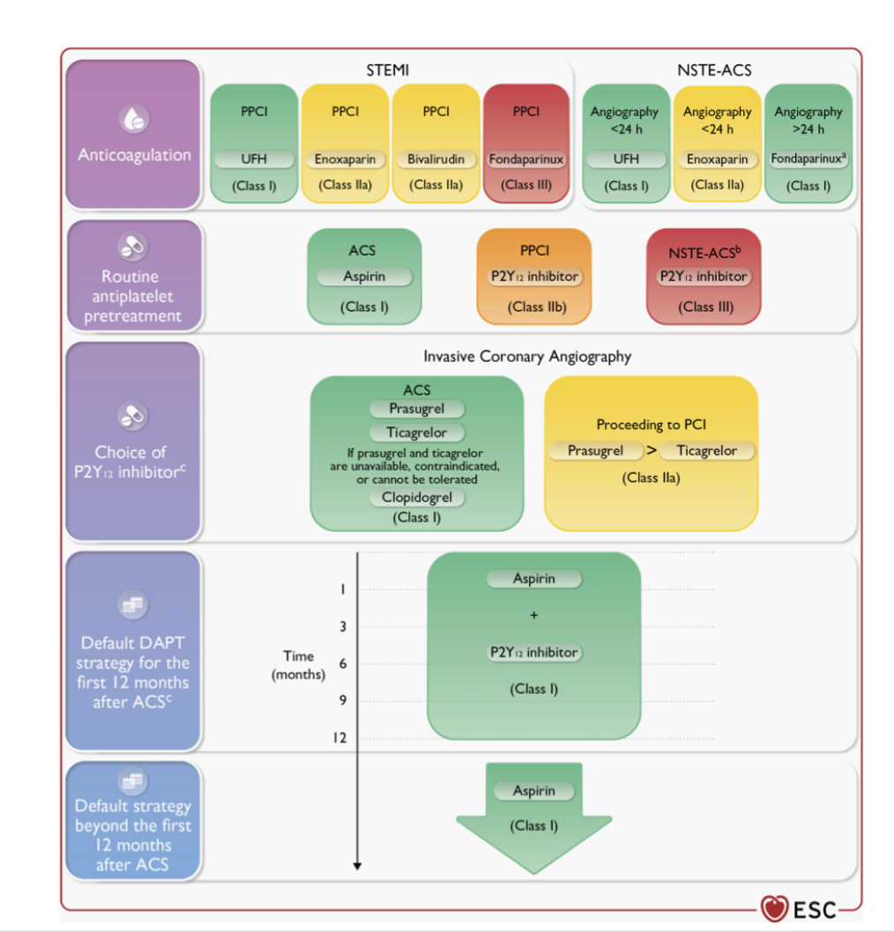

Slide 89
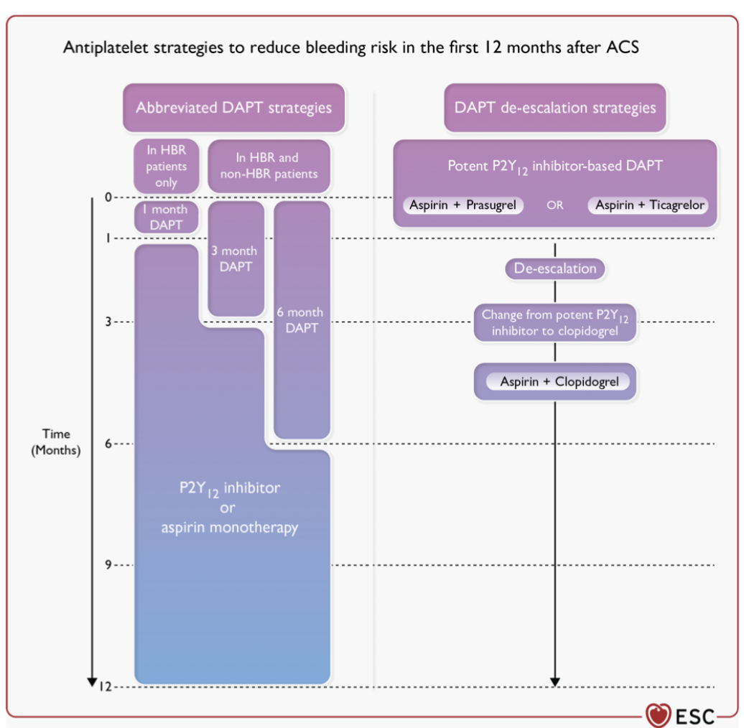

Slide 93
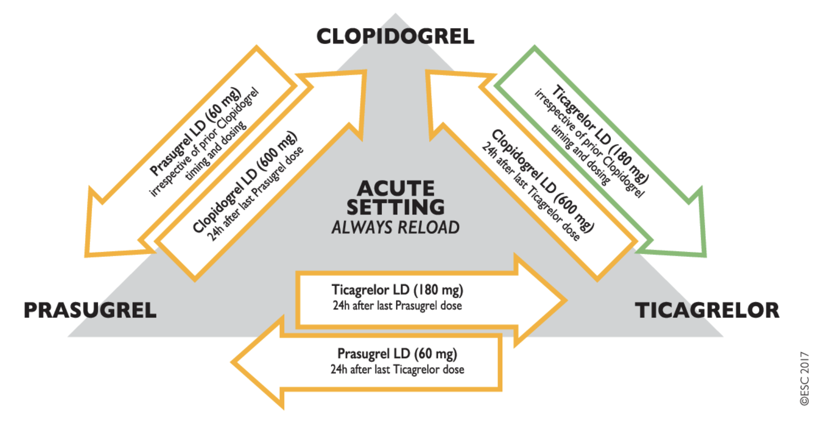

Slide 94
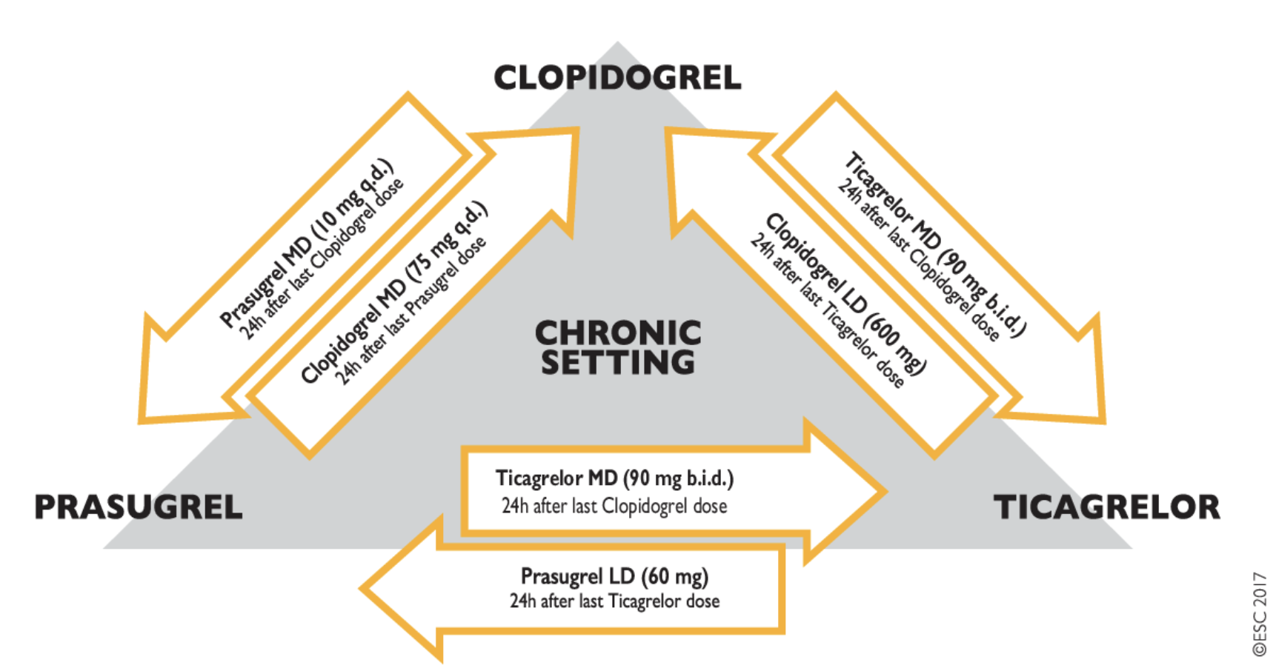

Slide 96
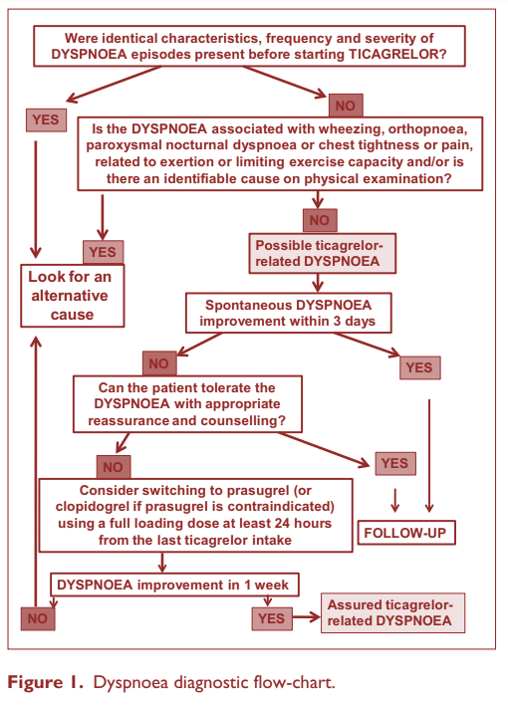
Dyspnea
13.8%
7.8%
0.9%
0.1%
History
Pattern, Onset, Quality, Duration, Alleviation
Clopidogrel
Ticagrelor
Examination
Orthopnea, PND, Wheezing, Crackles
Intervention
Reassurance

Slide 97
Vomiting
Opiates and vomiting: Dos, Don’ts
As vomiting is a common adverse effect of opioids, and moreover, opioids are associated with reduced platelet inhibition.
Alternatives
Limit
Reload
Crush
Alternative pain relievers for opioids in the acute phase of STEMI like Acetaminophen may be suitable, as presented in the main analysis of the ON-TIME 3 trial.
If opioids are still being considered (eg, persistent pain despite adequate treatment), use of metoclopramide might help to limit the adverse effects of opioids on platelet inhibition.
In vomiting patients, it is necessary to record how much time has passed since the administration of oral drugs and to describe the possible presence of undissolved tablets in vomit.
Crushing ticagrelor tablets or simultaneous intravenous metoclopramide administration have been proven to increase the availability of the drug and its antiplatelet effect.

Slide 98
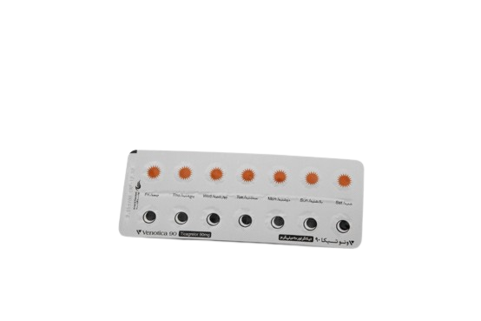
Ischemic Heart Disease
ARVAND PHARMED
Venotica
Medication
Dosing
Ticagrelor
60 mg / 90 mg
Indications
Indication
Acute coronary syndrome
Coronary artery disease with no prior history
Acute ischemic stroke
Guideline 1st Class of
Recommendation

Slide 99
ARVAND PHARMED
We Are a Family.

Slide 100
SOCRATES

Slide 101
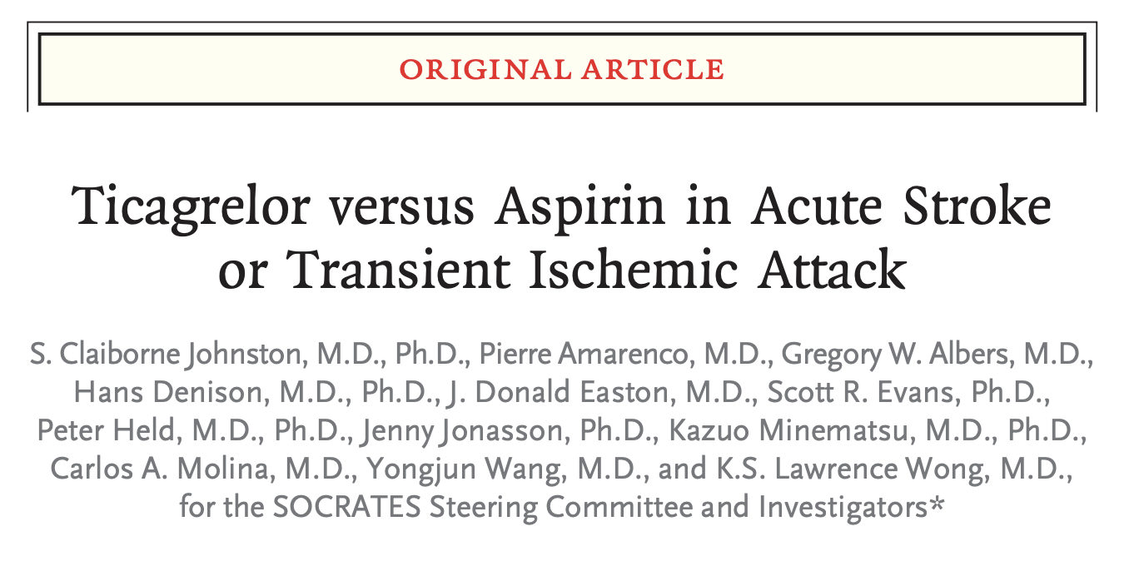

Slide 103
THALES

Slide 105
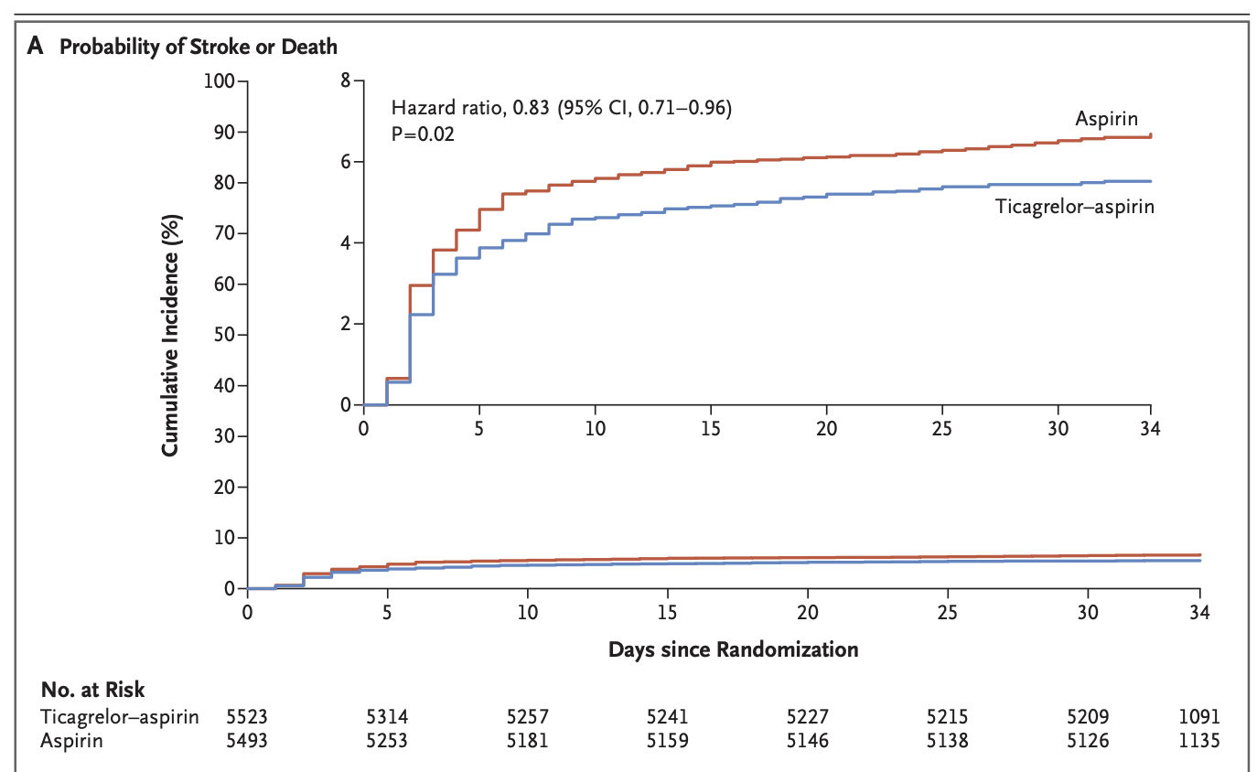

Slide 106
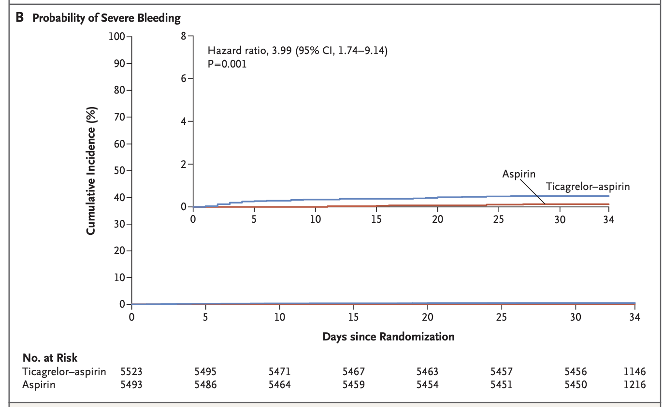

Slide 108
EUCLID

Slide 109
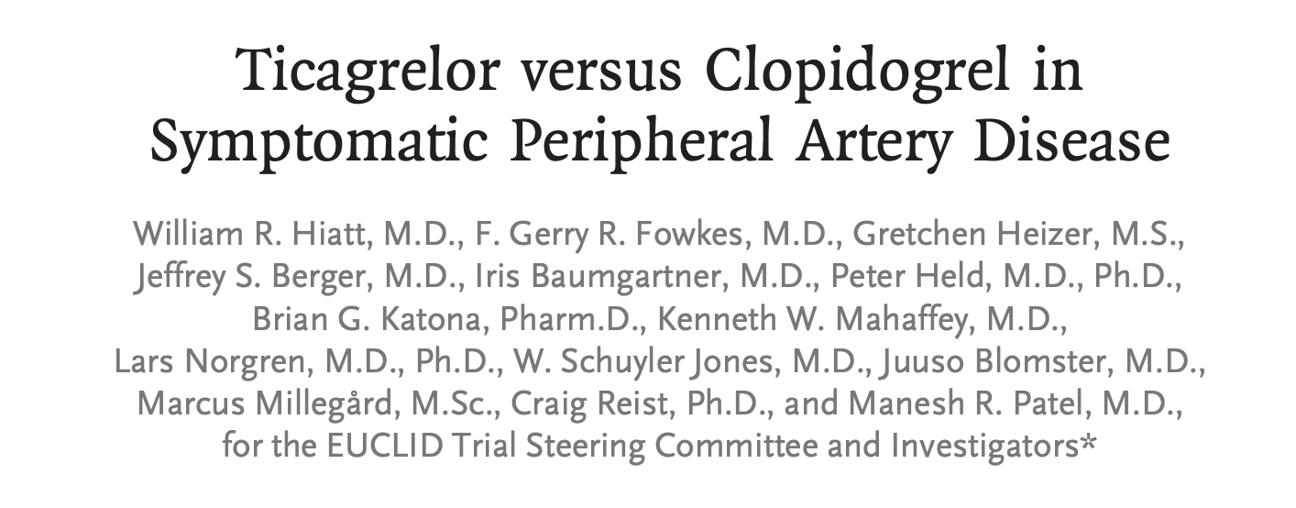

Slide 111
