Slide 1
About Heart Failure
A.Amirfarhangi MD.
IR-1223-ELP-9041-SP

Slide 2
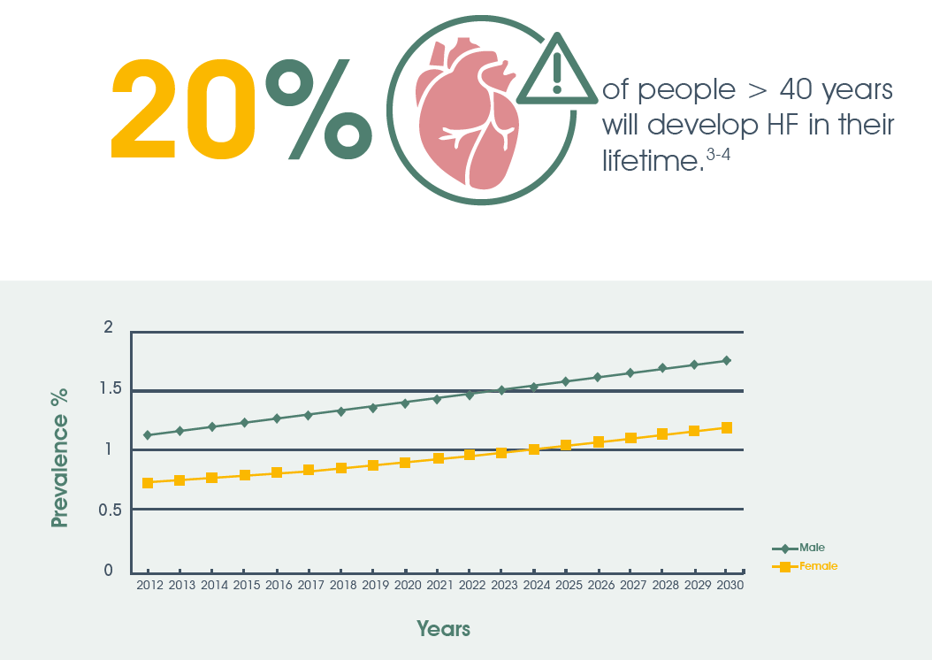
4.2% prevalence in general adult population that is increasing through the years
Circ Heart Fail. 2013; 6(3): 606-19.
Circulation. 2002; 106(24): 3068-72.
Eur J Heart Fail. 2020; 22(8): 1342-1356.
Notes:
More than 2.5 million people with HF live in Iran
Diagnosis rate of HF is 50%.
From 45 through 95 years of age, overall lifetime risks for HF range from 20% to 45%.
Data from patients admitted with HF between 2005 to 2009 in the AHA GWTG-HF registry demonstrate a prevalence of 46% HFpEF, 8.2% HFmrEF, and 46% HFrEF, with similar 5-year mortality across the HF subgroups in risk-adjusted survival analysis.

Slide 3
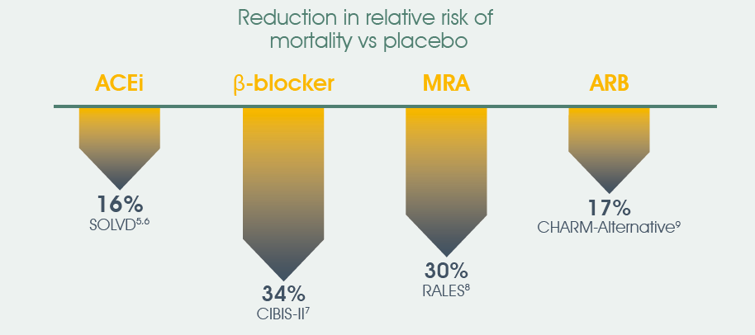
Mortality in HFrEF remains high despite the introduction of new therapies
Circ Heart Fail. 2013; 6(3): 606-19.
Eur Heart J. 2012; 33(14): 1787-847.
N Engl J Med. 1991; 325(5): 293-302.
Lancet. 1999; 353(9146): 9-13.
N Engl J Med. 1999; 341(10): 709-17.
Lancet. 2003; 362(9386): 772-6.
Circulation. 2013; 128(16): e240-327.
N Engl J Med. 2002; 347(18): 1397-402.
Am J Cardiol. 2008; 101(7): 1016-22.
Circulation. 2010; 121(7): e46-e215.
Notes:
Mortality declines have been attributed primarily to evidence-based approaches to treat HFrEF and the implementation of treatment with neurohormonal blockade, coronary revascularization, implantable cardioverter defibrillators, and cardiac resynchroni­zation therapies.
Initiation of contemporary guideline-directed medical therapy for HFrEF (quadruple therapy with angiotensin receptor neprilysin inhibitors, β-blockers, mineralocorticoid receptor antagonists, and sodium glucose cotransporter-2 inhibitors) is estimated to reduce the hazard of cardiovascular death or HF hospitalization by up to 62% (HR, 0.38 [95% CI, 0.30–0.47]) compared with limited con­ventional therapy, resulting in estimated 1.4 to 6.3 additional years alive.
5-year mortality did not decline from 2000 to 2010 and remained high at ≈50% (52.6% overall; 24.4% for those 60 years of age and 54.4% for those 80 years of age).

Slide 4
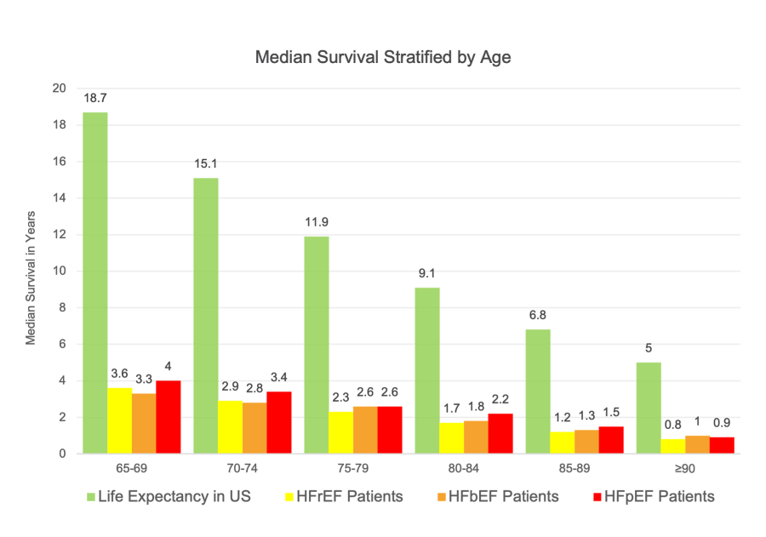
Heart Failure Mortality

Slide 5
Why hospitalization for HF matters?
6X greater risk of death in the first month after just one HF hospitalization in comparison with non-hospitalized patients.
4% of patients will die in hospital.
HF is the Number 1 cause of hospitalization for patients aged >65 years.
10% of patients will die within 30 days following hospitalization.
The number of HF hospitalization is a strong predictor of patient mortality.
Up to 30% of patients will die within 1 year following hospitalization.
Lancet. 1999; 353(9146): 9-13.
Circulation. 2007; 116(13): 1482–1487.
Circulation.2016; 133(23): 2254–2262.
Am J Cardiol. 2008; 101(7): 1016-22.
Circulation. 2010; 121(7): e46-e215.
Am Heart J. 2009; 157(6): 1010-7.
Circulation. 2010; 122(19): 1975-96.

Slide 6
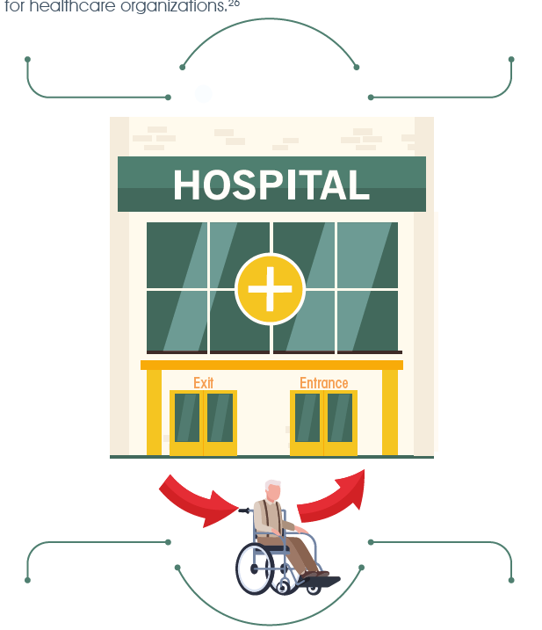
Why re-admission for HF matters?
The 30-day re-admission rate for HF patients is an important performance indicator for healthcare organizations.
20% of patients will be re-admitted again within that same year
Highest 30-day re-admission rate (25%) in hospitals is for HF.
Over 80% of patients will be re-admitted within 5 years.
Lancet 2019; 4(8): E406–E420.
J Am Coll Cardiol. 2017; 70(20): 2476-2486.
N Engl J Med. 2009; 360(14): 1418-28.
Am Heart J. 2014; 168(5): 721-30.
JAMA. 2013; 309(4): 355-63.
Mayo Clin Proc. 2019; 94(10): 1939-1950.

Slide 7
Heart Failure Treatment

Slide 9
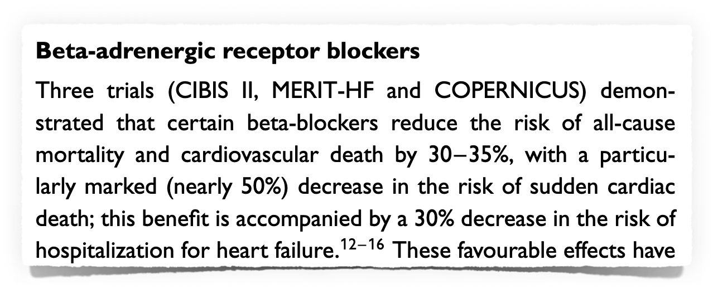

Slide 10
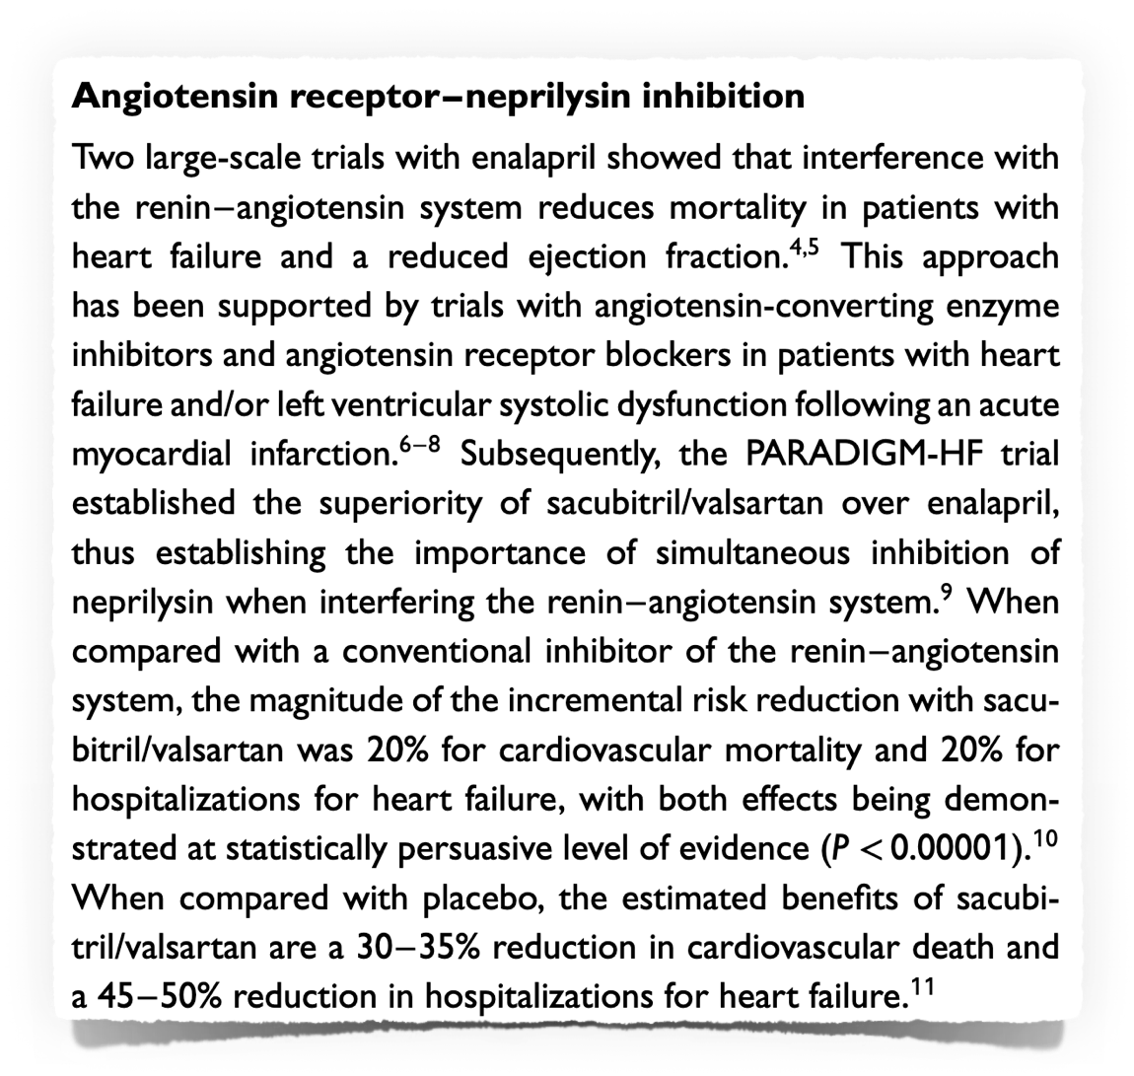

Slide 11
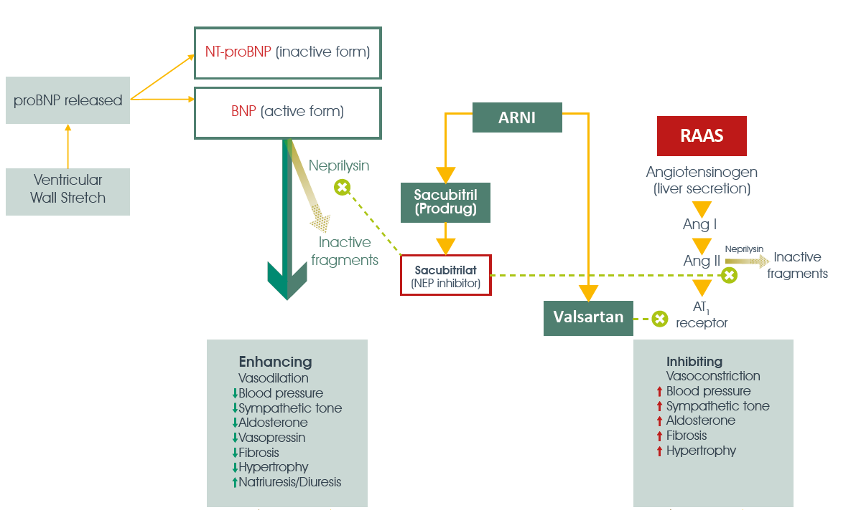
Targeting two essential pathways in a complementary manner
Sacubitril/Valsartan FDA Label. Reference ID: 4185290.

Slide 12
Treatment of HF With Reduced Ejection Fraction
If patients have chronic symptomatic HFrEF with NYHA class II or III symptoms and they tolerate an ACEi or ARB, they should be switched to an ARNI because of improvement in morbidity and mortality. (COR:1)
ACC/AHA Guideline 2022

Slide 13
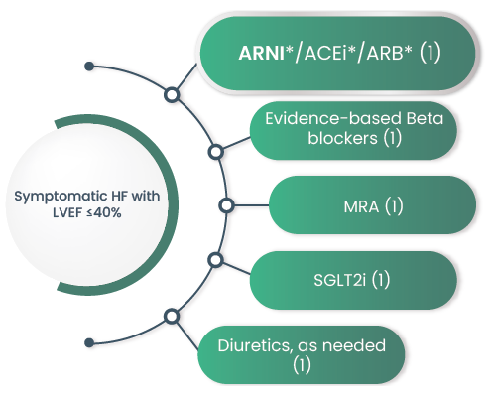
Treatment of HF With Reduced Ejection Fraction
ACC/AHA Guideline 2022

Slide 14
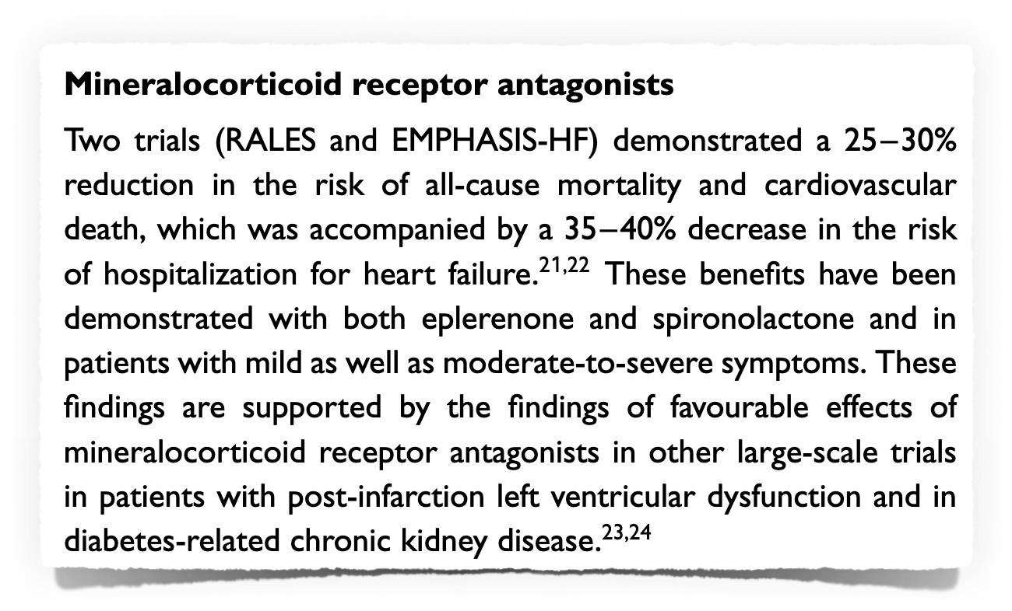

Slide 16
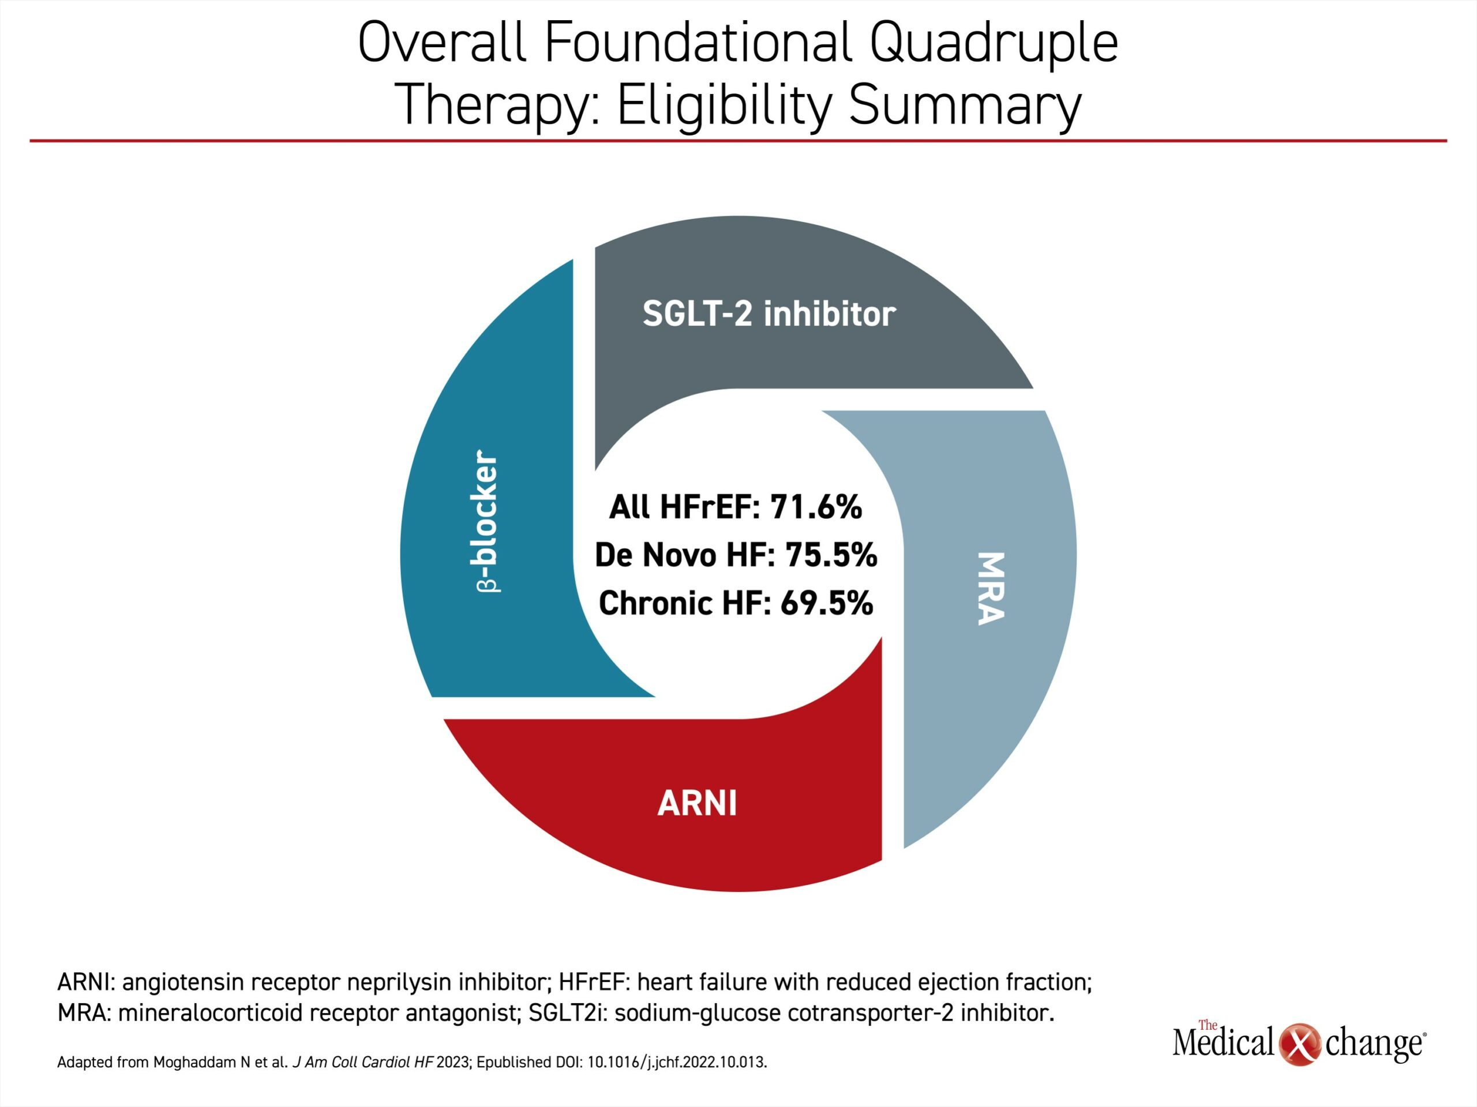

Slide 18
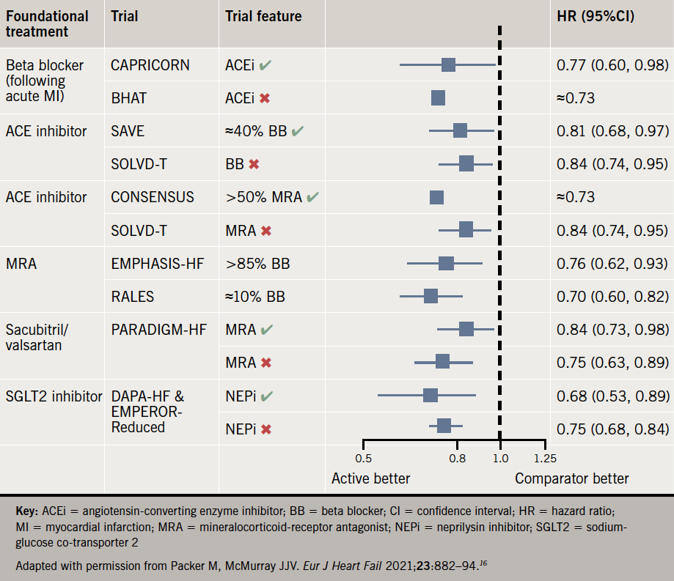

Slide 20
Hypotension
Renal Dysfunction

Slide 21
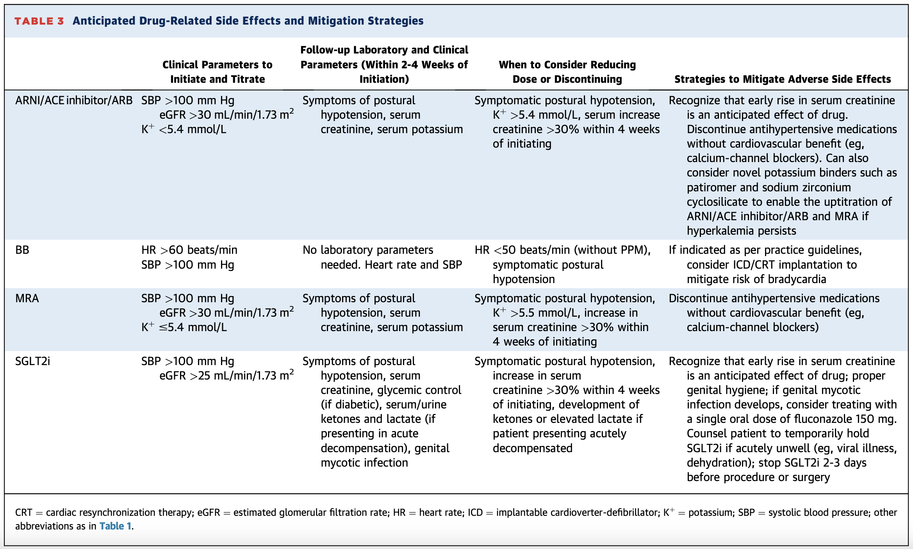

Slide 22
Volume-and/or salt-depleted patients (e.g. by high dose diuretic therapy)
Dietary salt restriction
Hypovolemia (because of diarrhea or vomiting …)
Concomitant nonlife saving vasodilators (like Amlodipine, Diltiazem, Prazosin, Terazosin and Nitrates)
Patients with mild (eGFR 60-89 mL/min) and moderate (eGFR 30 – 59 mL/min) renal impairment.
Patients ≥65 years old
Patients with low SBP (<112 mmHg)
ICD and CRT
Risk Factors for Symptomatic Hypotension

Slide 23
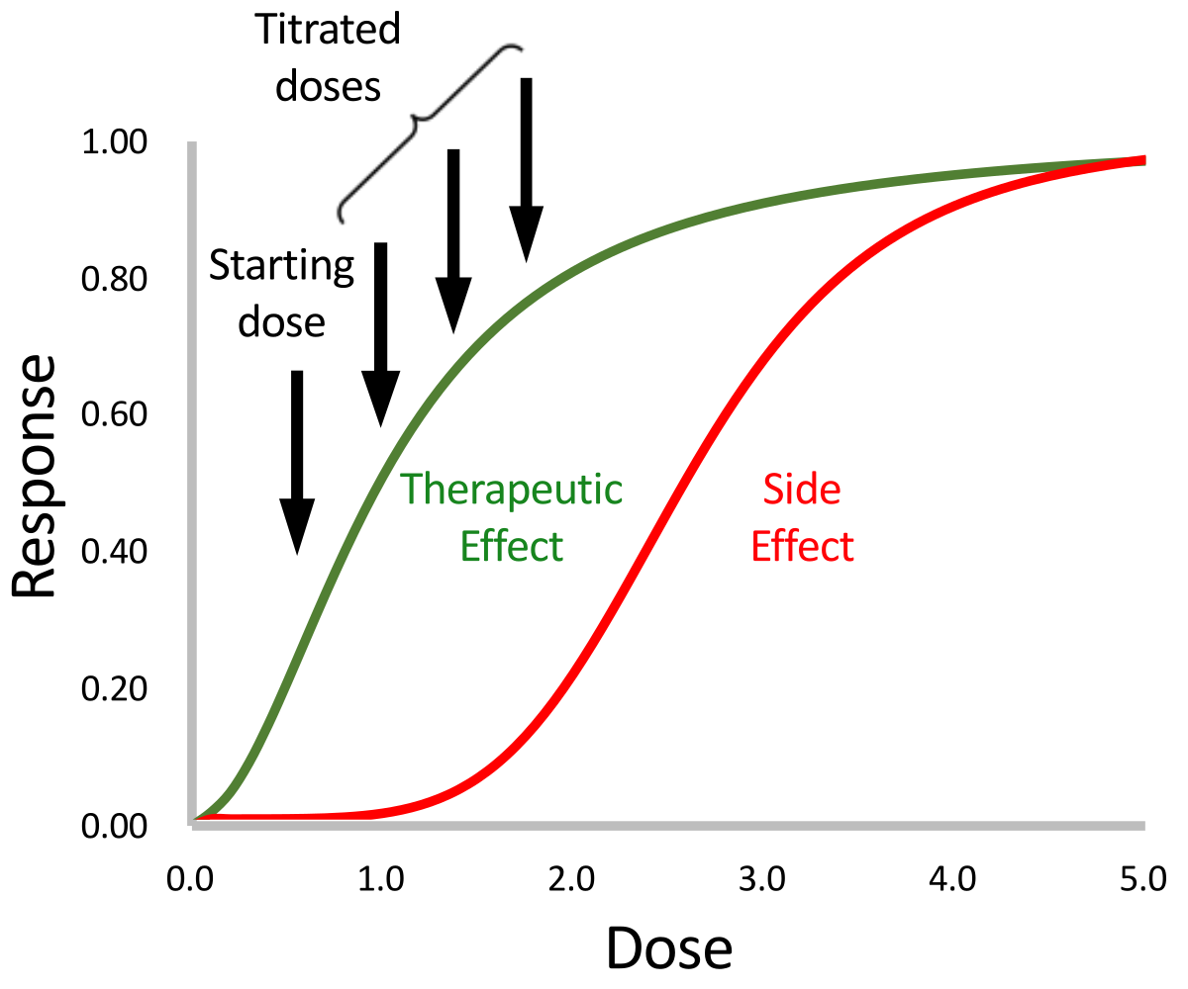

Slide 24
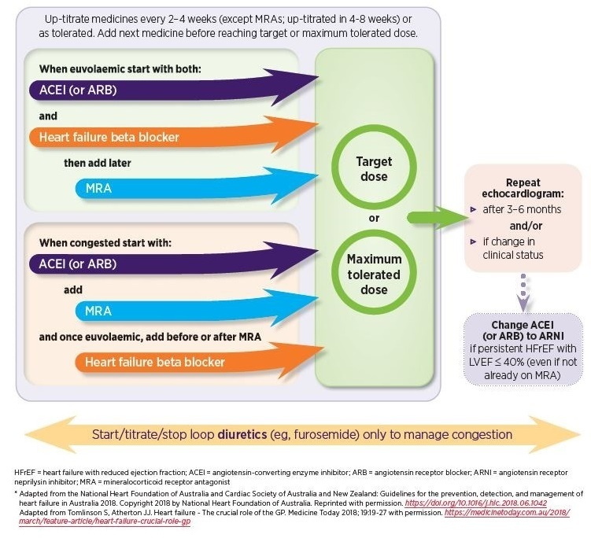

Slide 29
۱- نارسایی قلبی از همان ماههای اول و در سال اول مرگ و میر بالایی دارد.
۲- بستری شدن بدلیل نارسایی قلبی می تواند میزان مرگ و میر را افزایش دهد.
۳- چهار گروه دارویی نقش بسیار مهمی در کاهش مورتالیته و بستری شدن دارند.
۴- اثرات این چهار دسته دارویی مستقل از هم هستند.
۵- بیشترین اثرات مثبت این دسته از داروها در همان ماه اول شروع دارو خود را نشان می دهد.
۶- شروع با دوز کم و افزایش تدریجی دوز دارو نه تنها اثر دارو را کم نمی کند،
بلکه به اثربخشی بهتر دارو کمک می کند.

Slide 30
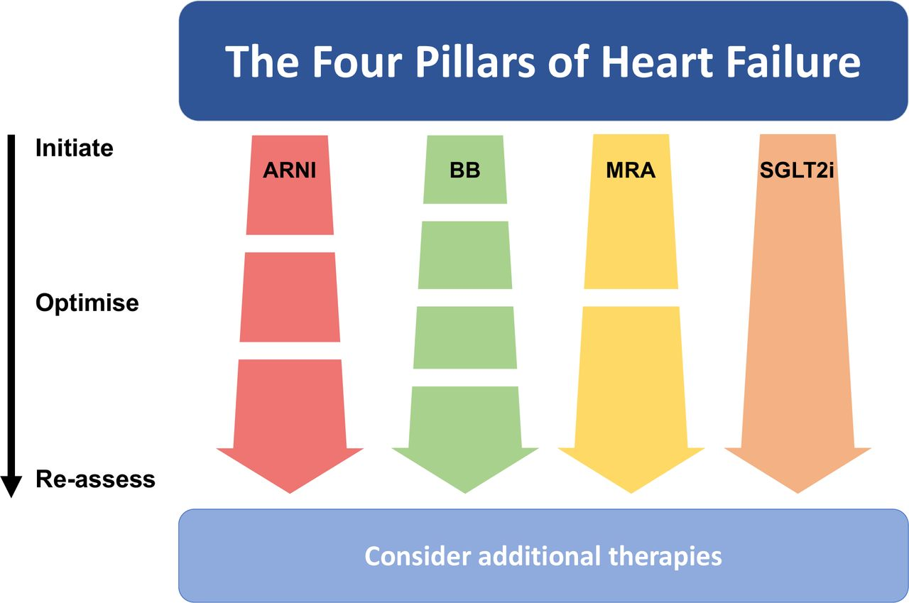

Slide 32
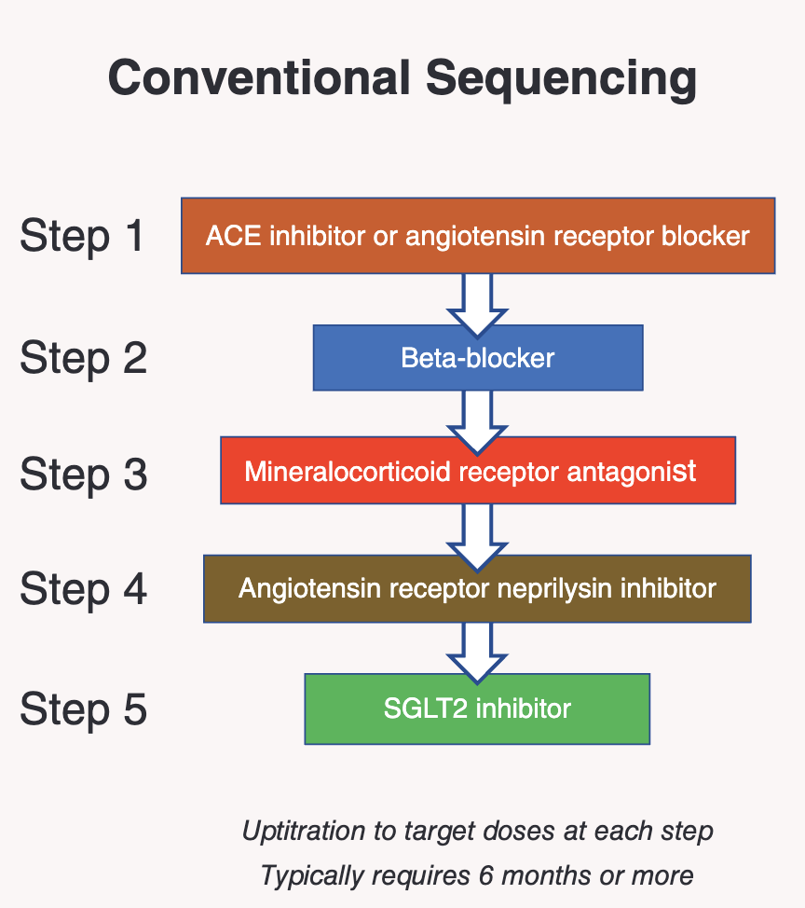

Slide 34
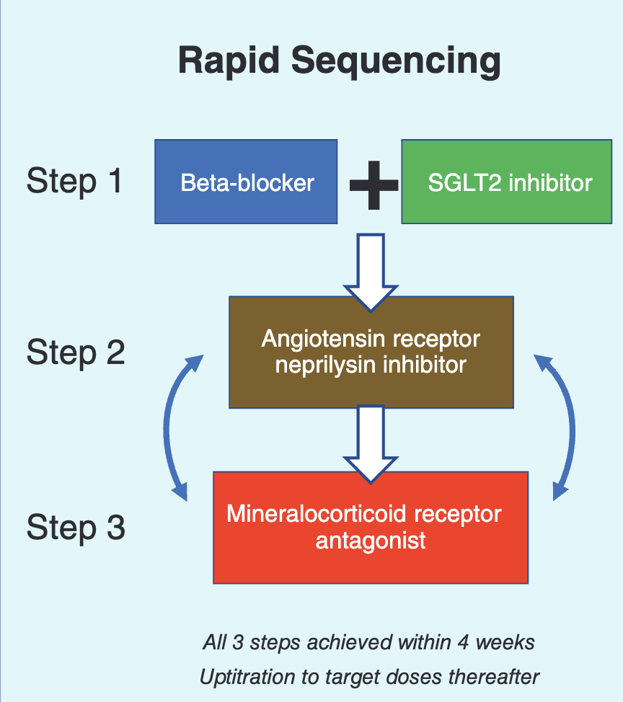

Slide 36
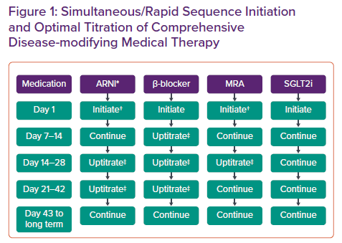

Slide 37
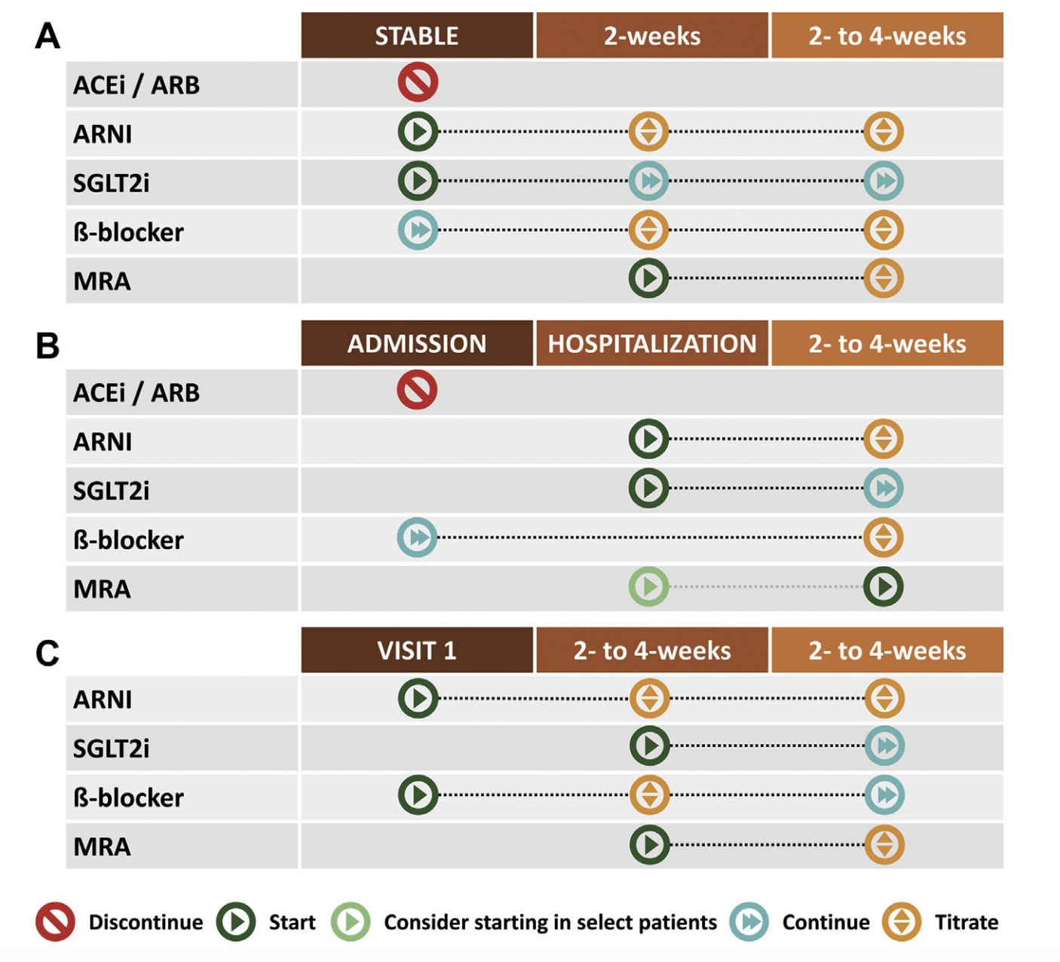

Slide 40
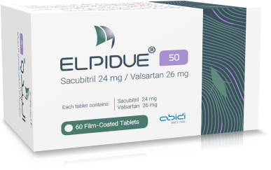
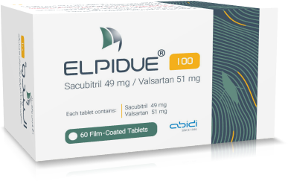
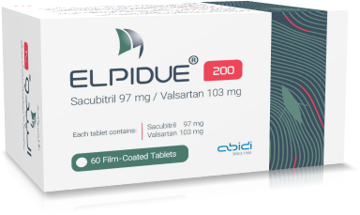
Newly Diagnosed Patients (or Not currently on ACEi or ARB)
50 mg
BD
2-4 Weeks as tolerated
100 mg BD
2-4 Weeks as tolerated
200 mg BD
as tolerated
Sacubitril/Valsartan FDA Label. Reference ID: 4185290.
Eur J Heart Fail. 2016; 18(9): 1193-202.

Slide 41
Switching from ACEi
Low-dose ACEi
50 mg
BD
2-4 Weeks as tolerated
100 mg BD
2-4 Weeks as tolerated
200 mg BD
as tolerated
ACEi for a 36-hours washout
High-dose ACEi
50 mg
BD
2-4 Weeks as tolerated
100 mg BD
2-4 Weeks as tolerated
200 mg BD
as tolerated
• Low-dose ACEi: total daily dose of ≤10 mg of enalapril or therapeutically equivalent dose of another ACEi (eg, lisinopril ≤10 mg)
• High-dose ACEi: total daily dose of >10 mg of enalapril or therapeutically equivalent dose of another ACEi (eg, lisinopril >10 mg)
Sacubitril/Valsartan FDA Label. Reference ID: 4185290.
Eur J Heart Fail. 2016; 18(9): 1193-202.

Slide 42
Switching from ARB
Low-dose ARB
50 mg
BD
2-4 Weeks as tolerated
100 mg BD
2-4 Weeks as tolerated
200 mg BD
as tolerated
High-dose ARB
50 mg
BD
2-4 Weeks as tolerated
100 mg BD
2-4 Weeks as tolerated
200 mg BD
as tolerated
• Low-dose ARB: total daily dose of ≤160 mg valsartan or therapeutically equivalent dose of another ARB (eg, losartan ≤50 mg)
• High-dose ARB: total daily dose of >160 mg valsartan or therapeutically equivalent dose of another ARB (eg, losartan >50 mg)
Sacubitril/Valsartan FDA Label. Reference ID: 4185290.
Eur J Heart Fail. 2016; 18(9): 1193-202.

Slide 43
Dosing in patients with severe renal impairment* or moderate hepatic impairment#
50 mg
BD
2-4 Weeks as tolerated
100 mg BD
2-4 Weeks as tolerated
200 mg BD
as tolerated
• No starting dose adjustment is needed for mild or moderate renal impairment & mild hepatic impairment.
• Use in patients with severe hepatic impairment is not recommended.
* eGFR < 30 mL/min/1.73 m²
# Child-Pugh B Classification
Sacubitril/Valsartan FDA Label. Reference ID: 4185290.
Eur J Heart Fail. 2016; 18(9): 1193-202.

Slide 44
Problem Solving: Worsening renal function and hyperkalemia
Some rise in urea (BUN), creatinine and K+ is to be expected after an ARNI; if an increase is small and asymptomatic, no action is necessary.
A reduction in eGFR up to >30 mL/min/1.73 m² is acceptable.
An increase in K+ up to <5.5 mmol/L is acceptable.
If urea, creatinine or K+ does rise excessively, consider stopping concomitant nephrotoxic drugs (e.g. NSAIDs) and other K+ supplements or retaining agents (triamterene, amiloride).
Evaluate and treat other potential causes of worsening renal function (e.g. intrinsic kidney disease).
ESC Guideline 2021
Notes:
Significant hyperkaliemia (K⁺ >5.0 mmol/L).

Slide 45
Problem Solving: Worsening renal function and hyperkalemia
If no congestion is present, reduce or suspend diuretic therapy.
May need to hold or stop MRAs.
If serum creatinine increase by >50% above baseline or be in the range of 3.1 – 3.5 mg/dL or eGFR is 20-25 mL/min/1.73 m² persist despite adjustment of concomitant medications, decrease dose of ARNI by one-half and recheck labs within 12 weeks.
If serum creatinine >3.5 mg/dL or eGFR <20 mL/min/ min/1.73 m², stop ARNI and recheck labs.
ESC Guideline 2021
Notes:
Re-check blood chemistry (urea/BUN, creatinine, K⁺) 12 weeks after initiation and 12 weeks after final dose titration.
If greater rises in creatinine or K ⁺ than those outlined above persist despite adjustment of concomitant medications, the dose of the ARNI should be halved and blood chemistry re-checked within 12 weeks; if there is still an unsatisfactory response, specialist advice should be sought.
If K ⁺ rises to >5.5 mmol/L or eGFR lowers to <30 mL/min/1.73 m², the ARNI should be stopped and specialist advice sought.
Blood chemistry should be monitored frequently and serially until K ⁺ and creatinine have plateaued.

