Slide 2
2022 ACC/AHA Guideline for the Diagnosis and Management of Aortic Disease
Developed in Collaboration with and endorsed by the American Association for Thoracic Surgery, American College of Radiology, Society of Cardiovascular Anesthesiologists, Society for Cardiovascular Angiography and Interventions, Society of Thoracic Surgeons, and Society for Vascular Surgery.
Endorsed by Society for Interventional Radiology and Society for Vascular Medicine

Slide 3
Normal Anatomy, Abnormal Anatomy, and Definitions

Slide 4
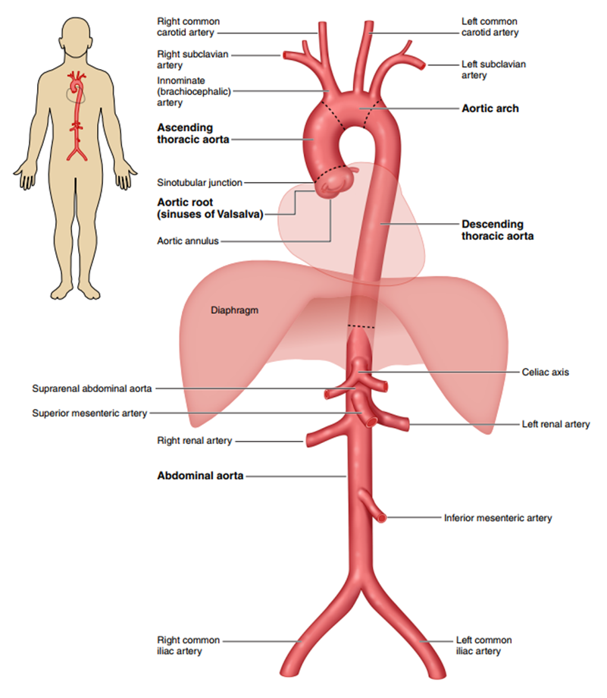
Figure 1. The Anatomy of the Aorta and Its Main Branches.

Slide 5
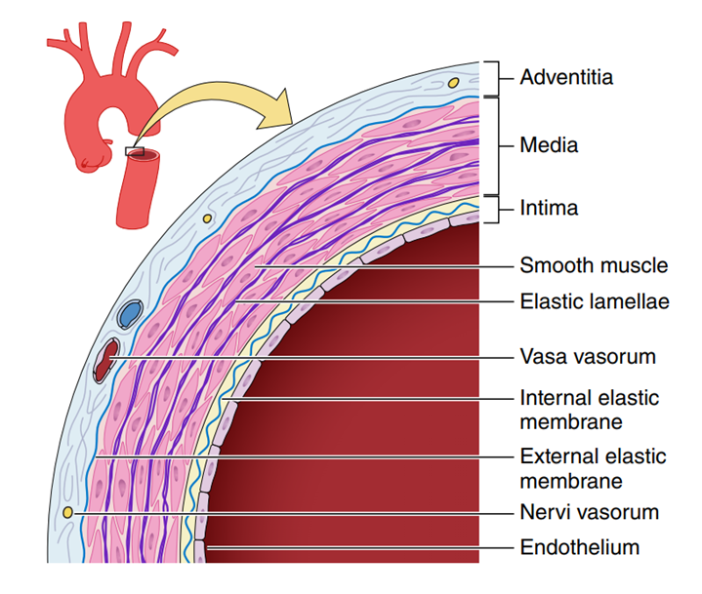
Figure 2. A Simplified Diagram Depicting the Key Histologic Components of the Aortic Wall.

Slide 6
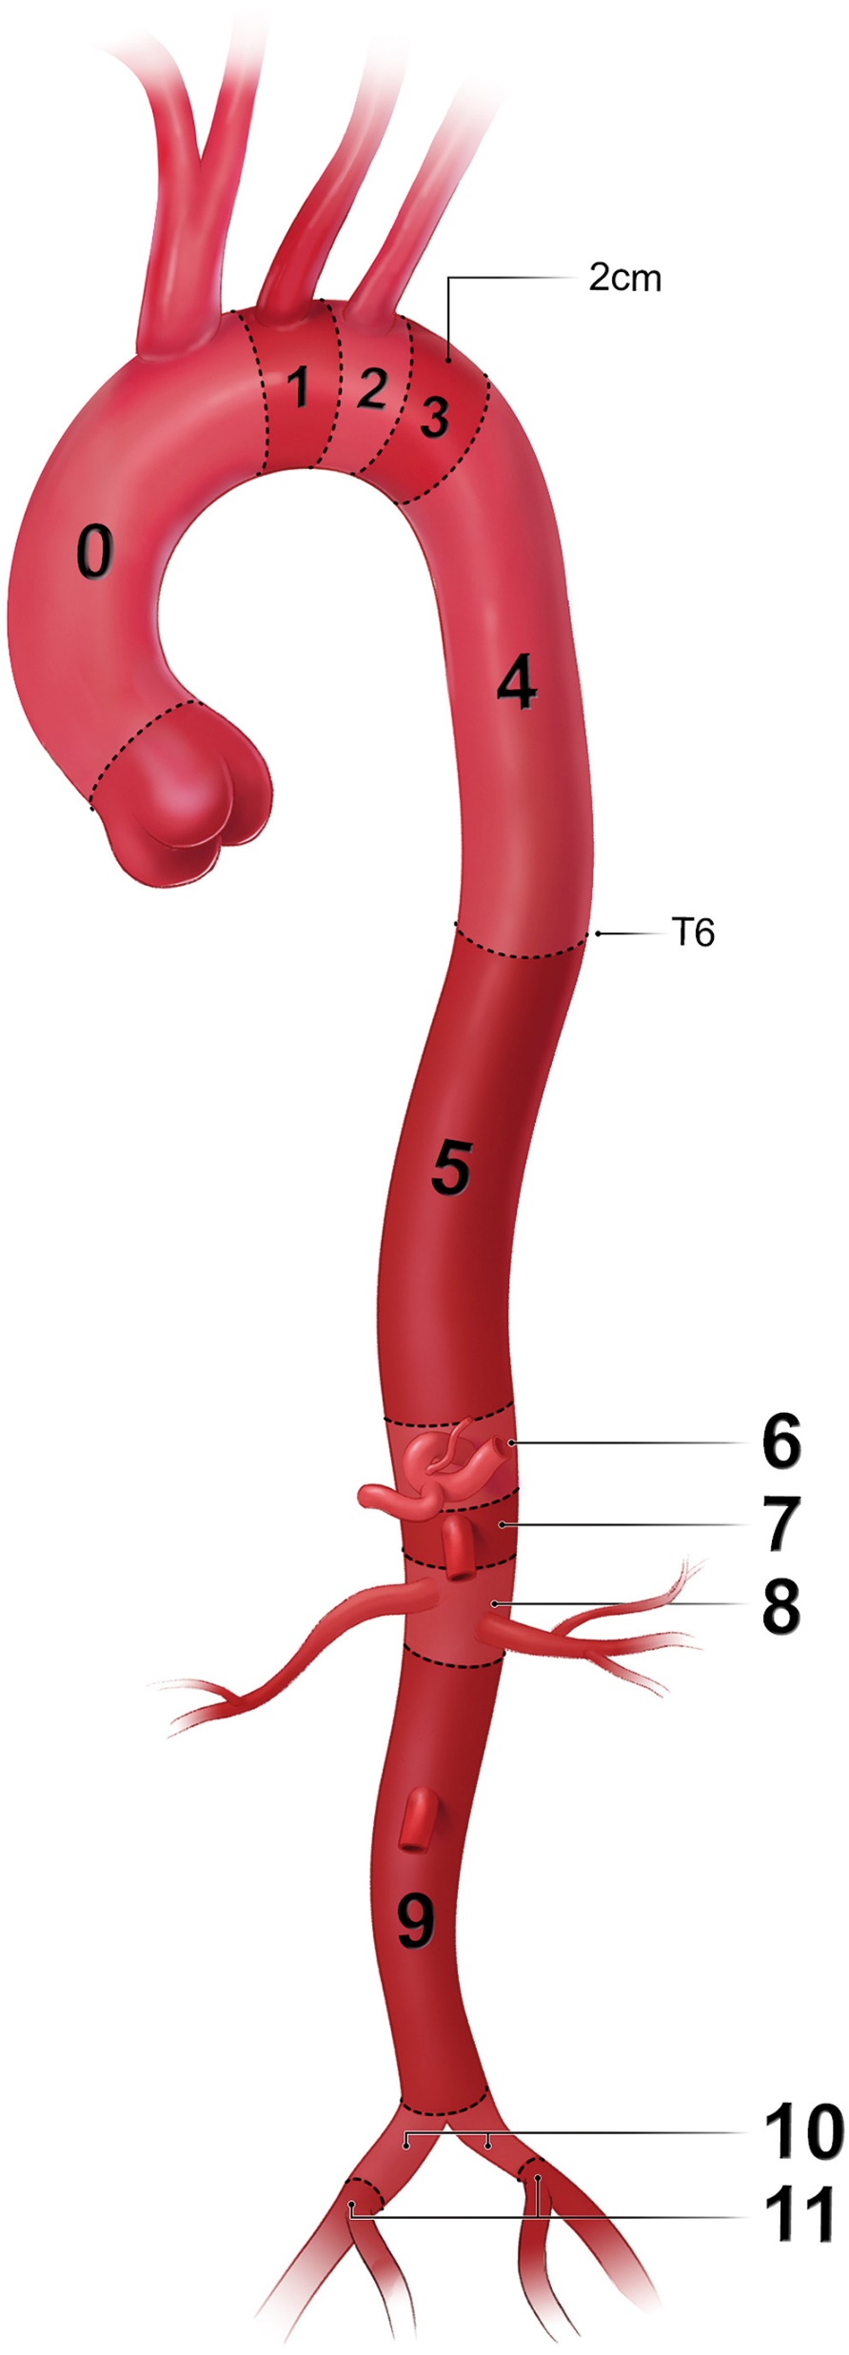
Figure 3. Classification of Aortic Anatomic Segments by 11 Landing Zones.
Zone 0 (involves the ascending to distal end of the origin of the innominate artery); Zone 1 (involves the origin of the left common carotid; between the innominate and the left carotid); Zone 2 (involves the origin of the left subclavian; between the left carotid and the left subclavian); Zone 3 (involves the proximal descending thoracic aorta down to the T4 vertebral body; the first 2 cm distal to the left subclavian); Zone 4 (the end of zone 3 to the mid-descending aorta – T6); Zone 5 (the mid-descending aorta to the celiac); Zone 6 (involves the origin of the celiac; the celiac to the superior mesenteric); Zone 7 (involves the origin of the superior mesenteric artery; the superior mesenteric to the renals); Zone 8 (involves the origin of the renal arteries; the renal to the infrarenal abdominal aorta); Zone 9 (the infrarenal abdominal aorta to the level of aortic bifurcation ); Zone 10 (the common iliac); Zone 11 (involves the origin of the external iliac arteries).

Slide 7
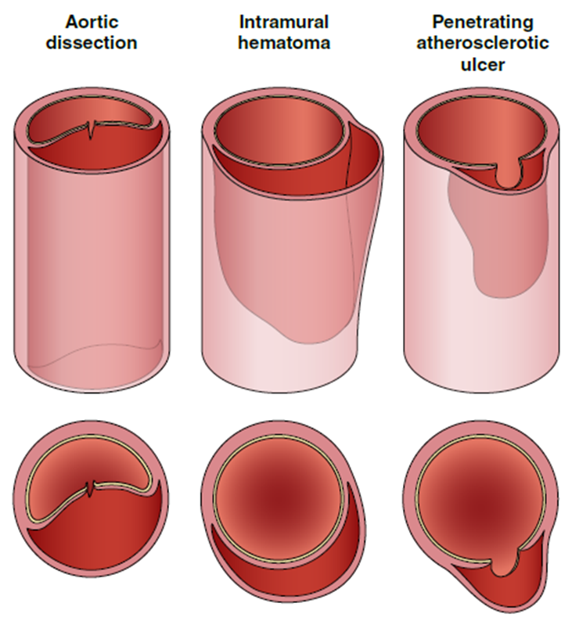
Figure 6. Acute Aortic Syndromes.

Slide 8
Table 3. Classification of Aortic Dissection Chronicity Based on the 2020 SVS/STS Reporting Standards
Chronicity | Time From Onset of Symptoms
Hyperacute | <24 h
Acute | 1–14 d
Subacute | 15–90 d
Chronic | >90 d
STS indicates Society of Thoracic Surgeons; and SVS, Society for Vascular Surgery.

Slide 9
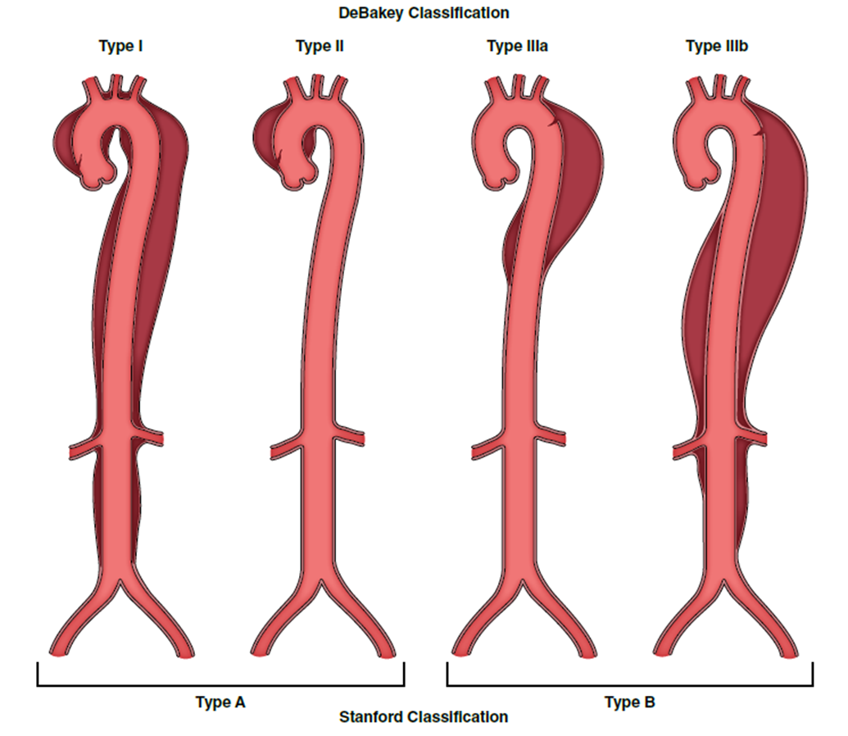
Figure 7. Classification of Acute Aortic Dissection.

Slide 10
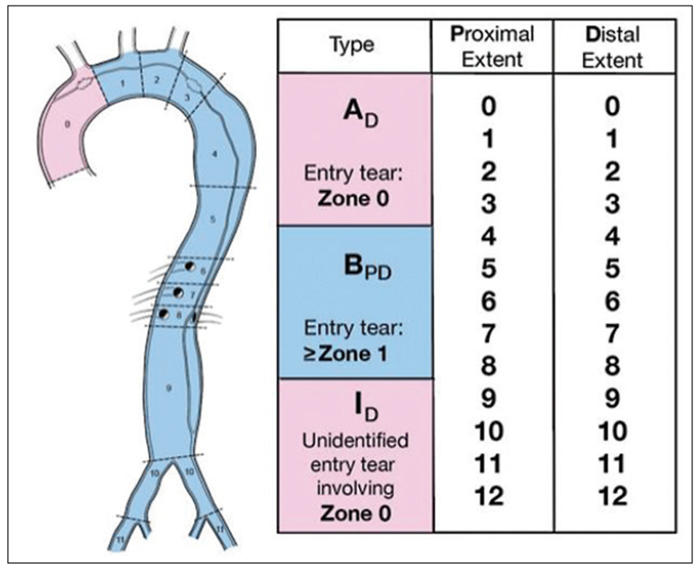
Figure 8. Anatomic Reporting of Aortic Dissection Based on the 2020 SVS/STS Reporting Standards.

Slide 11
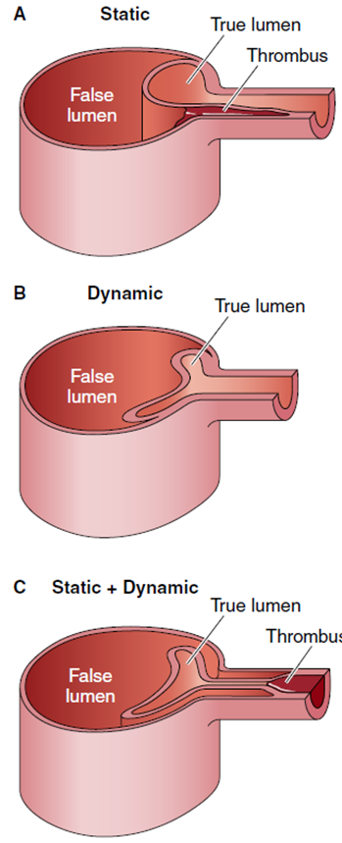
Figure 9. Mechanisms of Dynamic and Static Obstruction in Aortic Dissection.

Slide 12
Acute Aortic Syndromes

Slide 13
Table 22. Signs and Symptoms of AAS
Clinical Signs and Symptoms | Cause
Asymmetric blood pressure (>20 mm Hg) between limbs | Compromise of branch artery flow
Bowel ischemia or gastrointestinal bleed | Malperfusion of the celiac or superior mesenteric artery
Dysphagia | Compression of the esophagus
Dyspnea | Compression of trachea or bronchus, congestive heart failure from aortic regurgitation, or cardiac tamponade
Hemoptysis | Vascular rupture into lung parenchyma
Hoarseness | Compression recurrent laryngeal nerve
Horner’s syndrome | Compression of sympathetic chain
Myocardial ischemia or myocardial infarction | Coronary artery involvement by dissection or compression by aneurysm
AAS indicates acute aortic syndrome.

Slide 14
Table 22. Signs and Symptoms of AAS
New murmur of aortic regurgitation | Incomplete aortic valve closure secondary to leaflet tethering by the dilated aorta or cusp prolapse because of dissection into the aortic root
Oliguria or hematuria (gross) | Malperfusion of 1 or both renal arteries
Paraplegia | Spinal malperfusion attributable intercostal artery involvement
Lower extremity ischemia | Malperfusion of iliac artery
Shock | Cardiac tamponade, hemothorax, frank aortic rupture, acute severe aortic regurgitation, severe myocardial ischemia
Shortness of breath | Pericardial effusion, congestive heart failure from acute severe aortic regurgitation, or hemothorax
Stroke symptoms | Carotid or vertebral artery involved
Superior vena cava syndrome | Compression of the superior vena cava
Syncope | Carotid artery involvement or cardiac tamponade
AAS indicates acute aortic syndrome.

Slide 15
AAS: Diagnostic Evaluation (Imaging, Laboratory Testing)
Recommendations for AAS: Diagnostic Evaluation (Imaging, Laboratory Testing)
COR | LOE | Recommendations
1 | C-LD | In patients with a suspected AAS, CT is recommended for initial diagnostic imaging, given its wide availability, accuracy, and speed, as well as the extent of anatomic detail it provides.
2a | C-LD | In patients with a suspected AAS, TEE and MRI are reasonable alternatives for initial diagnostic imaging.

Slide 16
Table 23. Plain Chest X-Ray Findings Suggestive of Aortic Dissection
Signs of Aortic Dissection on Chest X-Ray
Mediastinal widening
Disruption of the normally distinct contour of the aortic knob
Calcium sign, which appears as a separation of the intimal calcification from the aortic wall of >5 mm
Double density appearance within the aorta
Tracheal deviation to the right
Deviation of the nasogastric tube to the right

Slide 17
Table 24. Aortic Dissection Detection Risk Score (ADD-RS) Items
High-Risk Conditions | High-Risk Pain Features | High-Risk Examination Features
Marfan syndrome or other connective tissue disease | Chest, back, or abdominal pain described as: | Pulse deficit or systolic blood pressure differential
Family history of aortic disease | Abrupt onset | Focal neurologic deficit (with pain)
Known aortic valve disease | Severe in intensity | Murmur of aortic regurgitation (new, with pain)
Recent aortic manipulation | Ripping or tearing in quality | Hypotension or shock state
Known thoracic aortic aneurysm

Slide 18
Table 25. Aorta Simplified Score (AORTAs)10 Pretest Probability Assessment Score
Clinical Item | Points
Hypotension/shock | 2
Aneurysm | 1
Pulse deficit | 1
Neurologic deficit | 1
Severe pain | 1
Sudden-onset pain | 1

Slide 19
Acute Medical Management of AAS
Recommendations for Acute Medical Management of AAS Referenced studies that support the recommendations are summarized in the Online Data Supplement.
COR | LOE | Recommendations
1 | B-NR | In patients presenting to the hospital with AAS, prompt treatment with anti-impulse therapy with invasive monitoring of BP with an arterial line in an ICU setting is recommended as initial treatment to decrease aortic wall stress.
1 | C-LD | Patients with AAS should be treated to an SBP <120 mm Hg or to lowest BP that maintains adequate end-organ perfusion, as well as to a target heart rate of 60 to 80 bpm.

Slide 20
Acute Medical Management of AAS (con’t.)
1 | B-NR | In patients with AAS, initial management should include intravenous beta blockers, except in patients with contraindications.
2a | B-NR | In those with contraindications or intolerance to beta blockers, initial management with an intravenous non-dihydropyridine calcium channel blocker is reasonable for heart rate control.
1 | C-LD | In patients with AAS, initial management should include intravenous vasodilators if the BP is not well controlled after initiation of intravenous beta-blocker therapy.
1 | C-EO | Patients with AAS should be treated with pain control, as needed, to help with hemodynamic management.

Slide 21
Subsequent Medical Management of AAS
Recommendation for Subsequent Medical Management of AAS Referenced studies that support the recommendation are summarized in the Online Data Supplement.
COR | LOE | Recommendation
1 | B-NR | In patients with AAS, it is recommended to treat with long-term beta blockers (unless contraindicated) to control heart rate and BP to reduce late aortic-related adverse events. Additional antihypertensive agents (particularly ARBs and ACEIs) should be added, as necessary, to adequately control BP.

Slide 22
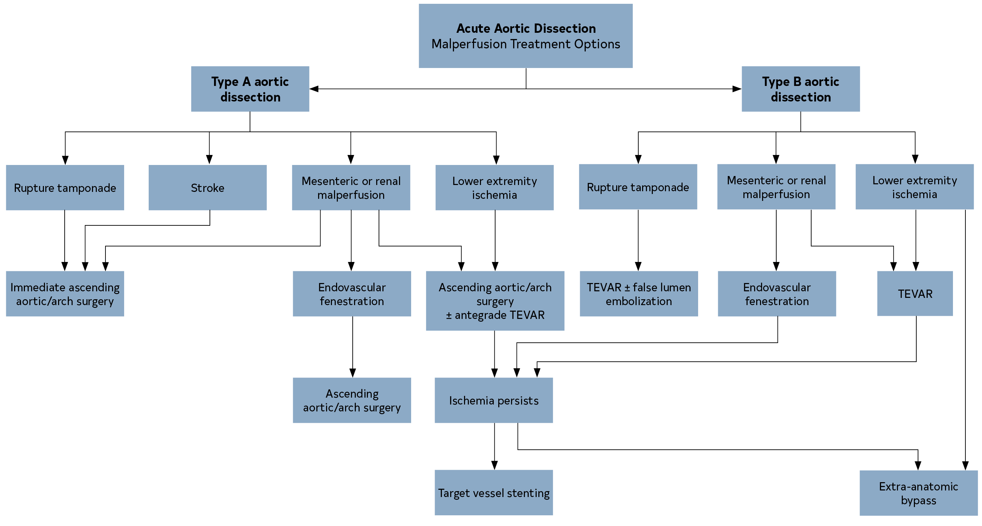
Figure 21. Acute Aortic Dissection: Malperfusion Treatment Options.
AoD indicates aortic dissection; and TEVAR, thoracic endovascular aortic repair.

Slide 23
Initial Surgical Considerations in Acute Type A Aortic Dissection
Recommendations for Initial Surgical Considerations in Acute Type A Aortic Dissection Referenced studies that support the recommendations are summarized in the Online Data Supplement.
COR | LOE | Recommendations
1 | B-NR | In patients presenting with suspected or confirmed acute type A aortic dissection, emergency surgical consultation and evaluation and immediate surgical intervention is recommended because of the high risk of associated life-threatening complications.

Slide 24
Initial Surgical Considerations in Acute Type A Aortic Dissection (con’t.)
2a | B-NR | In patients presenting with acute type A aortic dissection, who are stable enough for transfer, transfer from a low- to a high-volume aortic center is reasonable to improve survival.
2a | B-NR | In patients presenting with nonhemorrhagic stroke complicating acute type A aortic dissection, surgical intervention is reasonable over medical therapy to reduce mortality and improve neurologic outcomes.

Slide 25
Management of Malperfusion
Recommendations for Management of Malperfusion Referenced studies that support the recommendations are summarized in the Online Data Supplement.
COR | LOE | Recommendations
1 | B-NR | In patients with acute type A aortic dissection presenting with renal, mesenteric, or lower extremity malperfusion, it is recommended to proceed to immediate operative repair of the ascending aorta.
2a | C-LD | In patients with acute type A aortic dissection presenting with clinically significant mesenteric (celiac, SMA) malperfusion, either immediate operative repair of the ascending aorta or immediate mesenteric revascularization via endovascular or open surgical intervention by those with this expertise before ascending aortic repair is reasonable.

Slide 26
Table 26. Clinical Evidence of Malperfusion (“Malperfusion Syndrome”)
End Organ | Clinical Findings
Cardiac | Electrocardiographic changes of ischemia or infarction, troponin elevation, myocardial dysfunction
Cerebral | Stroke and neurologic deficits, coma and altered mental status
Spinal | Paraplegia
Mesenteric | Abdominal pain, bowel ischemia, lactic acidosis, elevation of liver function test results
Renal | Acute kidney injury, oliguria
Extremity | Loss of pulses in ≥1 extremity, sensory or motor dysfunction

Slide 27
Surgical Repair Strategies in Acute Type A Aortic Dissection
Recommendations for Surgical Repair Strategies in Acute Type A Aortic Dissection Referenced studies that support the recommendations are summarized in the Online Data Supplement.
COR | LOE | Recommendations
Aortic Repair Strategies
1 | B-NR | In patients with acute type A aortic dissection and a partially dissected aortic root but no significant aortic valve leaflet pathology, aortic valve resuspension is recommended over valve replacement.

Slide 28
Surgical Repair Strategies in Acute Type A Aortic Dissection (con’t.)
1 | B-NR | In patients with acute type A aortic dissection who have extensive destruction of the aortic root, a root aneurysm, or a known genetic aortic disorder, aortic root replacement is recommended with a mechanical or biological valved conduit.
2b | C-LD | In selected patients who are stable, valve-sparing root repair may be reasonable, when performed by experienced surgeons in a Multidisciplinary Aortic Team.
1 | B-NR | In patients with acute type A aortic dissection undergoing aortic repair, an open distal anastomosis is recommended to improve survival and increase false-lumen thrombosis rates.

Slide 29
Surgical Repair Strategies in Acute Type A Aortic Dissection (con’t.)
1 | B-NR | In patients with acute type A aortic dissection without an intimal tear in the arch or a significant arch aneurysm, hemiarch repair is recommended over more extensive arch replacement.
2b | C-LD | In patients with acute type A aortic dissection and a dissection flap extending through the arch into the descending thoracic aorta, an extended aortic repair with antegrade stenting of the proximal descending thoracic aorta may be considered to treat malperfusion and reduce late distal aortic complications.

Slide 30
Surgical Repair Strategies in Acute Type A Aortic Dissection (con’t.)
Perfusion and Cannulation Strategies
2a | B-NR | In patients with acute type A aortic dissection undergoing surgical repair, axillary cannulation, when feasible, is reasonable over femoral cannulation to reduce the risk of stroke or retrograde malperfusion.
2a | B-NR | In patients with acute type A aortic dissection undergoing surgical repair who require circulatory arrest, cerebral perfusion is reasonable to improve neurologic outcomes.
2a | B-NR | In patients with acute type A aortic dissection undergoing surgical repair, direct aortic or innominate artery cannulation with imaging guidance is reasonable as an alternative to femoral or axillary cannulation.

Slide 31
Management of Acute Type B Aortic Dissection
Recommendations for the Management of Acute Type B Aortic Dissection Referenced studies that support the recommendations are summarized in the Online Data Supplement.
COR | LOE | Recommendations
1 | B-NR | In all patients with uncomplicated acute type B aortic dissection, medical therapy is recommended as the initial management strategy.

Slide 32
Management of Acute Type B Aortic Dissection (con’t.)
1 | C-LD | In patients with acute type B aortic dissection and rupture or other complications (Table 27), intervention is recommended. In patients with rupture, in the presence of suitable anatomy, endovascular stent grafting, rather than open surgical repair, is recommended. In patients with other complications, in the presence of suitable anatomy, the use of endovascular approaches, rather than open surgical repair, is reasonable.
1 | C-EO
2a | C-LD
2b | B-R | In patients with uncomplicated acute type B aortic dissection who have high-risk anatomic features (Table 28), endovascular management may be considered.

Slide 33
Table 27. Consensus Features of Complicated Acute Type B Aortic Dissection
Feature | Comment
Aortic rupture | This can be either free or contained (including hemothorax, increasing periaortic hematoma, or both; or mediastinal hematoma) and should be addressed promptly.
Branch artery occlusion and malperfusion | Complete or partial occlusion of a major branch, with or without clinical evidence of ischemia; this includes visceral, renal, and peripheral arterial branches.
Extension of dissection³ | Extension of the dissection flap either distally or proximally (ie, retrograde type A dissection)
Aortic enlargement | Progressive enlargement of the true, false, or both lumens while in the acute phase may require prompt intervention.
Intractable pain
Uncontrolled hypertension

Slide 34
Table 28. High-Risk Features in Uncomplicated Acute Type B Aortic Dissection
High-Risk Imaging Findings
Maximal aortic diameter >40 mm
False-lumen diameter >20–22 mm
Entry tear >10 mm
Entry tear on lesser curvature
Increase in total aortic diameter of >5 mm between serial imaging studies
Bloody pleural effusion
Imaging-only evidence of malperfusion
High-Risk Clinical Findings
Refractory hypertension despite >3 different classes of antihypertensive medications at maximal recommended or tolerated doses
Refractory pain persisting >12 h despite maximal recommended or tolerated doses
Need for readmission

Slide 35
Management of IMH
Recommendations for Management of IMH Referenced studies that support the recommendations are summarized in the Online Data Supplement.
COR | LOE | Recommendations
1 | B-NR | In patients with complicated (Table 29) acute type A or type B aortic IMH, urgent repair is recommended.
1 | B-NR | In patients with uncomplicated acute type A IMH, prompt open surgical repair is recommended.
2b | C-LD | In selected patients with uncomplicated acute type A IMH who are at increased operative risk and do not have high-risk imaging features (Table 30), an initial or expectant approach of medical management may be considered.
1 | B-NR | In patients with uncomplicated acute type B IMH, medical therapy as the initial management strategy is recommended.

Slide 36
Management of IMH (con’t.)
2a | C-LD | In patients with type B IMH who require repair of the distal aortic arch or descending thoracic aorta (zones 2-5) and have favorable anatomy, endovascular repair is reasonable when performed by surgeons with endovascular expertise.
2a | C-LD | In patients with type B IMH who require repair of the distal aortic arch or descending thoracic aorta (zones 2-5) and have unfavorable anatomy for endovascular repair, open surgical repair is reasonable.
2b | C-LD | In patients with uncomplicated type B IMH and high-risk imaging features (Table 30), intervention may be reasonable.

Slide 37
Table 29. Features of Complicated IMH
Feature
Malperfusion
Periaortic hematoma
Pericardial effusion with cardiac tamponade
Persistent, refractory, or recurrent pain
Rupture
IMH indicates intramural hematoma.

Slide 38
Table 30. High-Risk Imaging Features of IMH
For Type A IMH | For Type B IMH
Maximum aortic diameter >45–50 mm | Maximum aortic diameter >47–50 mm
Hematoma thickness ≥10 mm | Hematoma thickness ≥13 mm
Focal intimal disruption with ulcer-like projection involving ascending aorta or arch | Focal intimal disruption with ulcer-like projection involving the descending thoracic aorta if it develops in acute phase
Pericardial effusion on admission | Increasing or recurrent pleural effusion
IMH indicates intramural hematoma.

Slide 39
Table 30. High-Risk Imaging Features of IMH (con’t.)
For Both Type A and Type B IMH
Progression to aortic dissection
Increasing aortic diameter
Increasing hematoma thickness
IMH indicates intramural hematoma.

Slide 40
PAU With IMH, Rupture, or Both
Recommendations for PAU With IMH, Rupture, or Both Referenced studies that support the recommendations are summarized in the Online Data Supplement.
COR | LOE | Recommendations
1 | B-NR | In patients with PAU of the aorta with rupture, urgent repair is recommended.
1 | B-NR | In patients with PAU of the ascending aorta with associated IMH, urgent repair is recommended.
2a | C-LD | In patients with PAU of the aortic arch or descending thoracic aorta with associated IMH, urgent repair is reasonable.
2b | C-LD | In patients with PAU of the abdominal aorta with associated IMH, urgent repair may be considered.

Slide 41
Isolated PAU
Recommendations for Isolated PAU Referenced studies that support the recommendations are summarized in the Online Data Supplement.
COR | LOE | Recommendations
1 | B-NR | In patients with isolated PAU who are symptomatic and have persistent pain that is clinically correlated with the radiologic findings, repair is recommended.
2b | C-LD | In patients with isolated PAU who are asymptomatic but have high-risk imaging features (Table 31), elective repair may be considered.

Slide 42
Table 31. High-Risk Imaging Features of PAUs
Feature
Maximum PAU diameter ≥13–20 mm
Maximum PAU depth ≥10 mm
Significant growth of PAU diameter or depth
PAU associated with a saccular aneurysm
PAU with an increasing pleural effusion
PAU indicates penetrating atherosclerotic ulcer.

Slide 43
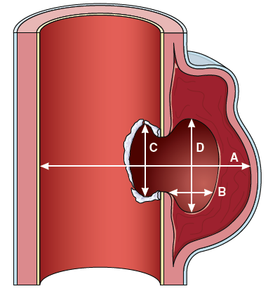
Figure 22. Dimensions of Penetrating Atherosclerotic Ulcers.
A, Maximal aortic diameter at ulcer site diameter (from ulcer across to opposite aortic wall). B, Depth of intramural blood pool. C, Length of intimal defect at ulcer site. D, Width of intramural blood pool.

Slide 44
PAU Open Surgical Repair Versus Endovascular Repair
Recommendations for PAU Open Surgical Repair Versus Endovascular Repair
COR | LOE | Recommendations
1 | C-LD | In patients who require repair of a PAU in the ascending aorta or proximal aortic arch (zones 0-1), open surgical repair is recommended.
2a | C-LD | In patients who require repair of a PAU in the distal aortic arch (zones 2-3), descending thoracic aorta, or abdominal aorta, either open surgical repair or endovascular repair is reasonable, based on anatomy and medical comorbidities.

Slide 45
Initial Management of BTTAI in the Emergency Department
Recommendations for Initial Management of BTTAI in the Emergency Department
COR | LOE | Recommendations
1 | C-EO | In patients with BTTAI, management and treatment at a trauma center with the facilities and expertise to treat aortic pathology is recommended.
1 | C-LD | In patients with BTTAI, anti-impulse therapy to reduce the risk of injury extension and rupture should be implemented, except in patients with hypotension or hypovolemic shock.

Slide 46
Approach to the Initial Management of BTTAI
Recommendations for Approach to the Initial Management of BTTAI
1 | C-LD | In patients with grade 1 BTTAI (Figure 23), nonoperative management and follow-up imaging are recommended.
1 | C-LD | In patients with grade 3 to 4 BTTAI (Figure 23) and nonprohibitive comorbidities or injuries, aortic intervention is recommended.
2a | C-LD | In patients with grade 2 BTTAI (Figure 23) and with high-risk imaging features (Table 32), aortic intervention is reasonable.
2b | C-LD | In patients with grade 2 BTTAI (Figure 23) and without high-risk imaging features (Table 32), nonoperative management and follow-up surveillance imaging may be reasonable.

Slide 47
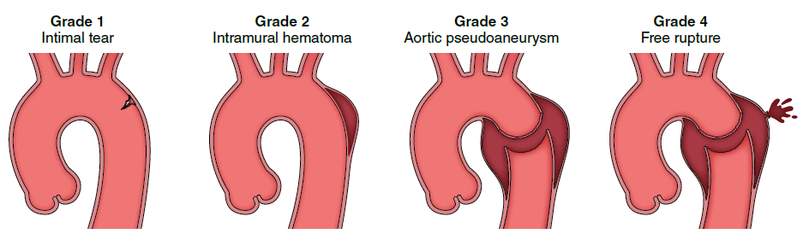
Figure 23. Classification System for BTTAIs.
BTTAI indicates blunt traumatic thoracic aortic injury.

Slide 48
Table 32. High-Risk Imaging Features of BTTAI
Posterior mediastinal hematoma >10 mm
Lesion to normal aortic diameter ratio >1.4
Mediastinal hematoma causing mass effect
Pseudocoarctation of the aorta
Large left hemothorax
Ascending aortic, aortic arch, or great vessel involvement
Aortic arch hematoma
BTTAI indicates blunt traumatic thoracic aortic injury.

Slide 49
Endovascular Versus Open Surgical Repair
Recommendation for Endovascular Versus Open Surgical Repair Referenced studies that support the recommendation are summarized in the Online Data Supplement.
1 | B-NR | In patients with BTTAI who meet indications for repair and with appropriate anatomy, TEVAR is recommended over open repair

Slide 50
Initial Management of Blunt Traumatic Abdominal Aortic Injury (BAAI)
Recommendations for Initial Management of BAAI Referenced studies that support the recommendations are summarized in the Online Data Supplement.
COR | LOE | Recommendations
1 | C-LD | In patients with grade 1 to 2 BAAI (Table 33) without malperfusion, anti-impulse therapy, if clinically tolerated, and repeat imaging within 24 to 48 hours of the initial scan is recommended to reduce risk of injury progression.
1 | C-LD | In patients with grade 4 BAAI (Table 33), repair should be performed to address life-threatening aortic injury.

Slide 51
Initial Management of Blunt Traumatic Abdominal Aortic Injury (BAAI) (con’t.)
2a | C-LD | In patients with grade 2 BAAI (Table 33) and associated malperfusion, it is reasonable to consider repair.
2a | C-LD | In patients with BAAI, treatment with either endovascular or open repair is reasonable and depends on degree of injury, aortic anatomy, and the patient’s overall clinical status.
2b | C-LD | In patients with grade 3 BAAI (Table 33), it may be reasonable to consider repair to reduce risk of progression to life-threatening injury.
3: Harm | B-NR | In patients with BAAI, the usefulness of routine application of resuscitative endovascular balloon occlusion of the aorta (REBOA) for hemorrhage control is unclear and, in some cases, may cause harm.

Slide 52
Table 33. Descriptions of Blunt Aortic Injury Grades
Injury Grade | Descriptions
1 | Minor intimal tear, intimal defect, or thrombus (≤10 mm)
2 | Large intimal flap, intimal defect, or thrombus (≥10 mm in length or width)
3 | Pseudoaneurysm
4 | Aortic rupture

Slide 53
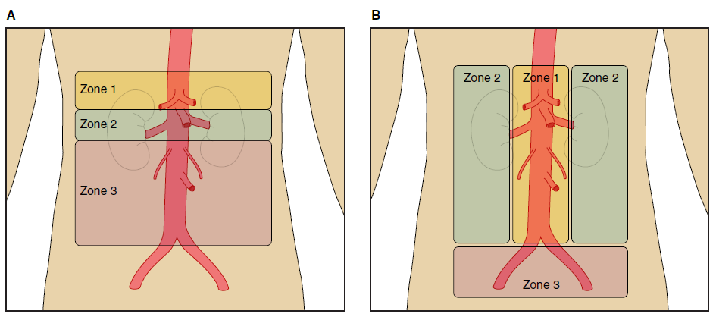
Figure 24. Abdominal Aortic Zones of Injury for Surgical Approaches and Abdominal Zones of Injury Based on Trauma Classification.

Slide 54
Long-Term Management and Surveillance After Blunt Traumatic Aortic Injury (BTAI)
Recommendations for Long-Term Management and Surveillance After BTAI
COR | LOE | Recommendations
2a | C-LD | In patients with BTAI who have undergone aortic repair, surveillance imaging at intervals appropriate for the repair approach and location (see Section 7.8, “Long-Term Management and Surveillance Imaging Following AAS”) is reasonable.
2b | C-LD | In patients with BTAI who have not undergone repair, surveillance imaging with a CT at 1 month, 6 months, and 12 months after the diagnosis and, if stable, at appropriate intervals thereafter (depending on the type and extent of the injury), may be reasonable.

Slide 55
Long-Term Surveillance Imaging After Aortic Dissection and IMH
Recommendations for Long-Term Surveillance Imaging After Aortic Dissection and IMH Referenced studies that support the recommendations are summarized in the Online Data Supplement.
COR | LOE | Recommendations
1 | B-NR | In patients who have had an acute aortic dissection and IMH treated with either open or endovascular aortic repair and have residual aortic disease, surveillance imaging with a CT (or MRI) is recommended after 1 month, 6 months, and 12 months and then, if stable, annually thereafter.
1 | B-NR | In patients who have had an acute aortic dissection and IMH that was managed with medical therapy alone, surveillance imaging with a CT (or MRI) is recommended after 1 month, 6 months, and 12 months and then, if stable, annually thereafter.

Slide 56
Long-Term Management After Acute Aortic Dissection and IMH
Recommendation for Long-Term Management After Acute Aortic Dissection and IMH Referenced studies that support the recommendation are summarized in the Online Data Supplement.
COR | LOE | Recommendation
1 | B-NR | In patients with a previous acute aortic dissection and IMH, whether initially treated medically or with intervention, who have chronic residual TAD and an aneurysm with a total aortic diameter of ≥5.5 cm, elective thoracic aortic repair is recommended.

Slide 57
Long-Term Management and Surveillance for PAUs
Recommendations for Long-Term Management and Surveillance for PAUs
COR | LOE | Recommendations
2a | C-LD | In patients with a PAU who have undergone aortic repair, surveillance imaging at intervals appropriate for the repair approach and location (see Section 6.5.6, “Surveillance After Aneurysm Repair”) is reasonable.
2a | C-LD | In patients with a PAU that is being managed medically, surveillance imaging with a CT is reasonable at 1 month after the diagnosis and, if stable, every 6 months for 2 years, and then at appropriate intervals thereafter (depending on patient age and PAU characteristics).

