Slide 1
2022 AHA/ACC/HFSA Guideline for the Management of Heart Failure
Developed in partnership with the Heart Failure Society of America

Slide 2
Citation
This slide set is adapted from the 2022 AHA/ACC/HFSA Guideline for the Management of Heart Failure. Published online ahead of print April 1, 2022, available at: Circulation. https://www.ahajournals.org/doi/10.1161/CIR.0000000000001063 And Journal of the American College of Cardiology published online ahead of print April 1, 2022. J Am Coll Cardiol. https://www.jacc.org/doi/10.1016/j.jacc.2021.12.012
© 2022 the American Heart Association, Inc., the American College of Cardiology Foundation, and Heart Failure Society of America. All rights reserved. This article has been published in Circulation, the Journal of the American College of Cardiology, and the Journal of Cardiac Failure.

Slide 3
2022 Writing Committee Members*
Paul A. Heidenreich, MD, MS, FACC, FAHA, FHFSA, Chair†
Biykem Bozkurt, MD, PhD, FACC, FAHA, FHFSA, Vice Chair†
David Aguilar, MD, MSc, FAHA†
Larry A. Allen, MD, MHS, FACC, FAHA, FHFSA†
Joni J. Byun†
Monica M. Colvin, MD, MS, FAHA†
Anita Deswal, MD, MPH, FACC, FAHA, FHFSA‡
Shannon M. Dunlay, MD, MS, FAHA, FHFSA†
Linda R. Evers, JD†
James C. Fang, MD, FACC, FAHA, FHFSA†
Savitri E. Fedson, MD, MA†
Gregg C. Fonarow, MD, FACC, FAHA, FHFSA§
Salim S. Hayek, MD, FACC†
Adrian F. Hernandez, MD, MHS‡
Prateeti Khazanie, MD, MPH, FHFSA†
Michelle M. Kittleson, MD, PhD†
Christopher S. Lee, PhD, RN, FAHA, FHFSA†
Mark S. Link, MD†
Carmelo A. Milano, MD†
Lorraine C. Nnacheta, DrPH, MPH†
Alexander T. Sandhu, MD, MS†
Lynne Warner Stevenson, MD, FACC, FAHA, FHFSA†
Orly Vardeny, PharmD, MS, FAHA, FHFSA║
Amanda R. Vest, MBBS, MPH, FHFSA║
Clyde W. Yancy, MD, MSc, MACC, FAHA, FHFSA†
*Writing committee members are required to recuse themselves from voting on sections to which their specific relationships with industry may apply; see Appendix 1 for detailed information. † ACC/AHA Representative. ‡ ACC/AHA Joint Committee on Clinical Practice Guidelines Liaison. §Task Force Performance Measures. ║HFSA Representative. #Former Joint Committee member; current member during the writing effort.

Slide 4
Top 10 Take-Home Messages
2022 Guideline for the Management of Heart Failure

Slide 5
Top 10 Take Home Messages
1. Guideline-directed medical therapy (GDMT) for heart failure (HF) with reduced ejection fraction (HFrEF) now includes 4 medication classes which include sodium-glucose cotransporter-2 inhibitors (SGLT2i).

Slide 6
Top 10 Take Home Messages
2. SGLT2 inhibitors have a 2a recommendation in heart failure with mildly reduced ejection fraction (HFmrEF). Weaker recommendations (2b) are made for ARNi, ACEi, ARB, MRA and beta blockers in this population.

Slide 7
Top 10 Take Home Messages
3. New recommendations for HFpEF are made for SGLT2 inhibitors (2a) , MRAs (2b) and ARNi (2b). Several prior recommendations have been renewed including treatment of hypertension (1), treatment of atrial fibrillation (2a), use of ARBs (2b) avoidance of routine use of nitrates or phosphodiesterase-5 inhibitors (3-no Benefit).

Slide 8
Top 10 Take Home Messages
4. Improved LVEF is used to refer to those patients with a previous HFrEF who now have an LVEF > 40%. These patients should continue their HFrEF treatment.

Slide 9
Top 10 Take Home Messages
5. Value statements were created for select recommendations where high-quality cost-effectiveness studies of the intervention have been published.

Slide 10
Top 10 Take Home Messages
6. Amyloid heart disease has new recommendations for treatment including screening for serum and urine monoclonal light chains, bone scintigraphy, genetic sequencing, tetramer stabilizer therapy, and anticoagulation.

Slide 11
Top 10 Take Home Messages
7. Evidence supporting increased filling pressures is important for the diagnosis of HF if the LVEF is >40%. Evidence for increased filling pressures can be obtained from non-invasive (e.g., natriuretic peptide, diastolic function on imaging) or invasive testing (e.g., hemodynamic measurement).

Slide 12
Top 10 Take Home Messages
8. Patients with advanced HF who wish to prolong survival should be referred to a team specializing in HF. A heart failure specialty team reviews HF management, assesses suitability for advanced HF therapies and uses palliative care including palliative inotropes where consistent with the patient’s goals of care.

Slide 13
Top 10 Take Home Messages
9. Primary prevention is important for those at risk for HF (Stage A) or pre-HF (Stage B). Stages of HF were revised to emphasize the new terminologies of “at risk” for HF for Stage A and Pre-HF for Stage B.

Slide 14
Top 10 Take Home Messages
10. Recommendations are provided for select patients with HF and iron deficiency, anemia, hypertension, sleep disorders, type 2 diabetes, atrial fibrillation, coronary artery disease and malignancy.

Slide 15
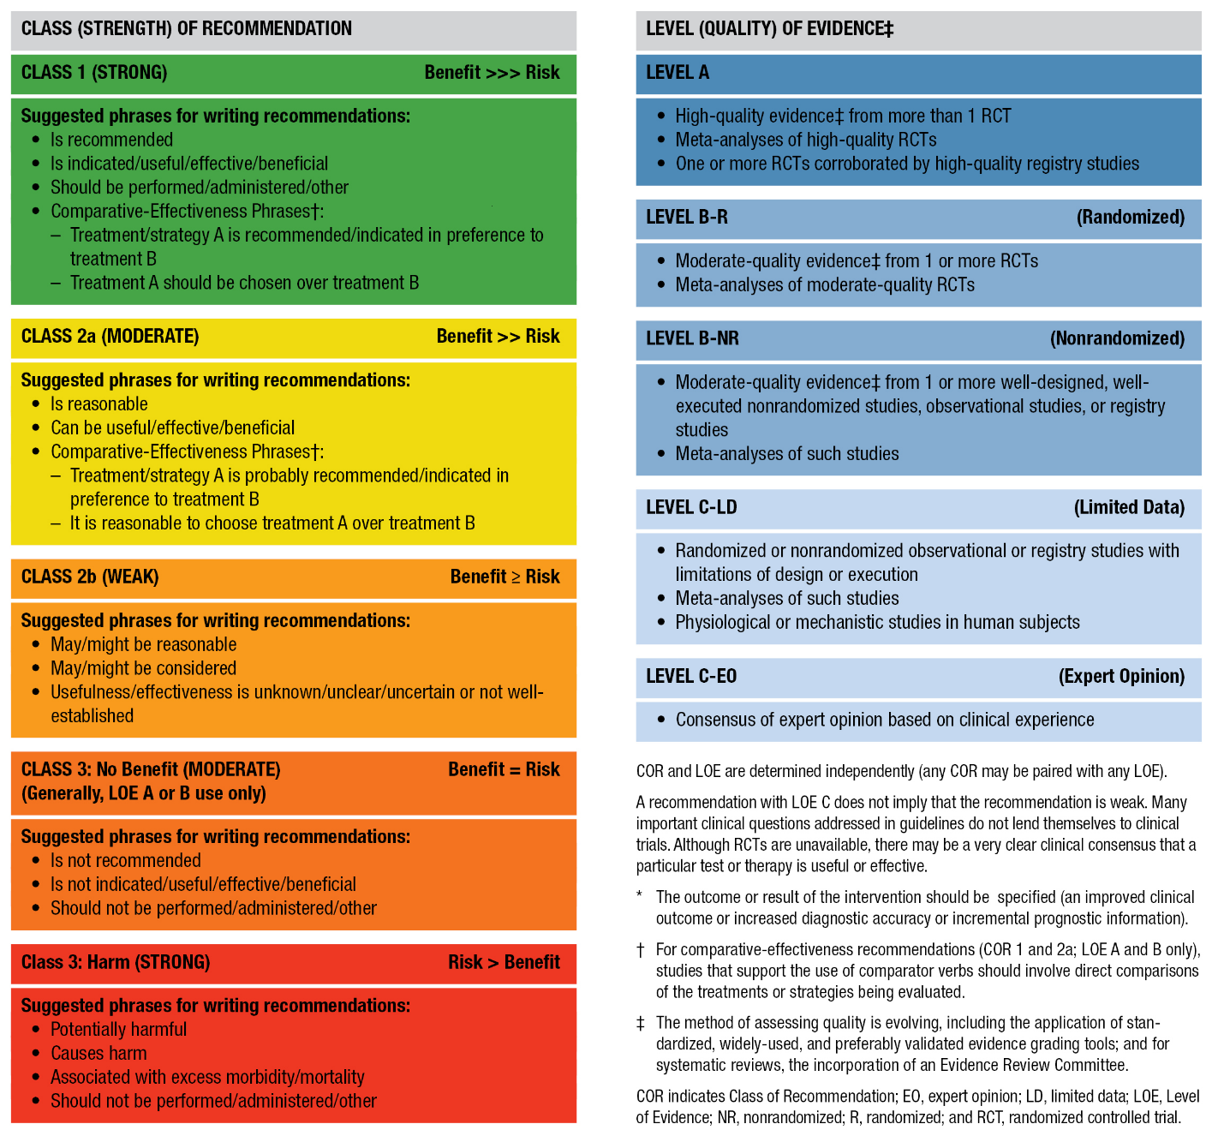
Table 2. Applying American College of Cardiology/American Heart Association Class of Recommendation and Level of Evidence to Clinical Strategies, Interventions, Treatments, or Diagnostic Testing in Patient Care (Updated May 2019)*

Slide 16
Definition of HF

Slide 17
Table 3. Stages of HF
Stages | Definition and Criteria
Stage A: At Risk for HF | At risk for HF but without symptoms, structural heart disease, or cardiac biomarkers of stretch or injury (e.g., patients with hypertension, atherosclerotic CVD, diabetes, metabolic syndrome and obesity, exposure to cardiotoxic agents, genetic variant for cardiomyopathy, or positive family history of cardiomyopathy).

Slide 18
Table 3. Stages of HF (con’t.)
Stage B: Pre-HF | No symptoms or signs of HF and evidence of 1 of the following:
 | Structural heart disease* Reduced left or right ventricular systolic function Reduced ejection fraction, reduced strain Ventricular hypertrophy Chamber enlargement Wall motion abnormalities Valvular heart disease
 | Evidence for increased filling pressures* By invasive hemodynamic measurements By noninvasive imaging suggesting elevated filling pressures (e.g., Doppler echocardiography)
 | Patients with risk factors and Increased levels of BNPs* or Persistently elevated cardiac troponin in the absence of competing diagnoses resulting in such biomarker elevations such as acute coronary syndrome, CKD, pulmonary embolus, or myopericarditis

Slide 19
Table 3. Stages of HF (con’t.)
Stage C: Symptomatic HF | Structural heart disease with current or previous symptoms of HF.
Stage D: Advanced HF | Marked HF symptoms that interfere with daily life and with recurrent hospitalizations despite attempts to optimize GDMT.
BNP indicates B-type natriuretic peptide; CKD, chronic kidney disease; GDMT, guideline-directed medical therapy; HF, heart failure; LV, left ventricular; and RV, right ventricular.

Slide 20
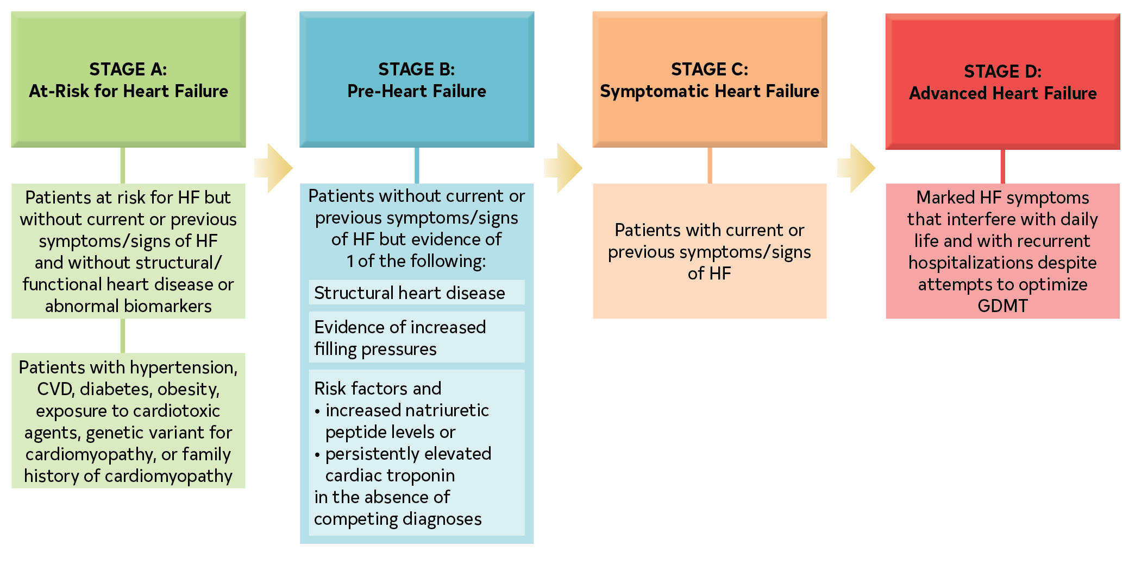
Figure 1. ACC/AHA Stages of HF
The ACC/AHA stages of HF are shown.
ACC indicates American College of Cardiology; AHA, American Heart Association; CVD, cardiovascular disease; GDMT, guideline-directed medical therapy; and HF, heart failure.

Slide 21
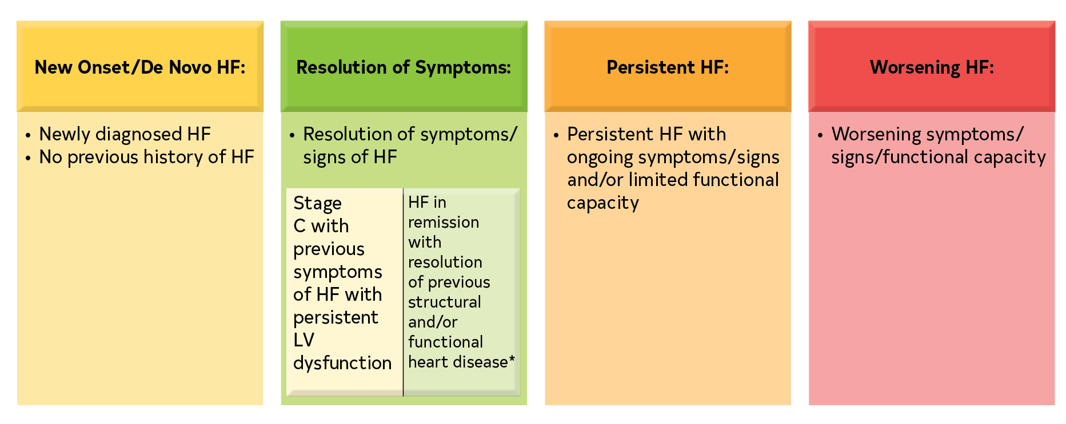
Figure 2. Trajectory of Class C HF
The trajectory of stage C HF is displayed. Patients whose symptoms and signs of HF are resolved are still stage C and should be treated accordingly. If all HF symptoms, signs, and structural abnormalities resolve, the patient is considered to have HF in remission.
*Full resolution of structural and functional cardiac abnormalities is uncommon.
HF indicates heart failure; and LV, left ventricular.

Slide 22
Table 4. Classification of HF by LVEF
Type of HF According to LVEF | Criteria
HFrEF (HF with reduced EF) | LVEF ≤40%
HFimpEF (HF with improved EF) | Previous LVEF ≤40% and a follow-up measurement of LVEF >40%
HFmrEF (HF with mildly reduced EF) | LVEF 41%–49% Evidence of spontaneous or provokable increased LV filling pressures (e.g., elevated natriuretic peptide, noninvasive and invasive hemodynamic measurement)
HFpEF (HF with preserved EF) | LVEF ≥50% Evidence of spontaneous or provokable increased LV filling pressures (e.g., elevated natriuretic peptide, noninvasive and invasive hemodynamic measurement)
HF indicates heart failure; LV, left ventricular; and LVEF, left ventricular ejection fraction.

Slide 23
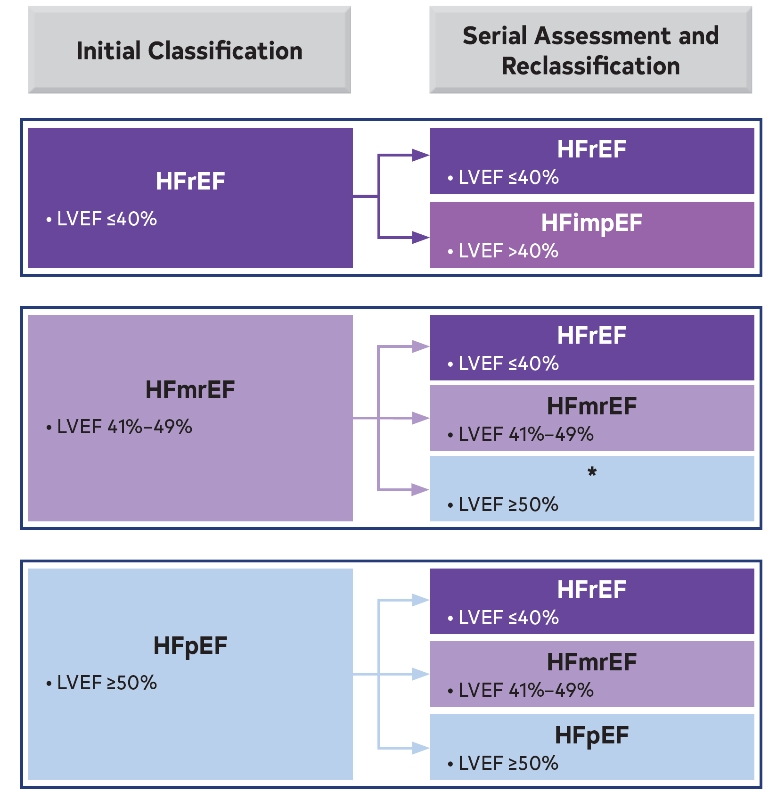
Figure 3. Classification and Trajectories of HF Based on LVEF

Slide 24
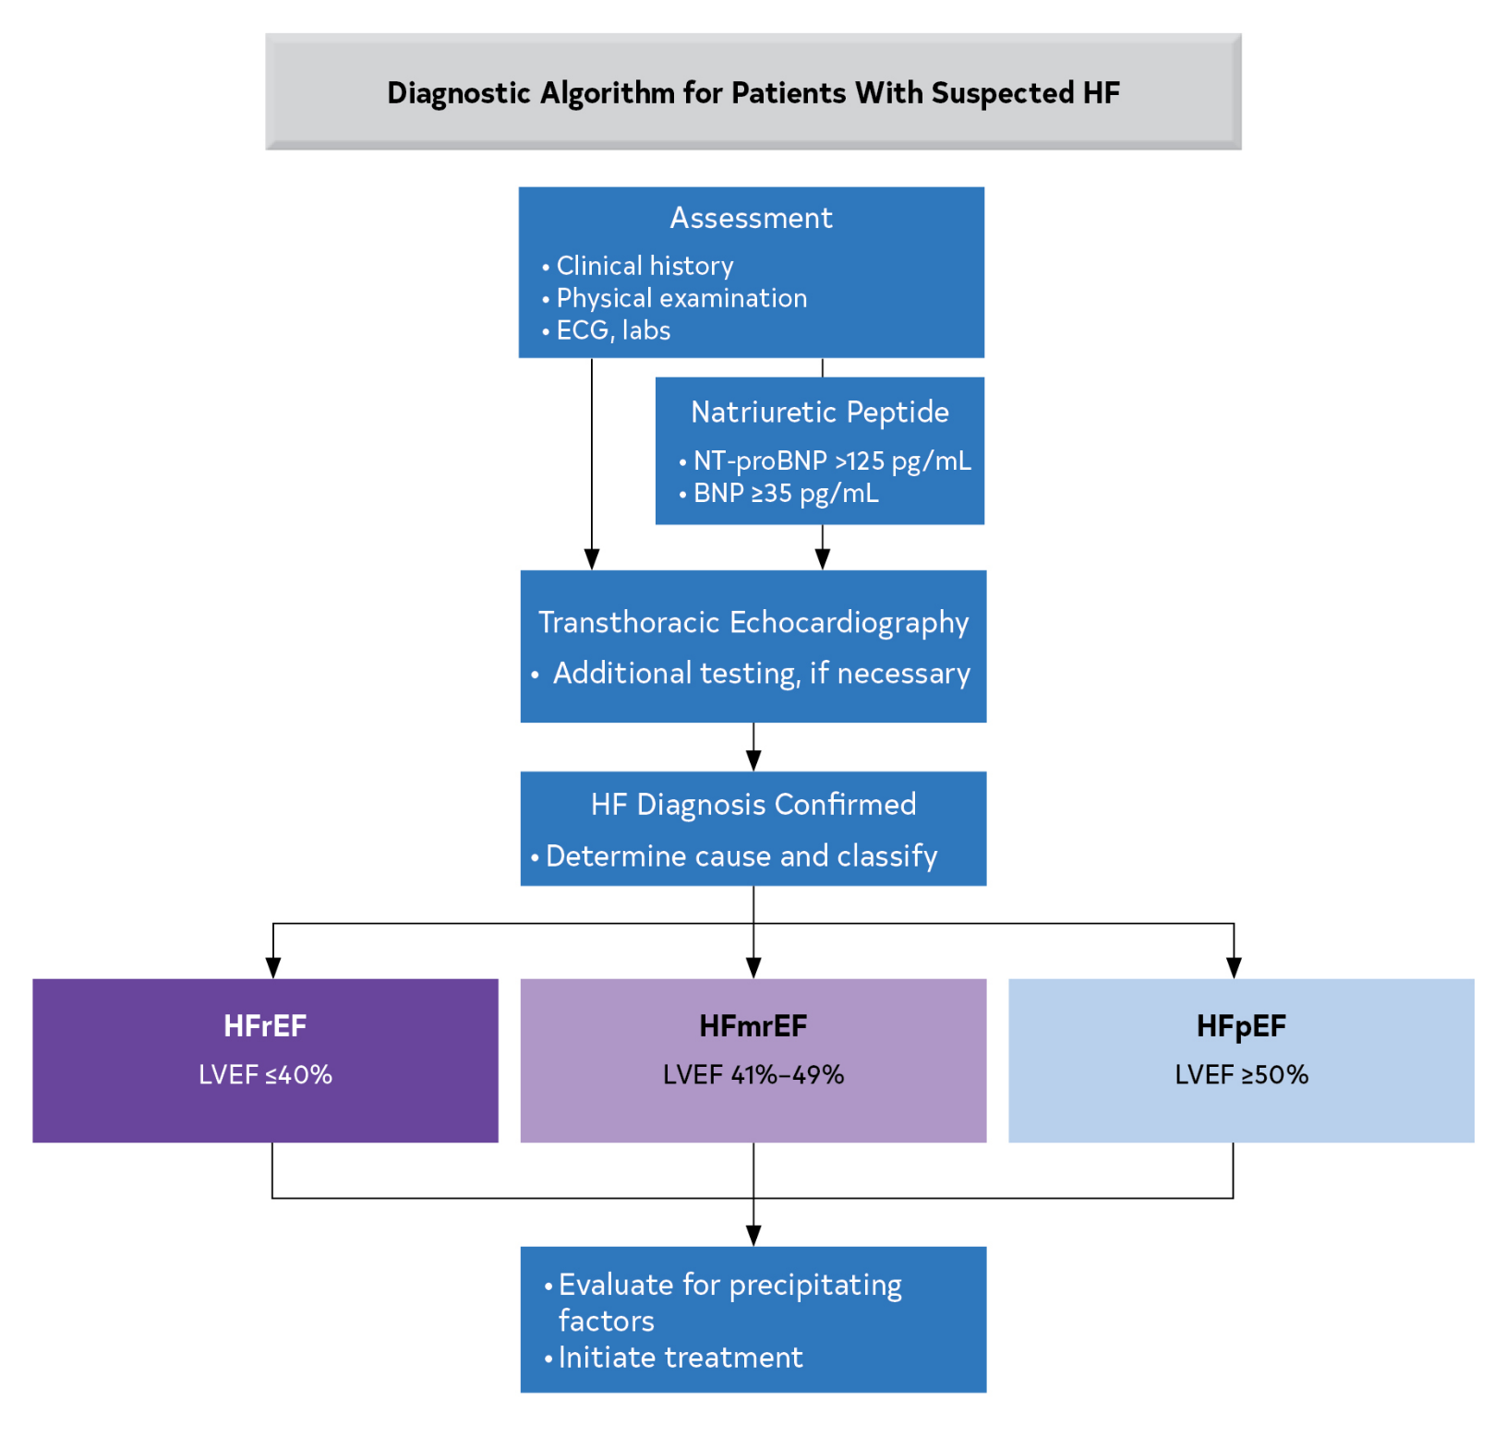
Figure 4. Diagnostic Algorithm for HF and EF-Based Classification
The algorithm for a diagnosis of HF and EF-based classification is shown.
BNP indicates B-type natriuretic peptide; ECG, electrocardiogram; EF, ejection fraction; HF, heart failure; HFmrEF, heart failure with mildly reduced ejection fraction; HFpEF, heart failure with preserved ejection fraction; HFrEF, heart failure with reduced ejection fraction; LVEF, left ventricular ejection fraction; LV, left ventricular; NP, natriuretic peptides; and NT-proBNP, N-terminal pro-B type natriuretic peptide.

Slide 25
Initial and Serial Evaluation

Slide 26
Clinical Assessment: History and Physical Examination
Recommendations for Clinical Assessment: History and Physical Examination Referenced studies that support the recommendations are summarized in the Online Data Supplements.
COR | LOE | Recommendations
1 | B-NR | In patients with HF, vital signs and evidence of clinical congestion should be assessed at each encounter to guide overall management, including adjustment of diuretics and other medications.
1 | B-NR | In patients with symptomatic HF, clinical factors indicating the presence of advanced HF should be sought via the history and physical examination.

Slide 27
Clinical Assessment: History and Physical Examination (con’t.)
1 | B-NR | In patients with cardiomyopathy, a 3-generation family history should be obtained or updated when assessing the cause of the cardiomyopathy to identify possible inherited disease.
1 | B-NR | In patients presenting with HF, a thorough history and physical examination should direct diagnostic strategies to uncover specific causes that may warrant disease-specific management.
1 | C-EO | In patients presenting with HF, a thorough history and physical examination should be obtained and performed to identify cardiac and noncardiac disorders, lifestyle and behavioral factors, and social determinants of health that might cause or accelerate the development or progression of HF.

Slide 28
Table 5. Other Potential Nonischemic Causes of HF
Cause | Reference
Chemotherapy and other cardiotoxic medications | (23-25)
Rheumatologic or autoimmune | (26)
Endocrine or metabolic (thyroid, acromegaly, pheochromocytoma, diabetes, obesity) | (27-31)
Familial cardiomyopathy or inherited and genetic heart disease | (32)
Heart rhythm–related (e.g., tachycardia-mediated, PVCs, RV pacing) | (33)
Hypertension | (34)
Infiltrative cardiac disease (e.g., amyloid, sarcoid, hemochromatosis) | (21, 35, 36)
Myocarditis (infectious, toxin or medication, immunological, hypersensitivity) | (37, 38)
Peripartum cardiomyopathy | (39)
Stress cardiomyopathy (Takotsubo) | (40, 41)
Substance abuse (e.g., alcohol, cocaine, methamphetamine) | (42-44)
HF indicates heart failure; PVC, premature ventricular contraction; and RV, right ventricular.

Slide 29
Initial Laboratory and Electrocardiographic Testing
Recommendations for Initial Laboratory and Electrocardiographic Testing Referenced studies that support the recommendations are summarized in the Online Data Supplements.
COR | LOE | Recommendations
1 | B-NR | For patients presenting with HF, the specific cause of HF should be explored using additional laboratory testing for appropriate management.
1 | C-EO | For patients who are diagnosed with HF, laboratory evaluation should include complete blood count, urinalysis, serum electrolytes, blood urea nitrogen, serum creatinine, glucose, lipid profile, liver function tests, iron studies, and thyroid-stimulating hormone to optimize management.
1 | C-EO | For all patients presenting with HF, a 12-lead ECG should be performed at the initial encounter to optimize management.

Slide 30
Use of Biomarkers for Prevention, Initial Diagnosis, and Risk Stratification
4.2. Recommendations for Use of Biomarkers for Prevention, Initial Diagnosis, and Risk Stratification Referenced studies that support the recommendations are summarized in the Online Data Supplements.
COR | LOE | Recommendations
1 | A | In patients presenting with dyspnea, measurement of B-type natriuretic peptide (BNP) or N-terminal prohormone of B-type natriuretic peptide (NT-proBNP) is useful to support a diagnosis or exclusion of HF.
1 | A | In patients with chronic HF, measurements of BNP or NT-proBNP levels are recommended for risk stratification.

Slide 31
Use of Biomarkers for Prevention, Initial Diagnosis, and Risk Stratification (con’t.)
1 | A | In patients hospitalized for HF, measurement of BNP or NT-proBNP levels at admission is recommended to establish prognosis.
2a | B-R | In patients at risk of developing HF, BNP or NT-proBNP–based screening followed by team-based care, including a cardiovascular specialist, can be useful to prevent the development of LV dysfunction or new-onset HF.
2a | B-NR | In patients hospitalized for HF, a predischarge BNP or NT-proBNP level can be useful to inform the trajectory of the patient and establish a postdischarge prognosis

Slide 32
Table 6. Selected Potential Causes of Elevated Natriuretic Peptide Levels
Cardiac
HF, including RV HF syndromes
ACS
Heart muscle disease, including LVH
VHD
Pericardial disease
AF
Myocarditis
Cardiac surgery
Cardioversion
Toxic-metabolic myocardial insults, including cancer chemotherapy

Slide 33
Table 6. Selected Potential Causes of Elevated Natriuretic Peptide Levels (50-53) (con’t.)
Noncardiac
Advancing age
Anemia
Renal failure
Pulmonary: Obstructive sleep apnea, severe pneumonia
Pulmonary embolism, pulmonary arterial hypertension
Critical illness
Bacterial sepsis
Severe burns
ACS indicates acute coronary syndromes; AF, atrial fibrillation; HF, heart failure; LVH, left ventricular hypertrophy; RV, right ventricular; and VHD, valvular heart disease.

Slide 34
Genetic Evaluation and Testing
Recommendations for Genetic Evaluation and Testing Referenced studies that support the recommendations are summarized in the Online Data Supplements.
COR | LOE | Recommendations
1 | B-NR | In first-degree relatives of selected patients with genetic or inherited cardiomyopathies, genetic screening and counseling are recommended to detect cardiac disease and prompt consideration of treatments to decrease HF progression and sudden death.
2a | B-NR | In select patients with nonischemic cardiomyopathy, referral for genetic counseling and testing is reasonable to identify conditions that could guide treatment for patients and family members.

Slide 35
Table 7. Examples of Factors Implicating Possible Genetic Cardiomyopathy
Phenotypic Category | Patient or Family Member Phenotypic Finding* | Ask Specifically About Family Members* With
Cardiac morphology | Marked LV hypertrophy | Any mention of cardiomyopathy, enlarged or weak heart, HF. Document even if attributed to other causes, such as alcohol or peripartum cardiomyopathy
 | LV noncompaction
 | Right ventricular thinning or fatty replacement on imaging or biopsy
Findings on 12-lead ECG | Abnormal high or low voltage or conduction, and repolarization, altered RV forces | Long QT or Brugada syndrome

Slide 36
Table 7. Examples of Factors Implicating Possible Genetic Cardiomyopathy (con’t.)
Dysrhythmias | Frequent NSVT or very frequent PVCs | ICD Recurrent syncope Sudden death attributed to “massive heart attack” without known CAD Unexplained fatal event such as drowning or single-vehicle crash
 | Sustained ventricular tachycardia or fibrillation
 | Early onset AF | “Lone” AF before age 65 years
 | Early onset conduction disease | Pacemaker before age 65 years
Extracardiac features | Skeletal myopathy Neuropathy Cutaneous stigmata Other possible manifestations of systemic syndromes | Any known skeletal muscle disease, including mention of Duchenne and Becker’s, Emory-Dreifuss limb-girdle dystrophy Systemic syndromes: Dysmorphic features Mental retardation Congenital deafness Neurofibromatosis Renal failure with neuropathy
AF indicates atrial fibrillation; CAD, coronary artery disease; LV, left ventricular; NSVT, nonsustained ventricular tachycardia; PVC, premature ventricular contraction; and RV, right ventricular.

Slide 37
Evaluation With Cardiac Imaging
Recommendations for Evaluation With Cardiac Imaging Referenced studies that support the recommendations are summarized in the Online Data Supplements.
COR | LOE | Recommendations
1 | C-LD | In patients with suspected or new-onset HF, or those presenting with acute decompensated HF, a chest x-ray should be performed to assess heart size and pulmonary congestion and to detect alternative cardiac, pulmonary, and other diseases that may cause or contribute to the patient’s symptoms.
1 | C-LD | In patients with suspected or newly diagnosed HF, transthoracic echocardiography (TTE) should be performed during initial evaluation to assess cardiac structure and function.

Slide 38
Evaluation With Cardiac Imaging (con’t.)
1 | C-LD | In patients with HF who have had a significant clinical change, or who have received GDMT and are being considered for invasive procedures or device therapy, repeat measurement of EF, degree of structural remodeling, and valvular function are useful to inform therapeutic interventions.
1 | C-LD | In patients for whom echocardiography is inadequate, alternative imaging (e.g., cardiac magnetic resonance [CMR], cardiac computed tomography [CT], radionuclide imaging) is recommended for assessment of LVEF.
2a | B-NR | In patients with HF or cardiomyopathy, CMR can be useful for diagnosis or management.

Slide 39
Evaluation With Cardiac Imaging (con’t.)
2a | B-NR | In patients with HF, an evaluation for possible ischemic heart disease can be useful to identify the cause and guide management.
2b | B-NR | In patients with HF and CAD who are candidates for coronary revascularization, noninvasive stress imaging (stress echocardiography, single-photon emission CT [SPECT], CMR, or positron emission tomography [PET]) may be considered for detection of myocardial ischemia to help guide coronary revascularization.
3: No Benefit | C-EO | In patients with HF in the absence of: 1) clinical status change, 2) treatment interventions that might have had a significant effect on cardiac function, or 3) candidacy for invasive procedures or device therapy, routine repeat assessment of LV function is not indicated.

Slide 40
Invasive Evaluation
Recommendations for Invasive Evaluation Referenced studies that support the recommendations are summarized in the Online Data Supplements.
COR | LOE | Recommendations
2a | B-NR | In patients with HF, endomyocardial biopsy may be useful when a specific diagnosis is suspected that would influence therapy.

Slide 41
Invasive Evaluation (con’t.)
2a | C-EO | In selected patients with HF with persistent or worsening symptoms, signs, diagnostic parameters, and in whom hemodynamics are uncertain, invasive hemodynamic monitoring can be useful to guide management.
3: No Benefit | B-R | In patients with HF, routine use of invasive hemodynamic monitoring is not recommended.
3: Harm | C-LD | For patients undergoing routine evaluation of HF, endomyocardial biopsy should not be performed because of the risk of complications.

Slide 42
Wearables and Remote Monitoring (Including Telemonitoring and Device Monitoring)
Recommendation for Wearables and Remote Monitoring (Including Telemonitoring and Device Monitoring) Referenced studies that support the recommendation are summarized in the Online Data Supplements.
COR | LOE | Recommendation
2b | B-R | In selected adult patients with NYHA class III HF and history of a HF hospitalization in the past year or elevated natriuretic peptide levels, on maximally tolerated stable doses of GDMT with optimal device therapy, the usefulness of wireless monitoring of PA pressure by an implanted hemodynamic monitor to reduce the risk of subsequent HF hospitalizations is uncertain.
Value Statement: Uncertain Value (B-NR) |  | In patients with NYHA class III HF with a HF hospitalization within the previous year, wireless monitoring of the PA pressure by an implanted hemodynamic monitor provides uncertain value .

Slide 43
Exercise and Functional Capacity Testing
Recommendations for Exercise and Functional Capacity Testing Referenced studies that support the recommendations are summarized in the Online Data Supplements.
COR | LOE | Recommendations
1 | C-LD | In patients with HF, assessment and documentation of NYHA functional classification are recommended to determine eligibility for treatments.
1 | C-LD | In selected ambulatory patients with HF, cardiopulmonary exercise testing (CPET) is recommended to determine appropriateness of advanced treatments (e.g., LVAD, heart transplant).
2a | C-LD | In ambulatory patients with HF, performing a CPET or 6- minute walk test is reasonable to assess functional capacity.
2a | C-LD | In ambulatory patients with unexplained dyspnea, CPET is reasonable to evaluate the cause of dyspnea.

Slide 44
Initial and Serial Evaluation: Clinical Assessment: HF Risk Scoring
Recommendation for Initial and Serial Evaluation: Clinical Assessment: HF Risk Scoring Referenced studies that support the recommendation are summarized in the Online Data Supplements.
COR | LOE | Recommendation
2a | B-NR | In ambulatory or hospitalized patients with HF, validated multivariable risk scores can be useful to estimate subsequent risk of mortality.

Slide 45
Table 8. Selected Multivariable Risk Scores to Predict Outcome in HF
Risk Score | Year Published
Chronic HF
All Patients With Chronic HF
Seattle Heart Failure Model https://depts.washington.edu/shfm/?width=1440&height=900 | 2006
Heart Failure Survival Score | 1997
MAGGIC http://www.heartfailurerisk.org/ | 2013
CHARM Risk Score | 2006
CORONA Risk Score | 2009
Specific to Chronic HFrEF
PARADIGM-HF | 2020
HF-ACTION | 2012
GUIDE-IT | 2019

Slide 46
Table 8. Selected Multivariable Risk Scores to Predict Outcome in HF (con’t.)
Specific to Chronic HFpEF
I-PRESERVE Score | (9) | 2011
TOPCAT | (10) | 2020
Acutely Decompensated HF
ADHERE Classification and Regression Tree (CART) Model | (11) | 2005
AHA Get With The Guidelines Score | (12) https://www.mdcalc.com/gwtg-heart-failure-risk-score (17) | 2010, 2021
EFFECT Risk Score | (13) http://www.ccort.ca/Research/CHFRiskModel.aspx (18) | 2003, 2016
ESCAPE Risk Model and Discharge Score | (14) | 2010
ADHERE indicates Acute Decompensated Heart Failure National Registry; AHA, indicates American Heart Association; ARIC, Atherosclerosis Risk in Communities; CHARM, Candesartan in Heart failure-Assessment of Reduction in Mortality and morbidity; CORONA, Controlled Rosuvastatin Multinational Trial in Heart Failure; EFFECT, Enhanced Feedback for Effective Cardiac Treatment; ESCAPE, Evaluation Study of Congestive Heart Failure and Pulmonary Artery Catheterization Effectiveness; GUIDE-ID, Guiding Evidence-Based Therapy Using Biomarker Intensified Treatment; HF, heart failure; HFpEF, heart failure with preserved ejection fraction; HF-ACTION, Heart Failure: A Controlled Trial Investigating Outcomes of Exercise Training MAGGIC Meta-analysis Global Group in Chronic Heart Failure; I-PRESERVE, Irbesartan in Heart Failure with Preserved Ejection Fraction Study; PCP-HF, Pooled Cohort Equations to Prevent HF; TOPCAT, Treatment of Preserved Cardiac Function Heart Failure with an Aldosterone Antagonist trial.

Slide 47
Stage A (Patients at Risk for HF)

Slide 48
Patients at Risk for HF (Stage A: Primary Prevention)
Recommendations for Patients at Risk for HF (Stage A: Primary Prevention) Referenced studies that support the recommendations are summarized in the Online Data Supplements.
COR | LOE | Recommendations
1 | A | In patients with hypertension, blood pressure should be controlled in accordance with GDMT for hypertension to prevent symptomatic HF.
1 | A | In patients with type 2 diabetes and either established CVD or at high cardiovascular risk, SGLT2i should be used to prevent hospitalizations for HF.

Slide 49
Patients at Risk for HF (Stage A: Primary Prevention) (con’t.)
1 | B-NR | In the general population, healthy lifestyle habits such as regular physical activity, maintaining normal weight, healthy dietary patterns, and avoiding smoking are helpful to reduce future risk of HF.
2a | B-R | For patients at risk of developing HF, natriuretic peptide biomarker–based screening followed by team-based care, including a cardiovascular specialist optimizing GDMT, can be useful to prevent the development of LV dysfunction (systolic or diastolic) or new-onset HF.
2a | B-NR | In the general population, validated multivariable risk scores can be useful to estimate subsequent risk of incident HF.

Slide 50
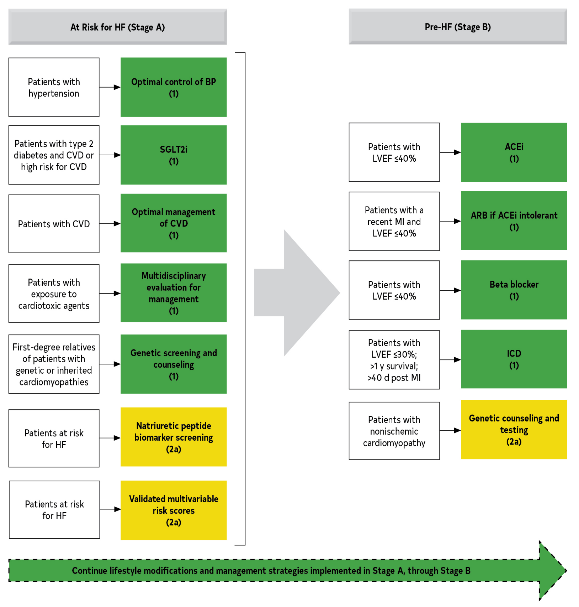
Figure 5. Recommendations (Class 1 and 2a) for Patients at Risk of HF (Stage A) and Those With Pre-HF (Stage B)
Colors correspond to COR in Table 2.
Class 1 and Class 2a recommendations for patients at risk for HF (stage A) and those with pre-HF (stage B) are shown. Management strategies implemented in patients at risk for HF (stage A) should be continued though stage B.
ACEi indicates angiotensin-converting enzyme inhibitor; ARB, angiotensin receptor blocker; BP, blood pressure; CVD, cardiovascular disease; HF, heart failure; ICD, implantable cardioverter-deﬁbrillator; LVEF, left ventricular ejection fraction; MI, myocardial infarction; and SGLT2i, sodium glucose cotransporter 2 inhibitor.

Slide 51
Table 9. Selected Multivariable Risk Scores to Predict Development of Incident HF
Risk Score | Year Published
Framingham Heart Failure Risk Score | 1999
Health ABC Heart Failure Score | 2008
ARIC Risk Score | 2012
PCP-HF | 2019
HF indicates heart failure; and PCP-HF, Pooled Cohort Equations to Prevent HF.

Slide 52
Stage B (Patients With Pre-HF)

Slide 53
Management of Stage B: Preventing the Syndrome of Clinical HF in Patients With Pre-HF
Recommendations for Management of Stage B: Preventing the Syndrome of Clinical HF in Patients With Pre-HF Referenced studies that support the recommendations are summarized in the Online Data Supplements.
COR | LOE | Recommendations
1 | A | In patients with LVEF ≤40%, ACEi should be used to prevent symptomatic HF and reduce mortality.
1 | A | In patients with a recent or remote history of MI or ACS, statins should be used to prevent symptomatic HF and adverse cardiovascular events.
1 | B-R | In patients with a recent or remote history of MI or acute coronary syndrome (ACS) and LVEF ≤40%, evidence-based beta blockers should be used to reduce mortality.

Slide 54
Management of Stage B: Preventing the Syndrome of Clinical HF in Patients With Pre-HF (con’t.)
1 | B-R | In patients with a recent or remote history of MI or ACS, statins should be used to prevent symptomatic HF and adverse cardiovascular events.
1 | B-R | In patients who are at least 40 days post-MI with LVEF ≤30% and NYHA class I symptoms while receiving GDMT and have reasonable expectation of meaningful survival for >1 year, an ICD is recommended for primary prevention of sudden cardiac death (SCD) to reduce total mortality.
1 | C-LD | In patients with LVEF ≤40%, beta blockers should be used to prevent symptomatic HF.
3: Harm | B-R | In patients with LVEF <50%, thiazolidinediones should not be used because they increase the risk of HF, including hospitalizations.
3: Harm | C-LD | In patients with LVEF <50%, nondihydropyridine calcium channel blockers with negative inotropic effects may be harmful.

Slide 55
Table 10. Other ACC/AHA Clinical Practice Guidelines Addressing Patients With Stage B HF
Consideration | Reference
Patients with an acute MI who have not developed HF symptoms treated in accordance with GDMT | 2013 ACCF/AHA Guideline for the Management of ST-Elevation Myocardial Infarction 2014 AHA/ACC Guideline for the Management of Patients With Non–ST-Elevation Acute Coronary Syndromes
Coronary revascularization for patients without symptoms of HF in accordance with GDMT | 2015 ACC/AHA/SCAI Focused Update on Primary Percutaneous Coronary Intervention for Patients With ST-Elevation Myocardial Infarction: An Update of the 2011 ACCF/AHA/SCAI Guideline for Percutaneous Coronary Intervention and the 2013 ACCF/AHA Guideline for the Management of ST-Elevation Myocardial Infarction (This guideline has been replaced by Lawton, 2021.) 2014 ACC/AHA/AATS/PCNA/SCAI/STS Focused Update of the Guideline for the Diagnosis and Management of Patients With Stable Ischemic Heart Disease 2011 ACCF/AHA Guideline for Coronary Artery Bypass Graft Surgery (This guideline has been replaced by Lawton, 2021.)

Slide 56
Table 10. Other ACC/AHA Clinical Practice Guidelines Addressing Patients With Stage B HF (con’t.)
Valve replacement or repair for patients with hemodynamically significant valvular stenosis or regurgitation and no symptoms of HF in accordance with GDMT | 2020 ACC/AHA Guideline for the Management of Patients With Valvular Heart Disease
Patients with congenital heart disease that may increase the risk for the development of HF | 2018 AHA/ACC Guideline for the Management of Adults With Congenital Heart Disease
AATS indicates American Association for Thoracic Surgery; ACC, American College of Cardiology; ACCF, American College of Cardiology Foundation; AHA, American Heart Association; GDMT, guideline-directed medical therapy; HF, heart failure; MI, myocardial infarction; PCNA, Preventive Cardiovascular Nurses Association; SCAI, Society for Cardiovascular Angiography and Interventions; and STS, The Society of Thoracic Surgeons.

Slide 57
Stage “C” HF

Slide 58
Nonpharmacological Interventions: Self-Care Support in HF
Recommendations for Nonpharmacological Interventions: Self-Care Support in HF Referenced studies that support the recommendations are summarized in the Online Data Supplements.
COR | LOE | Recommendations
1 | A | Patients with HF should receive care from multidisciplinary teams to facilitate the implementation of GDMT, address potential barriers to self-care, reduce the risk of subsequent rehospitalization for HF, and improve survival.

Slide 59
Nonpharmacological Interventions: Self-Care Support in HF (con’t.)
1 | B-R | Patients with HF should receive specific education and support to facilitate HF self-care in a multidisciplinary manner.
2a | B-NR | In patients with HF, vaccinating against respiratory illnesses is reasonable to reduce mortality.
2a | B-NR | In adults with HF, screening for depression, social isolation, frailty, and low health literacy as risk factors for poor self-care is reasonable to improve management.

Slide 60
Table 11. Potential Barriers to Effective HF Self-Care and Example Interventions
Potential Barrier | Example Screening Tools | Example Interventions
Medical Barriers
Cognitive impairment | Mini-Cog Mini-Mental State Examination (MMSE) Montreal Cognitive Assessment (MoCA) | Home health aide Home meal deliveries Adult day care Geriatric psychiatry referral Memory care support groups
Depression | Hamilton Depression Rating Scale (HAM-D) Beck Depression Inventory-II (BDI-II) Patient Health Questionnaire-9 (PHQ-9) | Psychotherapy Selective serotonin reuptake inhibitors Nurse-led support

Slide 61
Table 11. Potential Barriers to Effective HF Self-Care and Example Interventions (con’t.)
Substance use disorders | Tobacco, Alcohol, Prescription medication, and other Substance use (TAPS) | Referral to social work services and community support partners Referral for addiction psychiatry consultation
Frailty | Fried frailty phenotype | Cardiac rehabilitation Registered dietitian nutritionist evaluation for malnutrition
Social Barriers
Financial burden of HF treatments | COmprehensive Score for financial Toxicity–Functional Assessment of Chronic Illness Therapy (COST-FACIT) | PharmD referral to review prescription assistance eligibilities

Slide 62
Table 11. Potential Barriers to Effective HF Self-Care and Example Interventions (con’t.)
Food insecurity | Hunger Vital Sign, 2 items U.S. Household Food Security Survey Module, 6 items | Determine eligibility for the Supplemental Nutrition Assistance Program (SNAP) Connect patients with community partners such as food pantries/food banks Home meal deliveries Registered dietitian nutritionist evaluation for potential malnutrition
Homelessness or housing insecurity | Homelessness Screening Clinical Reminder (HSCR) | Referral to local housing services Connect patients with community housing partners

Slide 63
Table 11. Potential Barriers to Effective HF Self-Care and Example Interventions (con’t.)
Intimate partner violence or elder abuse | Humiliation, Afraid, Rape, Kick (HARK) questionnaire Partner Violence Screen (PVS) Woman Abuse Screening Tool (WAST) | Referral to social work services and community support partners
Limited English proficiency or other language barriers | Routinely inquire in which language the patient is most comfortable conversing | Access to interpreter services covering a wide range of languages, ideally in person or, alternatively, via video platform Printed educational materials in a range of appropriate languages

Slide 64
Table 11. Potential Barriers to Effective HF Self-Care and Example Interventions (con’t.)
Low health literacy | Short Assessment of Health Literacy (SAHL) Rapid Estimate of Adult Literacy in Medicine–Short Form (REALM-SF) Brief Health Literacy Screen (BHLS), 3 items | Agency for Healthcare Research and Quality (AHRQ) Health Literacy Universal Precautions Toolkit Written education tools provided at sixth grade reading level or below Graphic educational documents
Social isolation or low social support | Patient-Reported Outcomes Measurement Information System (PROMIS) Social Isolation Short Form | Determine eligibility for home care services Support group referral

Slide 65
Table 11. Potential Barriers to Effective HF Self-Care and Example Interventions (con’t.)
Transport limitations | No validated tools currently available. | Referral to social work services Determine eligibility for insurance or state-based transportation, or reduced-cost public transportation Maximize opportunities for telehealth visits and remote monitoring
HF indicates heart failure.

Slide 66
Dietary Sodium Restriction
Recommendation for Dietary Sodium Restriction
COR | LOE | Recommendation
2a | C-LD | For patients with stage C HF, avoiding excessive sodium intake is reasonable to reduce congestive symptoms.

Slide 67
Management of Stage C HF: Activity, Exercise Prescription, and Cardiac Rehabilitation
Recommendations for Management of Stage C HF: Activity, Exercise Prescription, and Cardiac Rehabilitation Referenced studies that support the recommendations are summarized in the Online Data Supplements.
COR | LOE | Recommendations
1 | A | For patients with HF who are able to participate, exercise training (or regular physical activity) is recommended to improve functional status, exercise performance, and QOL.
2a | B-NR | In patients with HF, a cardiac rehabilitation program can be useful to improve functional capacity, exercise tolerance, and health-related QOL.

Slide 68
Diuretics and Decongestion Strategies in Patients With HF
Recommendations for Diuretics and Decongestion Strategies in Patients With HF Referenced studies that support the recommendations are summarized in the Online Data Supplements.
COR | LOE | Recommendations
1 | B-NR | In patients with HF who have fluid retention, diuretics are recommended to relieve congestion, improve symptoms, and prevent worsening HF.
1 | B-NR | For patients with HF and congestive symptoms, addition of a thiazide (e.g., metolazone) to treatment with a loop diuretic should be reserved for patients who do not respond to moderate- or high-dose loop diuretics to minimize electrolyte abnormalities.

Slide 69
Table 12. Commonly Used Oral Diuretics in Treatment of Congestion for Chronic HF
Drug | Initial Daily Dose | Maximum Total Daily Dose | Duration of Action
Loop diuretics
Bumetanide | 0.5–1.0 mg once or twice | 10 mg | 4–6 h
Furosemide | 20–40 mg once or twice | 600 mg | 6–8 h
Torsemide | 10–20 mg once | 200 mg | 12–16 h

Slide 70
Table 12. Commonly Used Oral Diuretics in Treatment of Congestion for Chronic HF (con’t.)
Thiazide diuretics
Chlorthiazide | 250–500 mg once or twice | 1000 mg | 6–12 h
Chlorthalidone | 12.5–25 mg once | 100 mg | 24–72 h
Hydrochloro-thiazide | 25 mg once or twice | 200 mg | 6–12 h
Indapamide | 2.5 mg once | 5 mg | 36 h
Metolazone | 2.5 mg once | 20 mg | 12–24 h
HF indicates heart failure.

Slide 71
Renin-Angiotensin System Inhibition With ACEi or ARB or ARNi
Recommendations for Renin-Angiotensin System Inhibition With ACEi or ARB or ARNi Referenced studies that support the recommendations are summarized in the Online Data Supplements.
COR | LOE | Recommendations
1 | A | In patients with HFrEF and NYHA class II to III symptoms, the use of ARNi is recommended to reduce morbidity and mortality.
1 | A | In patients with previous or current symptoms of chronic HFrEF, the use of ACEi is beneficial to reduce morbidity and mortality when the use of ARNi is not feasible.

Slide 72
Renin-Angiotensin System Inhibition With ACEi or ARB or ARNi (con’t.)
1 | A | In patients with previous or current symptoms of chronic HFrEF who are intolerant to ACEi because of cough or angioedema and when the use of ARNi is not feasible, the use of ARB is recommended to reduce morbidity and mortality.
Value Statement: High Value (A) |  | In patients with previous or current symptoms of chronic HFrEF, in whom ARNi is not feasible, treatment with an ACEi or ARB provides high economic value.
1 | B-R | In patients with chronic symptomatic HFrEF NYHA class II or III who tolerate an ACEi or ARB, replacement by an ARNi is recommended to further reduce morbidity and mortality.

Slide 73
Renin-Angiotensin System Inhibition With ACEi or ARB or ARNi (con’t.)
Value Statement: High Value (A) |  | In patients with chronic symptomatic HFrEF, treatment with an ARNi instead of an ACEi provides high economic value.
3: Harm | B-R | ARNi should not be administered concomitantly with ACEi or within 36 hours of the last dose of an ACEi.
3: Harm | C-LD | ARNi should not be administered to patients with any history of angioedema.
3: Harm | C-LD | ACEi should not be administered to patients with any history of angioedema.

Slide 74
Beta Blockers
Recommendation for Beta Blockers Referenced studies that support the recommendation are summarized in the Online Data Supplements.
COR | LOE | Recommendation
1 | A | In patients with HFrEF, with current or previous symptoms, use of 1 of the 3 beta blockers proven to reduce mortality (e.g., bisoprolol, carvedilol, sustained-release metoprolol succinate) is recommended to reduce mortality and hospitalizations.
Value Statement: High Value (A) |  | In patients with HFrEF, with current or previous symptoms, beta-blocker therapy provides high economic value.

Slide 75
Mineralocorticoid Receptor Antagonists (MRAs)
Recommendations for Mineralocorticoid Receptor Antagonists (MRAs) Referenced studies that support the recommendations are summarized in the Online Data Supplements.
COR | LOE | Recommendations
 | A | In patients with HFrEF and NYHA class II-IV symptoms, an MRA (spironolactone or eplerenone) is recommended to reduce morbidity and mortality, if eGFR is >30 mL/min/1.73 m² and serum potassium is <5.0 mEq/L. Careful monitoring of potassium, renal function, and diuretic dosing should be performed at initiation and closely monitored thereafter to minimize risk of hyperkalemia and renal insufficiency.
Value Statement: High Value (A) |  | In patients with HFrEF and NYHA class II-IV symptoms, MRA therapy provides high economic value.
3: Harm | B-NR | In patients taking MRA whose serum potassium cannot be maintained at <5.5 mEq/L, MRA should be discontinued to avoid life-threatening hyperkalemia.
1

Slide 76
Sodium-Glucose Cotransporter 2 Inhibitors
Recommendation for SGLT2i Referenced studies that support the recommendation are summarized in the Online Data Supplements.
COR | LOE | Recommendation
1 | A | In patients with symptomatic chronic HFrEF, SGLT2i are recommended to reduce hospitalization for HF and cardiovascular mortality, irrespective of the presence of type 2 diabetes.
Value Statement: Intermediate Value (A) |  | In patients with symptomatic chronic HFrEF, SGLT2i therapy provides intermediate economic value.

Slide 77
Hydralazine and Isosorbide Dinitrate
Recommendations for Hydralazine and Isosorbide Dinitrate Referenced studies that support the recommendations are summarized in the Online Data Supplements.
COR | LOE | Recommendations
1 | A | For patients self-identified as African American with NYHA class III-IV HFrEF who are receiving optimal medical therapy, the combination of hydralazine and isosorbide dinitrate is recommended to improve symptoms and reduce morbidity and mortality.

Slide 78
Hydralazine and Isosorbide Dinitrate (con’t.)
Value Statement: High Value (B-NR) |  | For patients self-identified as African American with NYHA class III-IV HFrEF who are receiving optimal medical therapy with ACEi or ARB, beta blockers, and MRA, the combination of hydralazine and isosorbide dinitrate provides high economic value.
2b | C-LD | In patients with current or previous symptomatic HFrEF who cannot be given first-line agents, such as ARNi, ACEi, or ARB, because of drug intolerance or renal insufficiency, a combination of hydralazine and isosorbide dinitrate might be considered to reduce morbidity and mortality.

Slide 79
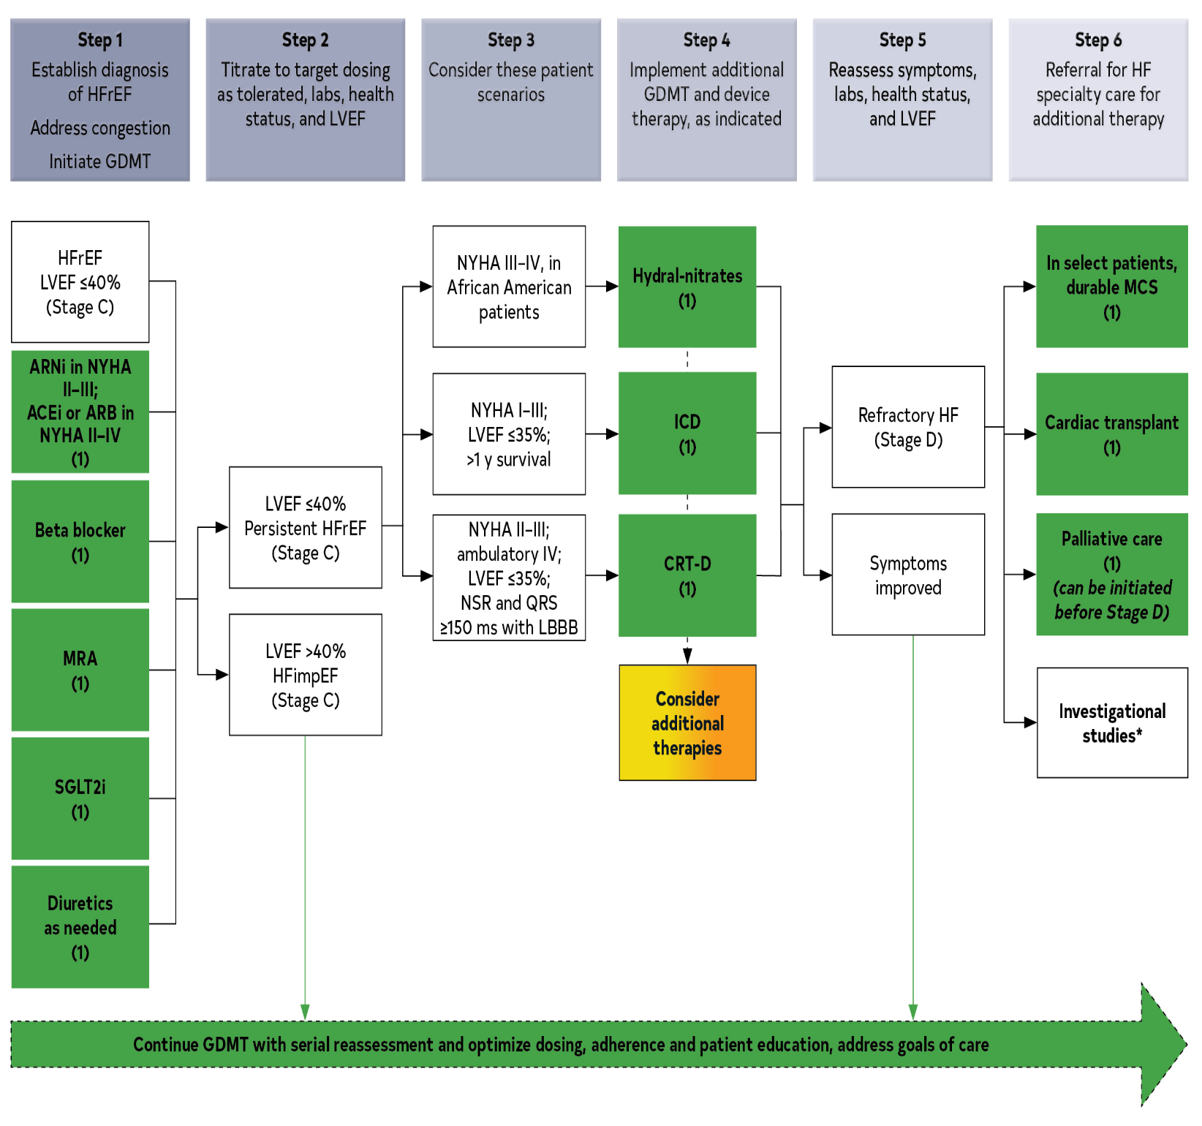
Figure 6. Treatment of HFrEF Stages C and D
Colors correspond to COR in Table 2.
Treatment recommendations for patients with HFrEF are displayed. Step 1 medications may be started simultaneously at initial (low) doses recommended for HFrEF. Alternatively, these medications may be started sequentially, with sequence guided by clinical or other factors, without need to achieve target dosing before initiating next medication. Medication doses should be increased to target as tolerated.

Slide 80
Other Drug Treatment
Recommendations for Other Drug Treatment Referenced studies that support the recommendations are summarized in the Online Data Supplements.
COR | LOE | Recommendations
2b | B-R | In patients with HF class II to IV symptoms, omega-3 polyunsaturated fatty acid (PUFA) supplementation may be reasonable to use as adjunctive therapy to reduce mortality and cardiovascular hospitalizations.

Slide 81
Other Drug Treatment (con’t.)
2b | B-R | In patients with HF who experience hyperkalemia (serum potassium level ≥5.5 mEq/L) while taking a renin-angiotensin-aldosterone system inhibitor (RAASi), the effectiveness of potassium binders (patiromer, sodium zirconium cyclosilicate) to improve outcomes by facilitating continuation of RAASi therapy is uncertain.
3: No Benefit | B-R | In patients with chronic HFrEF without a specific indication (e.g., venous thromboembolism [VTE], AF, a previous thromboembolic event, or a cardioembolic source), anticoagulation is not recommended.

Slide 82
Drugs of Unproven Value or That May Worsen HF
Recommendations for Drugs of Unproven Value or Drugs That May Worsen HF Referenced studies that support the recommendations are summarized in the Online Data Supplements.
COR | LOE | Recommendations
3: No Benefit | A | In patients with HFrEF, dihydropyridine calcium channel-blocking drugs are not recommended treatment for HF.
3: No Benefit | B-R | In patients with HFrEF, vitamins, nutritional supplements, and hormonal therapy are not recommended other than to correct specific deficiencies.
3: Harm | A | In patients with HFrEF, nondihydropyridine calcium channel-blocking drugs are not recommended.

Slide 83
Drugs of Unproven Value or That May Worsen HF (con’t.)
3: Harm | A | In patients with HFrEF, class IC antiarrhythmic medications and dronedarone may increase the risk of mortality.
3: Harm | A | In patients with HFrEF, thiazolidinediones increase the risk of worsening HF symptoms and hospitalizations.
3: Harm | B-R | In patients with type 2 diabetes and high cardiovascular risk, the dipeptidyl peptidase-4 (DPP-4) inhibitors saxagliptin and alogliptin increase the risk of HF hospitalization and should be avoided in patients with HF.
3: Harm | B-NR | In patients with HFrEF, NSAIDs worsen HF symptoms and should be avoided or withdrawn whenever possible.

Slide 84
Table 13. Selected Prescription Medications That May Cause or Exacerbate HF
Drug or Therapeutic Class | Associated With HF |  | Magnitude of HF Induction or Precipitation | Level of Evidence for HF Induction or Precipitation | Possible Mechanism(s) | Onset
 | Causes Direct Myocardial Toxicity | Exacerbates Underlying Myocardial Dysfunction
COX, nonselective inhibitors (NSAIDs) |  | X | Major | B | Prostaglandin inhibition leading to sodium and water retention, increased systemic vascular resistance, and blunted response to diuretics | Immediate
COX, selective inhibitors (COX-2 inhibitors) |  | X | Major | B
Thiazolidinediones |  | X | Major | A | Possible calcium channel blockade | Intermediate

Slide 85
Table 13. Selected Prescription Medications That May Cause or Exacerbate HF (con’t.)
Saxagliptin |  | X | Major | A | Unknown | Intermediate to delayed
Alogliptin |  | X | Major | A
Flecainide |  | X | Major | A | Negative inotrope, proarrhythmic effects | Immediate to intermediate
Disopyramide |  | X | Major | B
Sotalol |  | X | Major | A | Proarrhythmic properties, beta blockade | Immediate to intermediate
Dronedarone |  | X | Major | A | Negative inotrope
Alpha-1 blockers
Doxazosin |  | X | Moderate | B | Beta-1-receptor stimulation with increases in renin and aldosterone | Intermediate to delayed
Diltiazem |  | X | Major | B | Negative inotrope | Immediate to intermediate
Verapamil |  | X | Major | B
Nifedipine |  | X | Moderate | C | Negative inotrope | Immediate to intermediate
COX indicates cyclo-oxygenase; and HF, heart failure.

Slide 86
GDMT Dosing: Sequencing and Uptitration
Recommendations for GDMT Dosing: Sequencing and Uptitration Referenced studies that support the recommendations are summarized in the Online Data Supplements.
COR | LOE | Recommendations
1 | A | In patients with HFrEF, titration of guideline-directed medication dosing to achieve target doses showed to be efficacious in RCTs is recommended, to reduce cardiovascular mortality and HF hospitalizations, unless not well tolerated.
2a | C-EO | In patients with HFrEF, titration and optimization of guideline-directed medications as frequently as every 1 to 2 weeks depending on the patient’s symptoms, vital signs, and laboratory findings can be useful to optimize management.

Slide 87
Table 14. Drugs Commonly Used for HFrEF (Stage C HF)
Drug | Initial Daily Dose(s) | Target Doses(s) | Mean Doses Achieved in Clinical Trials | References
ACEi
Captopril | 6.25 mg 3 times daily | 50 mg 3 times daily | 122.7 mg total daily | (19)
Enalapril | 2.5 mg twice daily | 10–20 mg twice daily | 16.6 mg total daily | (3)
Fosinopril | 5–10 mg once daily | 40 mg once daily | NA | …
Lisinopril | 2.5–5 mg once daily | 20–40 mg once daily | 32.5–35.0 mg total daily | (17)
Perindopril | 2 mg once daily | 8–16 mg once daily | NA | …
Quinapril | 5 mg twice daily | 20 mg twice daily | NA | …
Ramipril | 1.25–2.5 mg once daily | 10 mg once daily | NA | …
Trandolapril | 1 mg once daily | 4 mg once daily | NA | …

Slide 88
Table 14. Drugs Commonly Used for HFrEF (Stage C HF)
(con’t.)
ARB
Candesartan | 4–8 mg once daily | 32 mg once daily | 24 mg total daily | (20)
Losartan | 25–50 mg once daily | 50–150 mg once daily | 129 mg total daily | (18)
Valsartan | 20–40 mg once daily | 160 mg twice daily | 254 mg total daily | (21)
ARNi
Sacubitril-valsartan | 49 mg sacubitril and 51 mg valsartan twice daily (therapy may be initiated at 24 mg sacubitril and 26 mg valsartan twice daily) | 97 mg sacubitril and 103 mg valsartan twice daily | 182 mg sacubitril and 193 mg valsartan total daily | (22)

Slide 89
Table 14. Drugs Commonly Used for HFrEF (Stage C HF)
(con’t.)
Beta blockers
Bisoprolol | 1.25 mg once daily | 10 mg once daily | 8.6 mg total daily | (1)
Carvedilol | 3.125 mg twice daily | 25–50 mg twice daily | 37 mg total daily | (23)
Carvedilol CR | 10 mg once daily | 80 mg once daily | NA | …
Metoprolol succinate extended release (metoprolol CR/XL) | 12.5–25 mg once daily | 200 mg once daily | 159 mg total daily | (11)
Mineralocorticoid receptor antagonists
Spironolactone | 12.5–25 mg once daily | 25–50 mg once daily | 26 mg total daily | (6)
Eplerenone | 25 mg once daily | 50 mg once daily | 42.6 mg total daily | (13)

Slide 90
Table 14. Drugs Commonly Used for HFrEF (Stage C HF)
(con’t.)
SGLT2i
Dapagliflozin | 10 mg once daily | 10 mg once daily | 9.8 mg total daily | (8)
Empagliflozin | 10 mg once daily | 10 mg once daily | NR | (9)
Isosorbide dinitrate and hydralazine
Fixed dose combination | 20 mg isosorbide dinitrate and 37.5 mg hydralazine 3 times daily | 40 mg isosorbide dinitrate and 75 mg hydralazine 3 times daily | 90 mg isosorbide dinitrate and ~175 mg hydralazine total daily | (10)
Isosorbide dinitrate and hydralazine | 20–30 mg isosorbide dinitrate and 25–50 mg hydralazine 3–4 times daily | 120 mg isosorbide dinitrate total daily in divided doses and 300 mg hydralazine total daily in divided doses | NA | (24)

Slide 91
Table 14. Drugs Commonly Used for HFrEF (Stage C HF)
(con’t.)
I_{f} Channel inhibitor
Ivabradine | 5 mg twice daily | 7.5 mg twice daily | 12.8 total daily | (25-27)
Soluble guanylate cyclase stimulator
Vericiguat | 2.5 mg once daily | 10 mg once daily | 9.2 mg total daily | (28)
Digoxin | 0.125–0.25 mg daily (modified according to monogram) | Individualized variable dose to achieve serum digoxin concentration 0.5–<0.9 ng/mL | NA | (29, 30)
ACE indicates angiotensin-converting enzyme; ARB, angiotensin receptor blocker; CR, controlled release; CR/XL, controlled release/extended release; HF, heart failure; HFrEF, heart failure with reduced ejection fraction; NA, not applicable; NR, not reported; and SGLT2i, sodium glucose cotransporter 2 inhibitor.

Slide 92
Table 15. Benefits of Evidence-Based Therapies for Patients With HFrEF
Evidence-Based Therapy | Relative Risk Reduction in All-Cause Mortality in Pivotal RCTs, % | NNT to Prevent All-Cause Mortality Over Time* | NNT for All-Cause Mortality (Standardized to 12 mo) | NNT for All- Cause Mortality (Standardized to 36 mo)
ACEi or ARB | 17 | 22 over 42 mo | 77 | 26
ARNi† | 16 | 36 over 27 mo | 80 | 27
Beta blocker | 34 | 28 over 12 mo | 28 | 9
Mineralocorticoid receptor antagonist | 30 | 9 over 24 mo | 18 | 6
SGLT2i | 17 | 43 over 18 mo | 63 | 22
Hydralazine or nitrate‡ | 43 | 25 over 10 mo | 21 | 7
CRT | 36 | 12 over 24 mo | 24 | 8
ICD | 23 | 14 over 60 mo | 70 | 23
ACEi indicates angiotensin-converting enzyme inhibitor; ARB, angiotensin receptor blocker; ARNi, angiotensin receptor neprilysin inhibitor; CRT, cardiac resynchronization therapy; ICD, implantable cardioverter-defibrillator; SGLT2i, sodium-glucose cotransporter-2 inhibitor; and NNT, number needed to treat.
*Median duration follow-up in the respective clinical trial.
†Benefit of ARNi therapy incremental to that achieved with ACEi therapy. For the other medications shown, the benefits are based on comparisons to placebo control.
‡Benefit of hydralazine-nitrate therapy was limited to African American patients in this trial.

Slide 93
Management of Stage C HF: Ivabradine
Recommendation for the Management of Stage C HF: Ivabradine Referenced studies that support the recommendation are summarized in the Online Data Supplements.
COR | LOE | Recommendation
2a | B-R | For patients with symptomatic (NYHA class II to III) stable chronic HFrEF (LVEF ≤35%) who are receiving GDMT, including a beta blocker at maximum tolerated dose, and who are in sinus rhythm with a heart rate of ≥70 bpm at rest, ivabradine can be beneficial to reduce HF hospitalizations and cardiovascular death.

Slide 94
Pharmacological Treatment for Stage C HFrEF (Digoxin)
Recommendation for the Pharmacological Treatment for Stage C HFrEF (Digoxin) Referenced studies that support the recommendation are summarized in the Online Data Supplements.
COR | LOE | Recommendation
2b | B-R | In patients with symptomatic HFrEF despite GDMT (or who are unable to tolerate GDMT), digoxin might be considered to decrease hospitalizations for HF.

Slide 95
Pharmacological Treatment for Stage C HFrEF: Soluble Guanylyl Cyclase Stimulators
Recommendation for Pharmacological Treatment for Stage C HFrEF: Soluble Guanylyl Cyclase Stimulators Referenced studies that support the recommendation are summarized in the Online Data Supplements.
COR | LOE | Recommendation
2b | B-R | In selected high-risk patients with HFrEF and recent worsening of HF already on GDMT, an oral soluble guanylate cyclase stimulator (vericiguat) may be considered to reduce HF hospitalization and cardiovascular death.

Slide 96
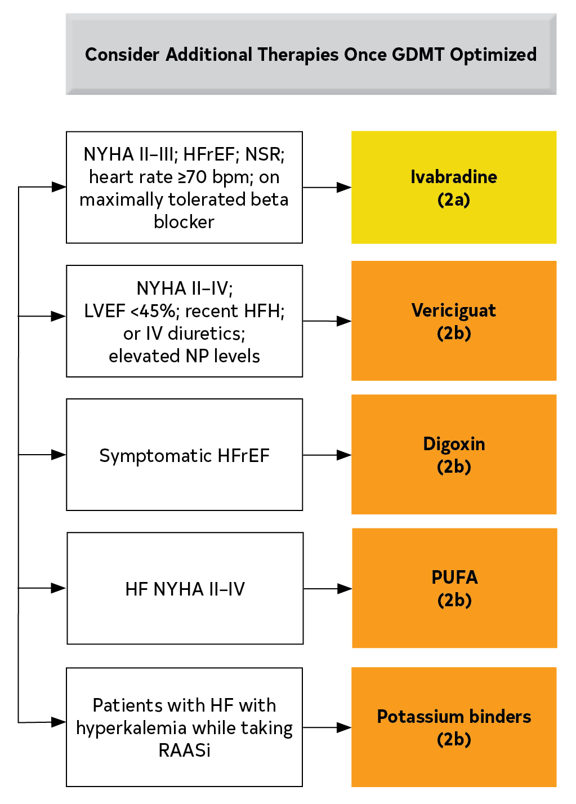
Figure 7. Additional Medical Therapies for Patients With HFrEF
Colors correspond to COR in Table 2
Recommendations for additional medical therapies that may be considered for patients with HF are shown.
GDMT indicates guideline-directed medical therapy; HF, heart failure; HFH, heart failure hospitalization; HFrEF, heart failure with reduced ejection fraction; IV, intravenous; LVEF, left ventricular ejection fraction; LVESD, left ventricular end systolic dimension; MV, mitral valve; MR, mitral regurgitation; NP, natriuretic peptide; NSR, normal sinus rhythm; and NYHA, New York Heart Association; RAASi, renin-angiotensin-aldosterone system inhibitors.

Slide 97
ICDs and CRTs
Recommendations for ICDs and CRTs Referenced studies that support the recommendations are summarized in the Online Data Supplements.
COR | LOE | Recommendations
1 | A | In patients with nonischemic DCM or ischemic heart disease at least 40 days post-MI with LVEF ≤35% and NYHA class II or III symptoms on chronic GDMT, who have reasonable expectation of meaningful survival for >1 year, ICD therapy is recommended for primary prevention of SCD to reduce total mortality.
Value Statement: High Value (A) |  | A transvenous ICD provides high economic value in the primary prevention of SCD particularly when the patient’s risk of death caused by ventricular arrythmia is deemed high and the risk of nonarrhythmic death (either cardiac or noncardiac) is deemed low based on the patient’s burden of comorbidities and functional status.

Slide 98
ICDs and CRTs (con’t.)
1 | B-R | In patients at least 40 days post-MI with LVEF ≤30% and NYHA class I symptoms while receiving GDMT, who have reasonable expectation of meaningful survival for >1 year, ICD therapy is recommended for primary prevention of SCD to reduce total mortality.
1 | B-R | For patients who have LVEF ≤35%, sinus rhythm, left bundle branch block (LBBB) with a QRS duration ≥150 ms, and NYHA class II, III, or ambulatory IV symptoms on GDMT, CRT is indicated to reduce total mortality, reduce hospitalizations, and improve symptoms and QOL.
Value Statement: High Value (B-NR) |  | For patients who have LVEF ≤35%, sinus rhythm, LBBB with a QRS duration of ≥150 ms, and NYHA class II, III, or ambulatory IV symptoms on GDMT, CRT implantation provides high economic value.

Slide 99
ICDs and CRTs (con’t.)
2a | B-R | For patients who have LVEF ≤35%, sinus rhythm, a non-LBBB pattern with a QRS duration ≥150 ms, and NYHA class II, III, or ambulatory class IV symptoms on GDMT, CRT can be useful to reduce total mortality, reduce hospitalizations, and improve symptoms and QOL.
2a | B-R | In patients with high-degree or complete heart block and LVEF of 36% to 50%, CRT is reasonable to reduce total mortality, reduce hospitalizations, and improve symptoms and QOL.
2a | B-NR | In patients with AF and LVEF ≤35% on GDMT, CRT can be useful to reduce total mortality, improve symptoms and QOL, and increase LVEF, if: a) the patient requires ventricular pacing or otherwise meets CRT criteria and b) atrioventricular nodal ablation or pharmacological rate control will allow near 100% ventricular pacing with CRT.

Slide 100
ICDs and CRTs (con’t.)
2a | B-NR | For patients on GDMT who have LVEF ≤35% and are undergoing placement of a new or replacement device implantation with anticipated requirement for significant (>40%) ventricular pacing, CRT can be useful to reduce total mortality, reduce hospitalizations, and improve symptoms and QOL.
2a | B-NR | For patients who have LVEF ≤35%, sinus rhythm, LBBB with a QRS duration of 120 to 149 ms, and NYHA class II, III, or ambulatory IV symptoms on GDMT, CRT can be useful to reduce total mortality, reduce hospitalizations, and improve symptoms and QOL.
2a | B-NR | In patients with genetic arrhythmogenic cardiomyopathy with high-risk features of sudden death, with EF ≤45%, implantation of ICD is reasonable to decrease sudden death.

Slide 101
ICDs and CRTs (con’t.)
2b | B-NR | For patients who have LVEF ≤35%, sinus rhythm, a non-LBBB pattern with QRS duration of 120 to 149 ms, and NYHA class III or ambulatory class IV on GDMT, CRT may be considered to reduce total mortality, reduce hospitalizations, and improve symptoms and QOL.
2b | B-NR | For patients who have LVEF ≤30%, ischemic cause of HF, sinus rhythm, LBBB with a QRS duration ≥150 ms, and NYHA class I symptoms on GDMT, CRT may be considered to reduce hospitalizations and improve symptoms and QOL.
3: No Benefit | B-R | In patients with QRS duration <120 ms, CRT is not recommended.

Slide 102
ICDs and CRTs (con’t.)
3: No Benefit | B-NR | For patients with NYHA class I or II symptoms and non-LBBB pattern with QRS duration <150 ms, CRT is not recommended (16-21, 28-33).
3: No Benefit | C-LD | For patients whose comorbidities or frailty limit survival with good functional capacity to <1 year, ICD and cardiac resynchronization therapy with defibrillation (CRT-D) are not indicated (1-9, 16-21).

Slide 103
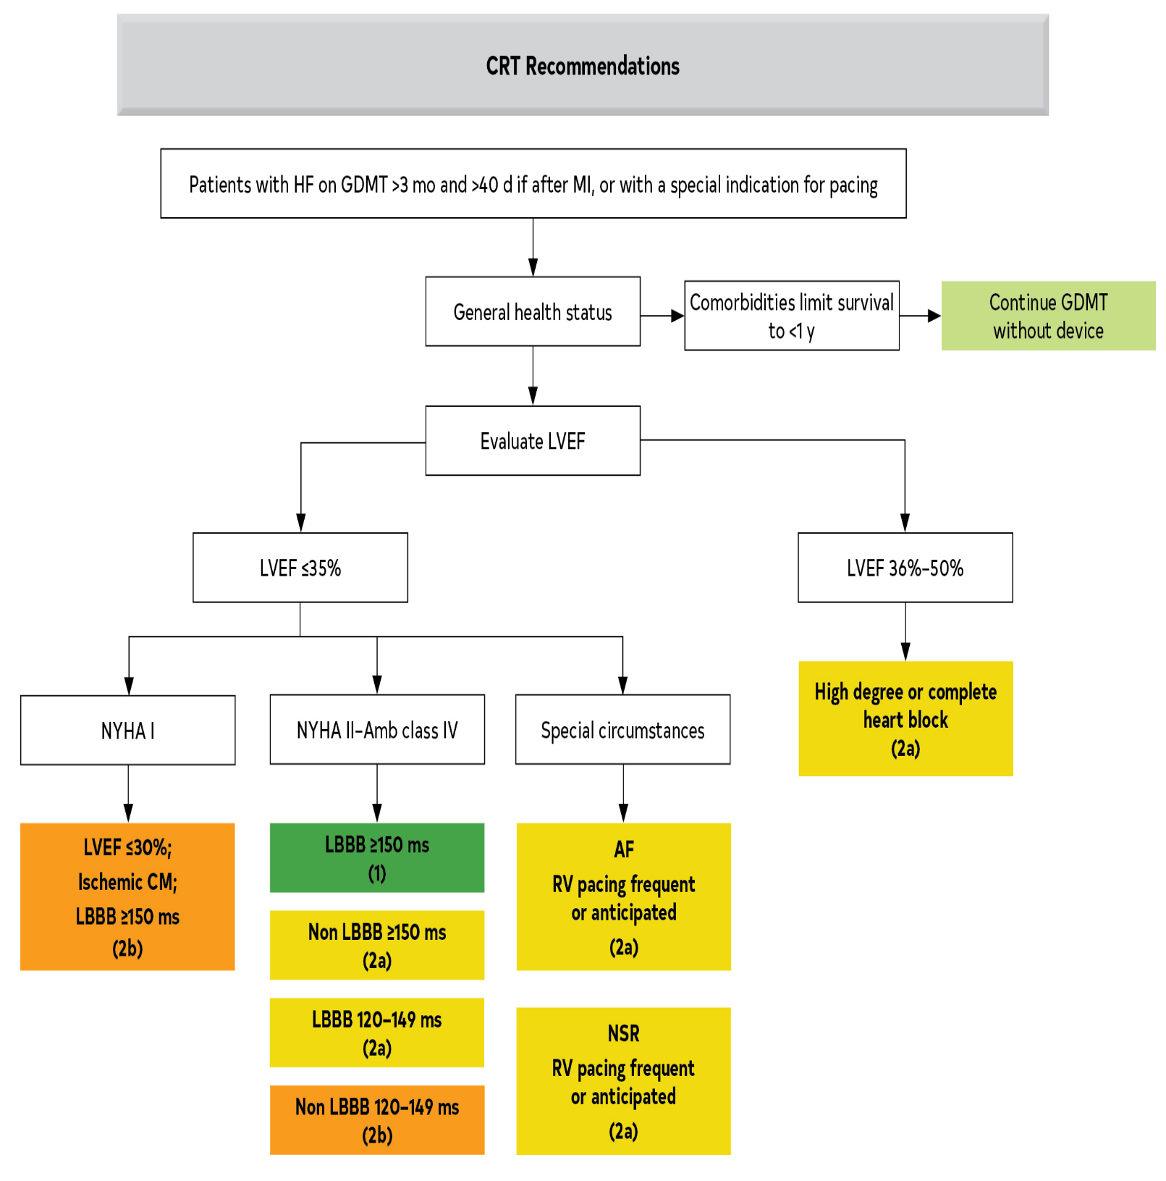
Figure 8. Algorithm for CRT Indications in Patients With Cardiomyopathy or HFrEF
Colors correspond to COR in Table 2.
Recommendations for cardiac resynchronization therapy (CRT) are displayed.
AF indicates atrial fibrillation; Amb, ambulatory; CM, cardiomyopathy; GDMT, guideline-directed medical therapy; HB, heart block; HF, heart failure; HFrEF, heart failure with reduced ejection fraction; LBBB, left bundle branch block; LV, left ventricular; LVEF, left ventricular ejection fraction; NSR, normal sinus rhythm; NYHA, New York Heart Association; and RV, right ventricular.

Slide 104
Revascularization for CAD
Recommendation for Revascularization for CAD Referenced studies that support the recommendation are summarized in the Online Data Supplements.
COR | LOE | Recommendation
1 | B-R | In selected patients with HF, reduced EF (EF ≤35%), and suitable coronary anatomy, surgical revascularization plus GDMT is beneficial to improve symptoms, cardiovascular hospitalizations, and long-term all-cause mortality.

Slide 105
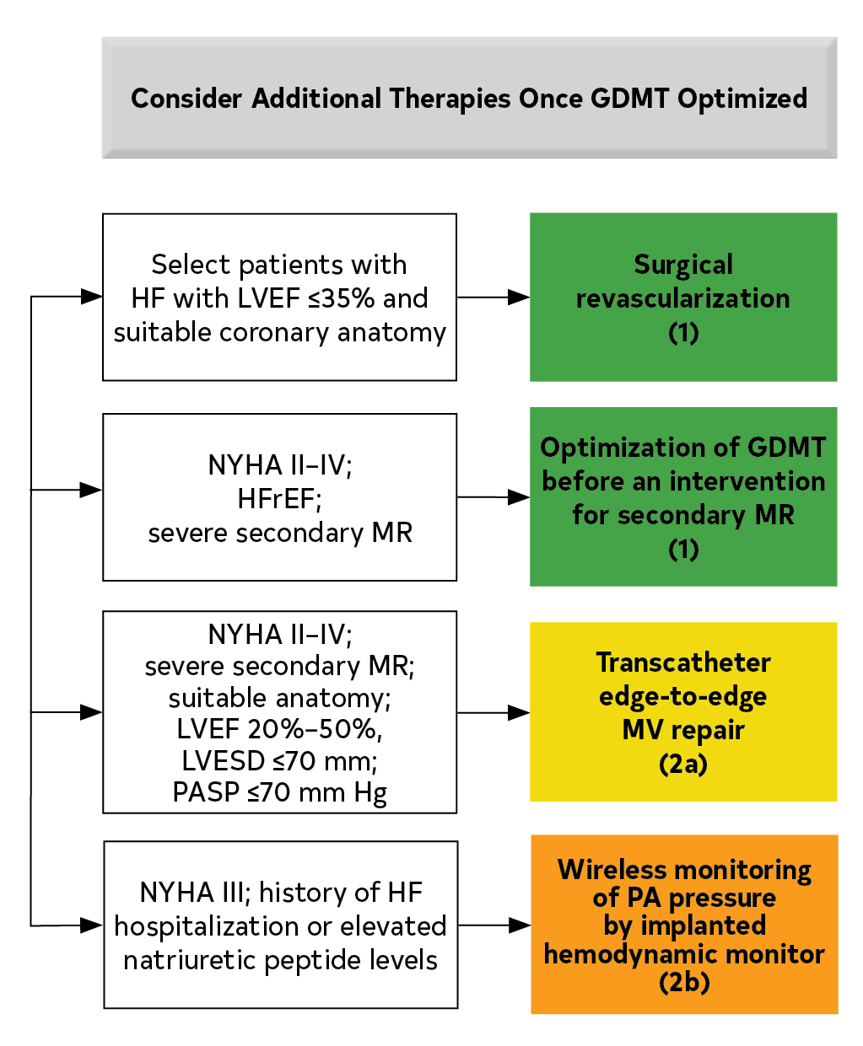
Figure 9. Additional Device Therapies
Colors correspond to COR in Table 2.
Recommendations for additional nonpharmaceutical interventions that may be considered for patients with HF are shown.
GDMT indicates guideline-directed medical therapy; HF, heart failure; HFH, heart failure hospitalization; HFrEF, heart failure with reduced ejection fraction; IV, intravenous; LVEF, left ventricular ejection fraction; LVESD, left ventricular end systolic dimension; MV, mitral valve; MR, mitral regurgitation; NP, natriuretic peptide; NSR, normal sinus rhythm; NYHA, New York Heart Association; and PASP, pulmonary artery systolic pressure.

Slide 106
Valvular Heart Disease
Recommendations for Valvular Heart Disease Referenced studies that support the recommendations are summarized in the Online Data Supplements.
COR | LOE | Recommendations
1 | B-R | In patients with HF, VHD should be managed in a multidisciplinary manner in accordance with clinical practice guidelines for VHD to prevent worsening of HF and adverse clinical outcomes.
1 | C-LD | In patients with chronic severe secondary MR and HFrEF, optimization of GDMT is recommended before any intervention for secondary MR related to LV dysfunction.

Slide 107
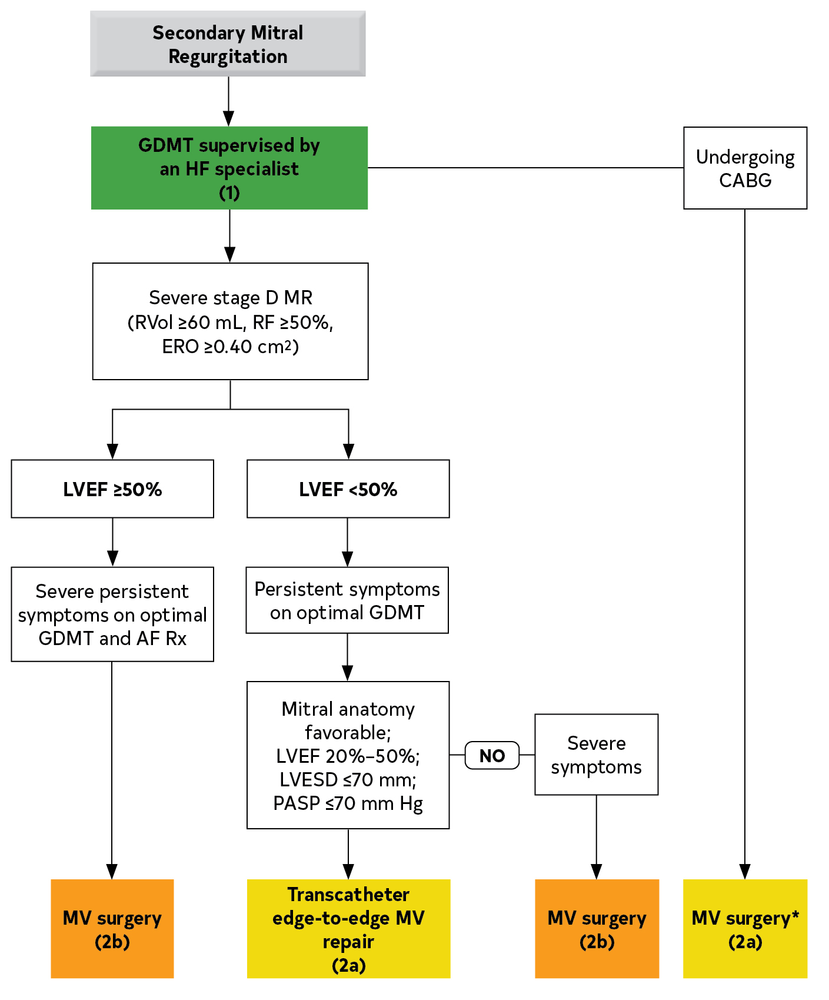
Figure 10. Treatment Approach in Secondary Mitral Regurgitation
Colors correspond to Table 2

Slide 108
HF With Mildly Reduced Ejection Fraction
Recommendations for HF With Mildly Reduced Ejection Fraction Referenced studies that support the recommendations are summarized in the Online Data Supplements.
COR | LOE | Recommendations
2a | B-R | In patients with HFmrEF, SGLT2i can be beneficial in decreasing HF hospitalizations and cardiovascular mortality.
2b | B-NR | Among patients with current or previous symptomatic HFmrEF (LVEF 41%–49%), use of evidence-based beta blockers for HFrEF, ARNi, ACEi or ARB, and MRAs may be considered to reduce the risk of HF hospitalization and cardiovascular mortality, particularly among patients with LVEF on the lower end of this spectrum.

Slide 109
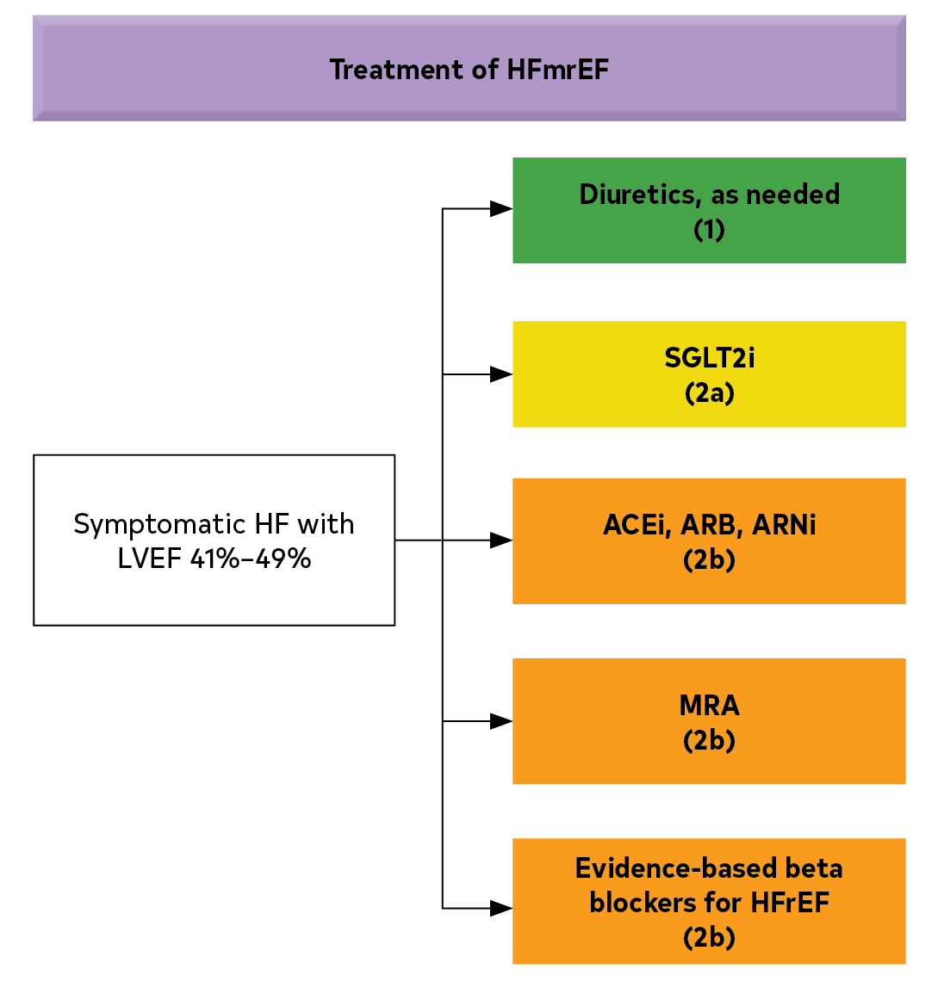
Figure 11. Recommendations for Patients With Mildly Reduced LVEF (41%–49%)
Colors correspond to COR in Table 2.
Medication recommendations for HFmrEF are displayed.
ACEi indicates angiotensin-converting enzyme inhibitor; ARB, angiotensin receptor blocker; ARNi, angiotensin receptor-neprilysin inhibitor; HRmrEF, heart failure with mildly reduced ejection fraction; HFrEF, heart failure with reduced ejection fraction; LVEF, left ventricular ejection fraction; MRA, mineralocorticoid receptor antagonist; and SGLT2i, sodium- glucose cotransporter 2 inhibitor.

Slide 110
HF With Improved Ejection Fraction
Recommendation for HF With Improved Ejection Fraction Referenced studies that support the recommendation are summarized in the Online Data Supplements.
COR | LOE | Recommendation
1 | B-R | In HFimpEF after treatment, GDMT should be continued to prevent relapse of HF and LV dysfunction, even in patients who may become asymptomatic.

Slide 111
HF With Preserved Ejection Fraction
Recommendations for HF With Preserved Ejection Fraction* Referenced studies that support the recommendations are summarized in the Online Data Supplements.
COR | LOE | Recommendations
1 | C-LD | Patients with HFpEF and hypertension should have medication titrated to attain blood pressure targets in accordance with published clinical practice guidelines to prevent morbidity.
2a | B-R | In patients with HFpEF, SGLT2i can be beneficial in decreasing HF hospitalizations and cardiovascular mortality.
2a | C-EO | In patients with HFpEF, management of AF can be useful to improve symptoms.

Slide 112
HF With Preserved Ejection Fraction (con’t.)
2b | B-R | In selected patients with HFpEF, MRAs may be considered to decrease hospitalizations, particularly among patients with LVEF on the lower end of this spectrum.
2b | B-R | In selected patients with HFpEF, the use of ARB may be considered to decrease hospitalizations, particularly among patients with LVEF on the lower end of this spectrum.
2b | B-R | In selected patients with HFpEF, ARNi may be considered to decrease hospitalizations, particularly among patients with LVEF on the lower end of this spectrum.
3: No-Benefit | B-R | In patients with HFpEF, routine use of nitrates or phosphodiesterase-5 inhibitors to increase activity or QOL is ineffective.

Slide 113
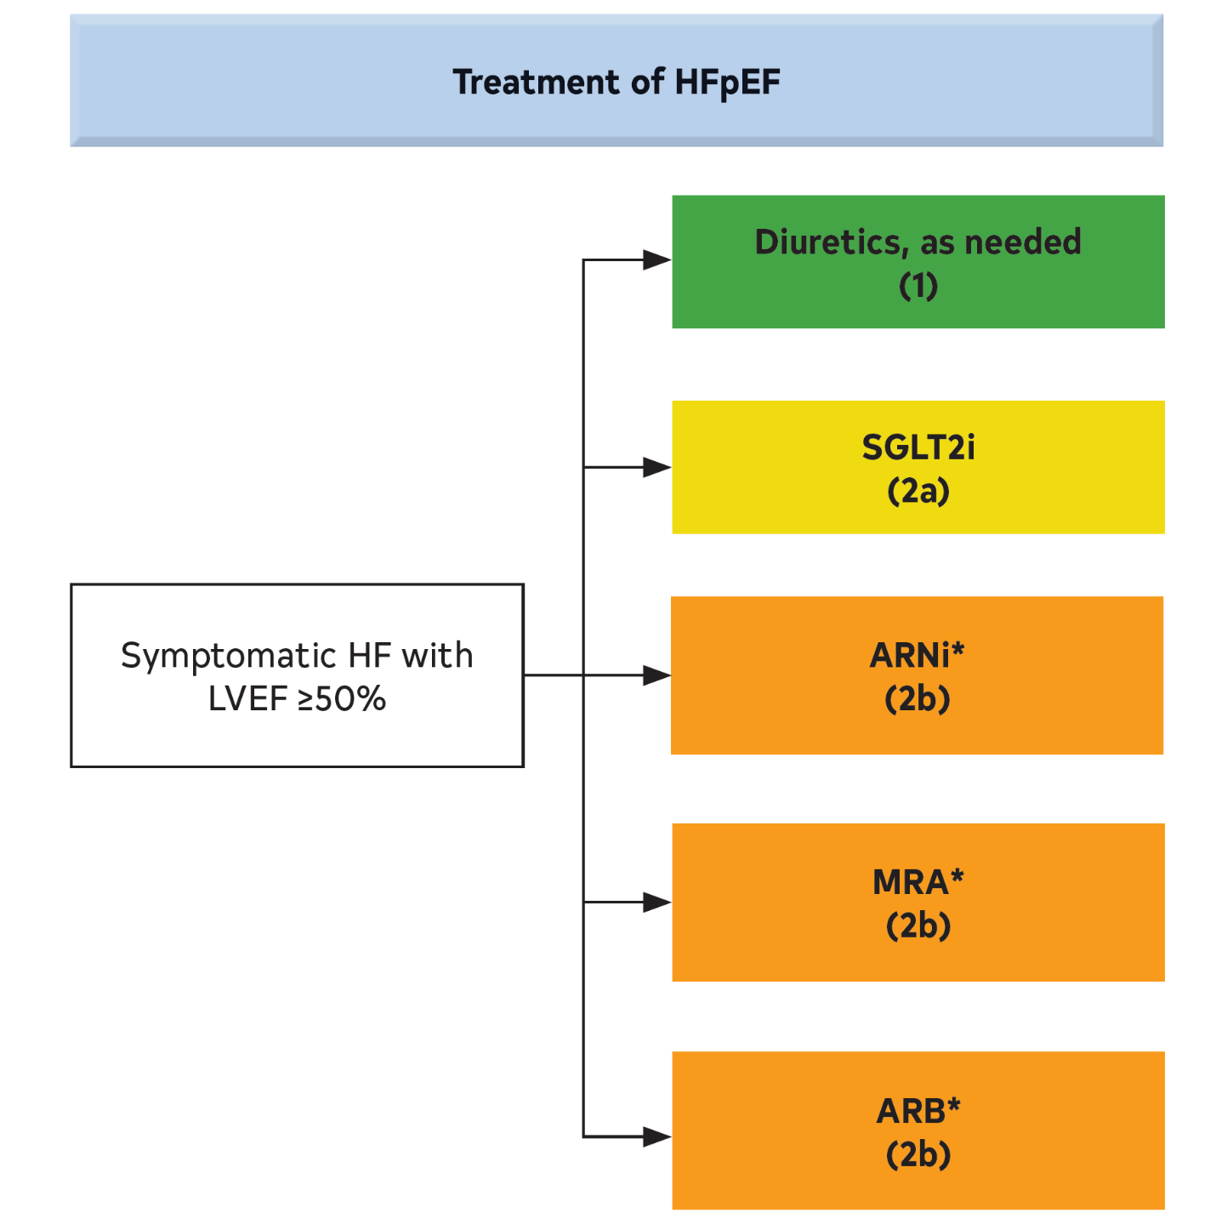
Figure 12. Recommendations for Patients With Preserved LVEF (≥50%)
Colors correspond to COR in Table 2.
Medication recommendations for HFpEF are displayed.
*Greater benefit in patients with LVEF closer to 50%.
ARB indicates angiotensin receptor blocker; ARNi, angiotensin receptor-neprilysin inhibitor; HF, heart failure; HFpEF, heart failure with preserved ejection fraction; LVEF, left ventricular ejection fraction; MRA, mineralocorticoid receptor antagonist; and SGLT2i, sodium-glucose cotransporter 2 inhibitor.

Slide 114
Diagnosis of Cardiac Amyloidosis
Recommendations for Diagnosis of Cardiac Amyloidosis Referenced studies that support the recommendations are summarized in the Online Data Supplements.
COR | LOE | Recommendations
1 | B-NR | Patients for whom there is a clinical suspicion for cardiac amyloidosis* should have screening for serum and urine monoclonal light chains with serum and urine immunofixation electrophoresis and serum free light chains.
1 | B-NR | In patients with high clinical suspicion for cardiac amyloidosis, without evidence of serum or urine monoclonal light chains, bone scintigraphy should be performed to confirm the presence of transthyretin cardiac amyloidosis.
1 | B-NR | In patients for whom a diagnosis of transthyretin cardiac amyloidosis is made, genetic testing with TTR gene sequencing is recommended to differentiate hereditary variant from wild-type transthyretin cardiac amyloidosis.
*LV wall thickness ≥14 mm in conjunction with fatigue, dyspnea, or edema, especially in the context of discordance between wall thickness on echocardiogram and QRS voltage on ECG, and in the context of aortic stenosis, HFpEF, carpal tunnel syndrome, spinal stenosis, and autonomic or sensory polyneuropathy.

Slide 115
Treatment of Cardiac Amyloidosis
Recommendations for Treatment of Cardiac Amyloidosis Referenced studies that support the recommendations are summarized in the Online Data Supplements.
COR | LOE | Recommendations
1 | B-R | In select patients with wild-type or variant transthyretin cardiac amyloidosis and NYHA class I to III HF symptoms, transthyretin tetramer stabilizer therapy (tafamidis) is indicated to reduce cardiovascular morbidity and mortality.
Value Statement: Low Value (B-NR) |  | At 2020 list prices, tafamidis provides low economic value (>$180,000 per QALY gained) in patients with HF with wild-type or variant transthyretin cardiac amyloidosis.
2a | C-LD | In patients with cardiac amyloidosis and AF, anticoagulation is reasonable to reduce the risk of stroke regardless of the CHA₂DS₂-VASc (congestive heart failure, hypertension, age ≥75 years, diabetes mellitus, stroke or transient ischemic attack [TIA], vascular disease, age 65 to 74 years, sex category) score .

Slide 116
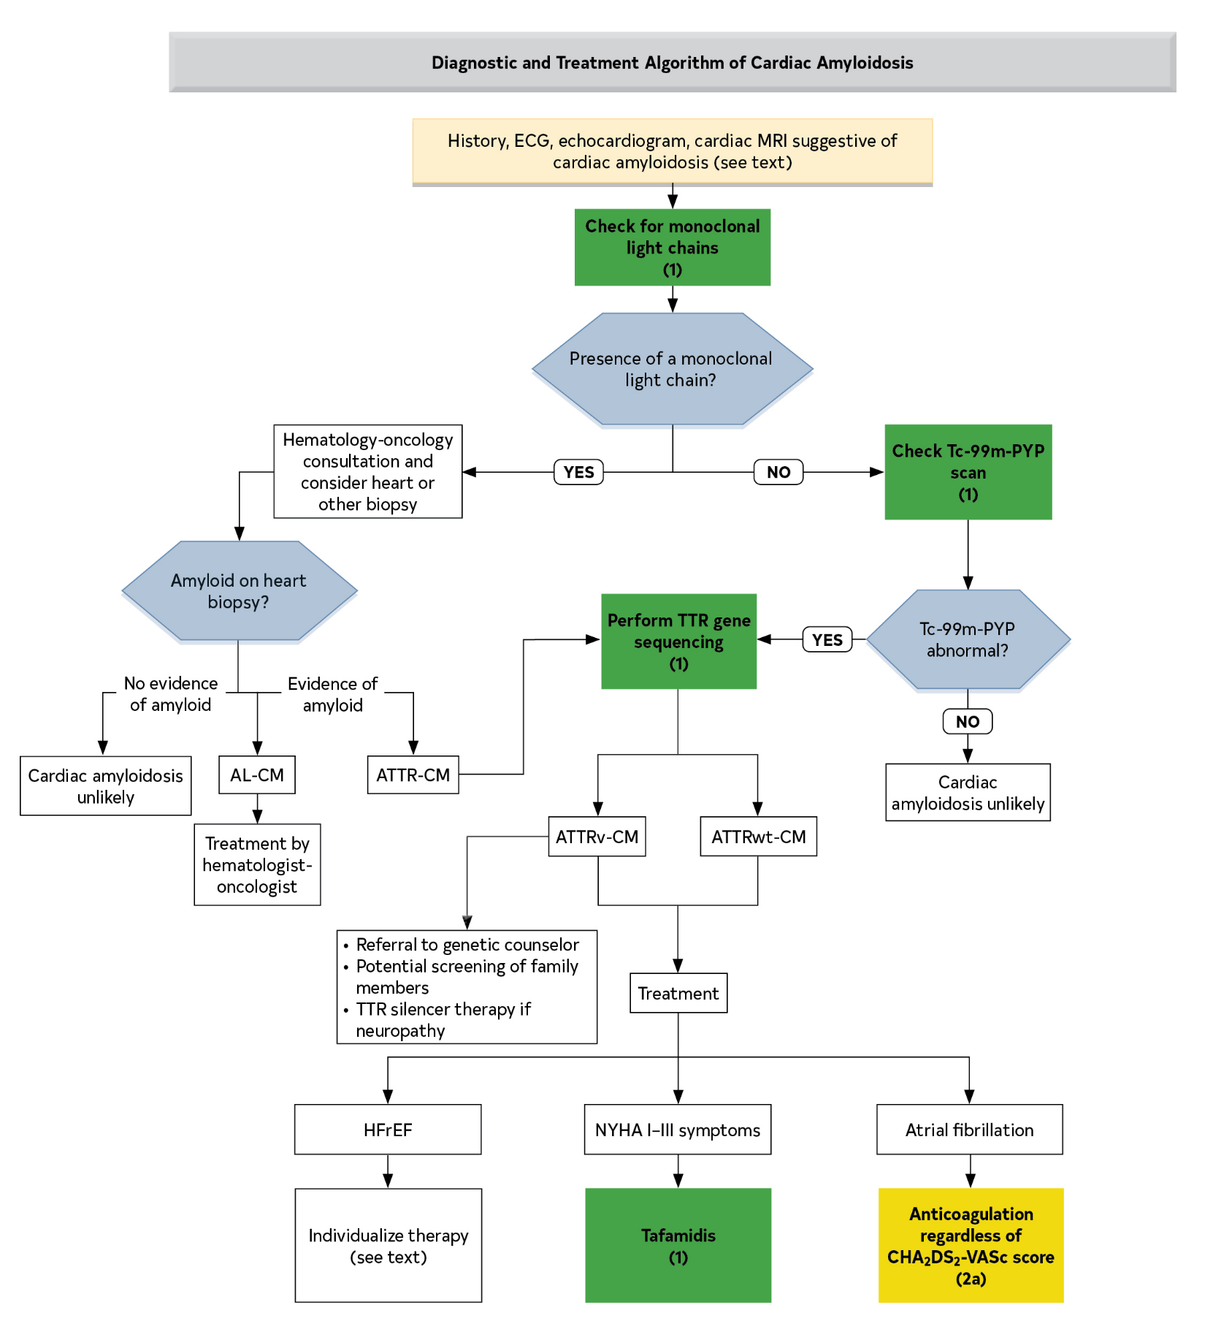
Figure 13. Diagnostic and Treatment of Transthyretin Cardiac Amyloidosis Algorithm
Colors correspond to COR in Table 2.
AF indicates atrial fibrillation; AL-CM, AL amyloid cardiomyopathy; ATTR-CM, transthyretin amyloid cardiomyopathy; ATTRv, variant transthyretin amyloidosis; ATTRwt, wild-type transthyretin amyloidosis; CHA2DS2-VASc, congestive heart failure, hypertension, age ≥75 years, diabetes mellitus, stroke or transient ischemic attack (TIA), vascular disease, age 65 to 74 years, sex category; ECG, electrocardiogram; H/CL, heart to contralateral chest; HFrEF, heart failure with reduced ejection fraction; IFE, immunofixation electrophoresis; MRI, magnetic resonance imaging; NYHA, New York Heart Association; PYP, pyrophosphate; Tc, technetium; and TTR, transthyretin.

Slide 117
Stage D (Advanced) HF

Slide 118
Specialty Referral for Advanced HF
Recommendation for Specialty Referral for Advanced HF
COR | LOE | Recommendation
1 | C-LD | In patients with advanced HF, when consistent with the patient’s goals of care, timely referral for HF specialty care is recommended to review HF management and assess suitability for advanced HF therapies (e.g., LVAD, cardiac transplantation, palliative care, and palliative inotropes).

Slide 119
Table 16. ESC Definition of Advanced HF
All of these criteria must be present despite optimal guideline-directed treatment:
 | Severe and persistent symptoms of HF (NYHA class III [advanced] or IV)
 | Severe cardiac dysfunction defined by ≥1 of these:
 |  | LVEF ≤30%
 |  | Isolated RV failure
 |  | Nonoperable severe valve abnormalities
 |  | Nonoperable severe congenital heart disease
 |  | EF ≥40%, elevated natriuretic peptide levels and evidence of significant diastolic dysfunction

Slide 120
Table 16. ESC Definition of Advanced HF (con’t.)
 | Hospitalizations or unplanned visits in the past 12 mo for episodes of:
 |  | Congestion requiring high-dose intravenous diuretics or diuretic combinations
 |  | Low output requiring inotropes or vasoactive medications
 |  | Malignant arrhythmias
 | Severe impairment of exercise capacity with inability to exercise or low 6-minute walk test distance (<300 m) or peak VO₂ (<12–14 mL/kg/min) estimated to be of cardiac origin
Criteria 1 and 4 can be met in patients with cardiac dysfunction (as described in criterion 2) but who also have substantial limitations as a result of other conditions (e.g., severe pulmonary disease, noncardiac cirrhosis, renal disease). The therapeutic options for these patients may be more limited.
EF indicates ejection fraction; ESC, European Society of Cardiology; HF, heart failure; LVEF, left ventricular ejection fraction; NYHA, New York Heart Association; RV, right ventricular; and VO2, oxygen consumption/oxygen uptake.
Adapted from Crespo-Leiro et al.

Slide 121
Table 17. INTERMACS Profiles
Profile∗ | Profile Description | Features
1 | Critical cardiogenic shock | Life-threatening hypotension and rapidly escalating inotropic/pressor support, with critical organ hypoperfusion often confirmed by worsening acidosis and lactate levels.
2 | Progressive decline | “Dependent” on inotropic support but nonetheless shows signs of continuing deterioration in nutrition, renal function, fluid retention, or other major status indicator. Can also apply to a patient with refractory volume overload, perhaps with evidence of impaired perfusion, in whom inotropic infusions cannot be maintained because of tachyarrhythmias, clinical ischemia, or other intolerance.

Slide 122
Table 17. INTERMACS Profiles (con’t.)
3 | Stable but inotrope dependent | Clinically stable on mild-moderate doses of intravenous inotropes (or has a temporary circulatory support device) after repeated documentation of failure to wean without symptomatic hypotension, worsening symptoms, or progressive organ dysfunction (usually renal).
4 | Resting symptoms on oral therapy at home | Patient who is at home on oral therapy but frequently has symptoms of congestion at rest or with activities of daily living (dressing or bathing). He or she may have orthopnea, shortness of breath during dressing or bathing, gastrointestinal symptoms (abdominal discomfort, nausea, poor appetite), disabling ascites, or severe lower extremity edema.
5 | Exertion intolerant | Patient who is comfortable at rest but unable to engage in any activity, living predominantly within the house or housebound.

Slide 123
Table 17. INTERMACS Profiles (con’t.)
6 | Exertion limited | Patient who is comfortable at rest without evidence of fluid overload but who is able to do some mild activity. Activities of daily living are comfortable, and minor activities outside the home such as visiting friends or going to a restaurant can be performed, but fatigue results within a few minutes or with any meaningful physical exertion.
7 | Advanced NYHA class III | Patient who is clinically stable with a reasonable level of comfortable activity, despite a history of previous decompensation that is not recent. This patient is usually able to walk more than a block. Any decompensation requiring intravenous diuretics or hospitalization within the previous month should make this person a Patient Profile 6 or lower.

Slide 124
Table 17. INTERMACS Profiles (con’t.)
ICD indicates implantable cardioverter-defibrillator; INTERMACS, Interagency Registry for Mechanically Assisted Circulatory Support; and NYHA, New York Heart Association.

Slide 125
Table 18. Clinical Indicators of Advanced HF
Repeated hospitalizations or emergency department visits for HF in the past 12 mo.
Need for intravenous inotropic therapy.
Persistent NYHA functional class III to IV symptoms despite therapy.
Severely reduced exercise capacity (peak VO₂, <14 mL/kg/min or <50% predicted, 6-minute walk test distance <300 m, or inability to walk 1 block on level ground because of dyspnea or fatigue).
Intolerance to RAAS inhibitors because of hypotension or worsening renal function.
Intolerance to beta blockers as a result of worsening HF or hypotension.
Recent need to escalate diuretics to maintain volume status, often reaching daily furosemide equivalent dose >160 mg/d or use of supplemental metolazone therapy.

Slide 126
Table 18. Clinical Indicators of Advanced HF
(con’t.)
Refractory clinical congestion.
Progressive deterioration in renal or hepatic function.
Worsening right HF or secondary pulmonary hypertension.
Frequent SBP ≤90 mm Hg.
Cardiac cachexia.
Persistent hyponatremia (serum sodium, <134 mEq/L).
Refractory or recurrent ventricular arrhythmias; frequent ICD shocks.
Increased predicted 1-year mortality (e.g., >20%) according to HF survival models (e.g., MAGGIC, SHFM).
HF indicates heart failure; ICD, implantable cardioverter-defibrillator; MAGGIC, Meta-analysis Global Group in Chronic Heart Failure; NYHA, New York Heart Association; RAAS, renin-angiotensin-aldosterone system; SBP, systolic blood pressure; SHFM, Seattle Heart Failure model; and VO2, oxygen consumption/oxygen uptake.

Slide 127
Table 19. Indications and Contraindications to Durable Mechanical Support
Indications (combination of these):
Frequent hospitalizations for HF
NYHA class IIIb to IV functional limitations despite maximal therapy
Intolerance of neurohormonal antagonists
Increasing diuretic requirement
Symptomatic despite CRT
Inotrope dependence
Low peak Vo₂ (<14–16)
End-organ dysfunction attributable to low cardiac output

Slide 128
Table 19. Indications and Contraindications to Durable Mechanical Support (con’t.)
Contraindications:
Absolute
Irreversible hepatic disease
Irreversible renal disease
Irreversible neurological disease
Medical nonadherence
Severe psychosocial limitations

Slide 129
Relative
Age >80 y for destination therapy
Obesity or malnutrition
Musculoskeletal disease that impairs rehabilitation
Active systemic infection or prolonged intubation
Untreated malignancy
Severe PVD
Active substance abuse
Impaired cognitive function
Unmanaged psychiatric disorder
Lack of social support
Table 19. Indications and Contraindications to Durable Mechanical Support (con’t.)
CRT indicates cardiac resynchronization therapy; HF, heart failure; NYHA, New York Heart Association; VO2, oxygen consumption; and PVD, peripheral vascular disease.

Slide 130
Nonpharmacological Management: Advanced HF
Recommendation for Nonpharmacological Management: Advanced HF
COR | LOE | Recommendation
2b | C-LD | For patients with advanced HF and hyponatremia, the benefit of fluid restriction to reduce congestive symptoms is uncertain.

Slide 131
Inotropic Support
Recommendations for Inotropic Support Referenced studies that support the recommendations are summarized in the Online Data Supplements.
COR | LOE | Recommendations
2a | B-NR | In patients with advanced (stage D) HF refractory to GDMT and device therapy who are eligible for and awaiting MCS or cardiac transplantation, continuous intravenous inotropic support is reasonable as “bridge therapy”.
2b | B-NR | In select patients with stage D HF, despite optimal GDMT and device therapy who are ineligible for either MCS or cardiac transplantation, continuous intravenous inotropic support may be considered as palliative therapy for symptom control and improvement in functional status.
3: Harm | B-R | In patients with HF, long-term use of either continuous or intermittent intravenous inotropic agents, for reasons other than palliative care or as a bridge to advanced therapies, is potentially harmful.

Slide 132
Table 20. Intravenous Inotropic Agents Used in the Management of HF
Inotropic Agent | Dose (mcg/kg) |  | Drug Kinetics and Metabolism | Effects |  |  |  | Adverse Effects | Special Considerations
 | Bolus | Infusion (/min) |  | CO | HR | SVR | PVR
Adrenergic agonists
Dopamine | NA | 5–10 | t_{1/2}: 2–20 min R, H, P | ↑ | ↑ | ↔ | ↔ | T, HA, N, tissue necrosis | Caution: MAO-I
 | NA | 10–15 | R, H, P | ↑ | ↑ | ↑ | ↔
Dobutamine | NA | 2.5–20 | t_{1/2}: 2–3 min H | ↑ | ↑ | ↔ | ↔ | ↑/↓BP, HA, T, N, F, hypersensitivity | Caution: MAO-I; CI: sulfite allergy

Slide 133
Table 20. Intravenous Inotropic Agents Used in the Management of HF (con’t.)
PDE 3 inhibitor
Milrinone | NR | 0.125–0.75 | t_{1/2}: 2.5 h H | ↑ | ↑ | ↓ | ↓ | T, ↓BP | Accumulation may occur in setting of renal failure; monitor kidney function and LFTs

Slide 134
Table 20. Intravenous Inotropic Agents Used in the Management of HF (con’t.)
Vasopressors
Epinephrine | NR | 5–15 mcg/min | t_{1/2}: 2–3 min | ↑ | ↑ | ↑ (↓) | ↔ | HA, T | Caution: MAO-I
 |  | 15–20 mcg/min | t_{1/2}: 2–3 min | ↑ | ↑↑ | ↑↑ | ↔ | HA, T, | Caution: MAO-I
Norepinephrine | NR | 0.5–30 mcg/min | t_{1/2}: 2.5 min | ↔ | ↑ | ↑↑ | ↔ | ↓ HR, tissue necrosis | Caution: MAO-I
BP indicates blood pressure; CI, contraindication; CO, cardiac output; F, fever; H, hepatic; HA, headache; HF, heart failure; HR, heart rate; LFT, liver function test; MAO-I, monoamine oxidase inhibitor; N, nausea; NA, not applicable; NR, not recommended; P, plasma; PDE, phosphodiesterase; PVR, pulmonary vascular resistance; R, renal; SVR, systemic vascular resistance; T, tachyarrhythmias; and t1/2, elimination half-life.
Up arrow means increase.
Side arrow means no change.
Down arrow means decrease.
Up/down arrow means either increase or decrease.

Slide 135
Mechanical Circulatory Support
Recommendations for Mechanical Circulatory Support Referenced studies that support the recommendations are summarized in the Online Data Supplements.
COR | LOE | Recommendations
1 | A | In select patients with advanced HFrEF with NYHA class IV symptoms who are deemed to be dependent on continuous intravenous inotropes or temporary MCS, durable LVAD implantation is effective to improve functional status, QOL, and survival.
2a | B-R | In select patients with advanced HFrEF who have NYHA class IV symptoms despite GDMT, durable MCS can be beneficial to improve symptoms, improve functional class, and reduce mortality.

Slide 136
Mechanical Circulatory Support
Value Statement: Uncertain Value (B-NR) |  | In patients with advanced HFrEF who have NYHA class IV symptoms despite GDMT, durable MCS devices provide low to intermediate economic value based on current costs and outcomes.
2a | B-NR | In patients with advanced HFrEF and hemodynamic compromise and shock, temporary MCS, including percutaneous and extracorporeal ventricular assist devices, are reasonable as a “bridge to recovery” or “bridge to decision”.

Slide 137
Cardiac Transplantation
Recommendation for Cardiac Transplantation
COR | LOE | Recommendation
1 | C-LD | For selected patients with advanced HF despite GDMT, cardiac transplantation is indicated to improve survival and QOL (1-3).
Value Statement: Intermediate Value (C-LD) |  | In patients with stage D (advanced) HF despite GDMT, cardiac transplantation provides intermediate economic value (4).

Slide 138
Patients Hospitalized With Acute Decompensated HF

Slide 139
Assessment of Patients Hospitalized With Decompensated HF
Recommendations for Assessment of Patients Hospitalized With Decompensated HF
1 | C-LD | In patients hospitalized with HF, severity of congestion and adequacy of perfusion should be assessed to guide triage and initial therapy.
1 | C-LD | In patients hospitalized with HF, the common precipitating factors and the overall patient trajectory should be assessed to guide appropriate therapy.
Goals for Optimization and Continuation of GDMT
1 | C-LD | For patients admitted with HF, treatment should address reversible factors, establish optimal volume status, and advance GDMT toward targets for outpatient therapy.

Slide 140
ACS
Uncontrolled hypertension
AF and other arrhythmias
Additional cardiac disease (e.g., endocarditis)
Acute infections (e.g., pneumonia, urinary tract)
Nonadherence with medication regimen or dietary intake
Anemia
Hyper- or hypothyroidism
Medications that increase sodium retention (e.g., NSAID)
Medications with negative inotropic effect (e.g., verapamil)
Table 21. Common Factors Precipitating HF Hospitalization With Acute Decompensated HF
ACS indicates acute coronary syndrome; AF, atrial fibrillation; and NSAID, nonsteroidal anti-inflammatory drug.

Slide 141
Maintenance or Optimization of GDMT During Hospitalization
Recommendations for Maintenance or Optimization of GDMT During Hospitalization Referenced studies that support the recommendations are summarized in the Online Data Supplements.
COR | LOE | Recommendations
1 | B-NR | In patients with HFrEF requiring hospitalization, preexisting GDMT should be continued and optimized to improve outcomes, unless contraindicated.
1 | B-NR | In patients experiencing mild decrease of renal function or asymptomatic reduction of blood pressure during HF hospitalization, diuresis and other GDMT should not routinely be discontinued.
1 | B-NR | In patients with HFrEF, GDMT should be initiated during hospitalization after clinical stability is achieved.
1 | B-NR | In patients with HFrEF, if discontinuation of GDMT is necessary during hospitalization, it should be reinitiated and further optimized as soon as possible.

Slide 142
Diuretics in Hospitalized Patients: Decongestion Strategy
Recommendations for Diuretics in Hospitalized Patients: Decongestion Strategy Referenced studies that support the recommendations are summarized in the Online Data Supplements.
COR | LOE | Recommendations
1 | B-NR | Patients with HF admitted with evidence of significant fluid overload should be promptly treated with intravenous loop diuretics to improve symptoms and reduce morbidity.
1 | B-NR | For patients hospitalized with HF, therapy with diuretics and other guideline-directed medications should be titrated with a goal to resolve clinical evidence of congestion to reduce symptoms and rehospitalizations.

Slide 143
Diuretics in Hospitalized Patients: Decongestion Strategy (con’t.)
1 | B-NR | For patients requiring diuretic treatment during hospitalization for HF, the discharge regimen should include a plan for adjustment of diuretics to decrease rehospitalizations.
2a | B-NR | In patients hospitalized with HF when diuresis is inadequate to relieve symptoms and signs of congestion, it is reasonable to intensify the diuretic regimen using either: higher doses of intravenous loop diuretics; or addition of a second diuretic.

Slide 144
Parenteral Vasodilation Therapy in Patients Hospitalized With HF
Recommendation for Parenteral Vasodilation Therapy in Patients Hospitalized With HF Referenced studies that support the recommendation are summarized in the Online Data Supplements.
COR | LOE | Recommendation
2b | B-NR | In patients who are admitted with decompensated HF, in the absence of systemic hypotension, intravenous nitroglycerin or nitroprusside may be considered as an adjuvant to diuretic therapy for relief of dyspnea.

Slide 145
VTE Prophylaxis in Hospitalized Patients
Recommendation for VTE Prophylaxis in Hospitalized Patients Referenced studies that support the recommendation are summarized in the Online Data Supplements.
COR | LOE | Recommendation
1 | B-R | In patients hospitalized with HF, prophylaxis for VTE is recommended to prevent venous thromboembolic disease.

Slide 146
Evaluation and Management of Cardiogenic Shock
Recommendations for Evaluation and Management of Cardiogenic Shock Referenced studies that support the recommendations are summarized in the Online Data Supplements.
COR | LOE | Recommendations
1 | B-NR | In patients with cardiogenic shock, intravenous inotropic support should be used to maintain systemic perfusion and preserve end-organ performance.
2a | B-NR | In patients with cardiogenic shock, temporary MCS is reasonable when end-organ function cannot be maintained by pharmacologic means to support cardiac function.

Slide 147
Evaluation and Management of Cardiogenic Shock (con’t.)
2a | B-NR | In patients with cardiogenic shock, management by a multidisciplinary team experienced in shock in reasonable.
2b | B-NR | In patients presenting with cardiogenic shock, placement of a PA line may be considered to define hemodynamic subsets and appropriate management strategies.
2b | C-LD | For patients who are not rapidly responding to initial shock measures, triage to centers that can provide temporary MCS may be considered to optimize management.

Slide 148
Table 22. Suggested Shock Clinical Criteria*
SBP <90 mm Hg for >30 min:
Or mean BP <60 mm Hg for >30 min
Or requirement of vasopressors to maintain systolic BP ≥90 mm Hg or mean BP ≥60 mm Hg
Hypoperfusion defined by:
Decreased mentation
Cold extremities, livedo reticularis
Urine output <30 mL/h
Lactate >2 mmol/L
BP indicates blood pressure; and SBP, systolic blood pressure.
*Systolic BP and hypoperfusion criteria need to be met for the shock diagnosis.

Slide 149
Table 23. Suggested Shock Hemodynamic Criteria*
SBP <90 mm Hg or mean BP <60 mm Hg
Cardiac index <2.2 L/min/m²
Pulmonary capillary wedge pressure >15 mm Hg
Other hemodynamic considerations
Cardiac power output ([CO x MAP]/451) <0.6 W
Shock index (HR/systolic BP) >1.0
RV shock
Pulmonary artery pulse index [(PASP-PADP)/CVP] <1.0
CVP >15 mm Hg
CVP-PCW >0.6
BP indicates blood pressure; CO, cardiac output; CVP, central venous pressure; HR, heart rate; MAP, mean arterial pressure; PADP, pulmonary artery diastolic pressure; PASP, pulmonary artery systolic pressure; PCW, pulmonary capillary wedge; RV, right ventricular; and SBP, systolic blood pressure.
*Diagnosis of shock requires ≥1 criteria to be present along with cardiac index <2.0 L/min/m² and SBP <90 mm Hg.

Slide 150
Table 24. Society for Cardiovascular Angiography and Interventions (SCAI) Cardiogenic Shock Criteria
Stage | Bedside Findings | Selected Laboratory Markers | Hemodynamics
A: At risk --Normotensive --Normal perfusion --Cause for risk for shock such as large myocardial infarction or HF | --Normal venous pressure --Clear lungs --Warm extremities --Strong palpable pulses --Normal mentation | --Normal renal function --Normal lactate | --SBP >100 mm Hg --Hemodynamics: Normal

Slide 151
Table 24. Society for Cardiovascular Angiography and Interventions (SCAI) Cardiogenic Shock Criteria (con’t.)
B: Beginning shock (“pre-shock”) --Hypotension --Normal perfusion | --Elevated venous pressure --Rales present --Warm extremities --Strong pulses --Normal mentation | --Preserved renal function --Normal lactate --Elevated BNP | a) SBP <90 mm Hg b) MAP <60 mm Hg or c) >30 mm Hg decrease from baseline SBP --HR >100 bpm --Hemodynamics: CI ≥2.2 L/min/m²

Slide 152
Table 24. Society for Cardiovascular Angiography and Interventions (SCAI) Cardiogenic Shock Criteria (con’t.)
C: Classic cardiogenic shock --Hypotension --Hypoperfusion | --Elevated venous pressure --Rales present --Cold, ashen, livedo --Weak or nonpalpable pulses --Altered mentation --Decreased urine output --Respiratory distress | --Impaired renal function --Increased lactate --Elevated BNP --Increased LFTs --Acidosis | --SBP <90 mm Hg; MAP <60 mm Hg; >30 mm Hg from baseline SBP despite drugs and temporary MCS --HR >100 bpm --Hemodynamics: CI ≤2.2 L/min/m²; PCW >15 mm Hg; CPO <0.6 W; PAPi <2.0; CVP-PCW >1.0

Slide 153
Table 24. Society for Cardiovascular Angiography and Interventions (SCAI) Cardiogenic Shock Criteria (con’t.)
D: Deteriorating --Worsening hypotension --Worsening hypoperfusion | Same as stage C | --Persistent or worsening values of stage C | Escalating use of pressors or MCS to maintain SBP and end-organ perfusion in setting of stage C hemodynamics
E: Extremis --Refractory hypotension --Refractory hypoperfusion | --Cardiac arrest --CPR | --Worsening values of stage C laboratories | --SBP only with resuscitation --PEA --Recurrent VT/VF
BNP indicates brain natriuretic peptide; CI, cardiac index; CPO, cardiac power output; CPR, cardiopulmonary resuscitation; CVP, central venous pressure; HR, heart rate; LFT, liver function test; MAP, mean arterial blood pressure; MCS, mechanical circulatory support; PAPi, pulmonary artery pulsatility index; PCW, pulmonary capillary wedge pressures; PEA, pulseless electrical activity; SBP, systolic blood pressure; VF, ventricular fibrillation; and VT, ventricular tachycardia.

Slide 154
Integration of Care: Transitions and Team-Based Approaches
Recommendations for Integration of Care: Transitions and Team-Based Approaches Referenced studies that support the recommendations are summarized in the Online Data Supplements.
COR | LOE | Recommendations
1 | B-R | In patients with high-risk HF, particularly those with recurrent hospitalizations for HFrEF, referral to multidisciplinary HF disease management programs is recommended to reduce the risk of hospitalization.

Slide 155
Integration of Care: Transitions and Team-Based Approaches (con’t.)
1 | B-NR | In patients hospitalized with worsening HF, patient-centered discharge instructions with a clear plan for transitional care should be provided before hospital discharge.
2a | B-NR | In patients hospitalized with worsening HF, participation in systems that allow benchmarking to performance measures is reasonable to increase use of evidence-based therapy, and to improve quality of care.
2a | B-NR | In patients being discharged after hospitalization for worsening HF, an early follow-up, generally within 7 days of hospital discharge, is reasonable to optimize care and reduce rehospitalization.

Slide 156
A transitional care plan, communicated with the patient and their outpatient clinicians before hospital discharge, should clearly outline plans for: Addressing any precipitating causes of worsening HF identified in the hospital; Adjusting diuretics based on volume status (including weight) and electrolytes; Coordination of safety laboratory checks (e.g., electrolytes after initiation or intensification of GDMT); Further changes to optimize GDMT, including: Plans for resuming medications held in the hospital; Plans for initiating new medications; Plans for titration of GDMT to goal doses as tolerated; Reinforcing HF education and assessing compliance with medical therapy and lifestyle modifications, including dietary restrictions and physical activity; Addressing high-risk characteristics that may be associated with poor postdischarge clinical outcomes, such as: Comorbid conditions (e.g., renal dysfunction, pulmonary disease, diabetes, mental health, and substance use disorders); Limitations in psychosocial support; Impaired health literacy, cognitive impairment; Additional surgical or device therapy, referral to cardiac rehabilitation in the future, where appropriate; Referral to palliative care specialists and/or enrollment in hospice in selected patients.
Table 25. Important Components of a Transitional Care Plan
GDMT indicates guideline-directed medical therapy; and HF, heart failure.

Slide 157
Comorbidities in Patients With HF

Slide 158
Management of Comorbidities in Patients With HF
Recommendations for the Management of Comorbidities in Patients With HF Referenced studies that support the recommendations are summarized in the Online Data Supplements.
COR | LOE | Recommendations
Management of Anemia or Iron Deficiency
2a | B-R | In patients with HFrEF and iron deficiency with or without anemia, intravenous iron replacement is reasonable to improve functional status and QOL.
3: Harm | B-R | In patients with HF and anemia, erythropoietin-stimulating agents should not be used to improve morbidity and mortality.

Slide 159
Management of Comorbidities in Patients With HF (con’t.)
 | Management of Hypertension
1 | C-LD | In patients with HFrEF and hypertension, uptitration of GDMT to the maximally tolerated target dose is recommended.
Management of Sleep Disorders
2a | C-LD | In patients with HF and suspicion of sleep-disordered breathing, a formal sleep assessment is reasonable to confirm the diagnosis and differentiate between obstructive and central sleep apnea.

Slide 160
Management of Comorbidities in Patients With HF (con’t.)
2a | B-R | In patients with HF and obstructive sleep apnea, continuous positive airway pressure may be reasonable to improve sleep quality and decrease daytime sleepiness.
3: Harm | B-R | In patients with NYHA class II to IV HFrEF and central sleep apnea, adaptive servo-ventilation causes harm.
Management of Diabetes
1 | A | In patients with HF and type 2 diabetes, the use of SGLT2i is recommended for the management of hyperglycemia and to reduce HF-related morbidity and mortality.

Slide 161
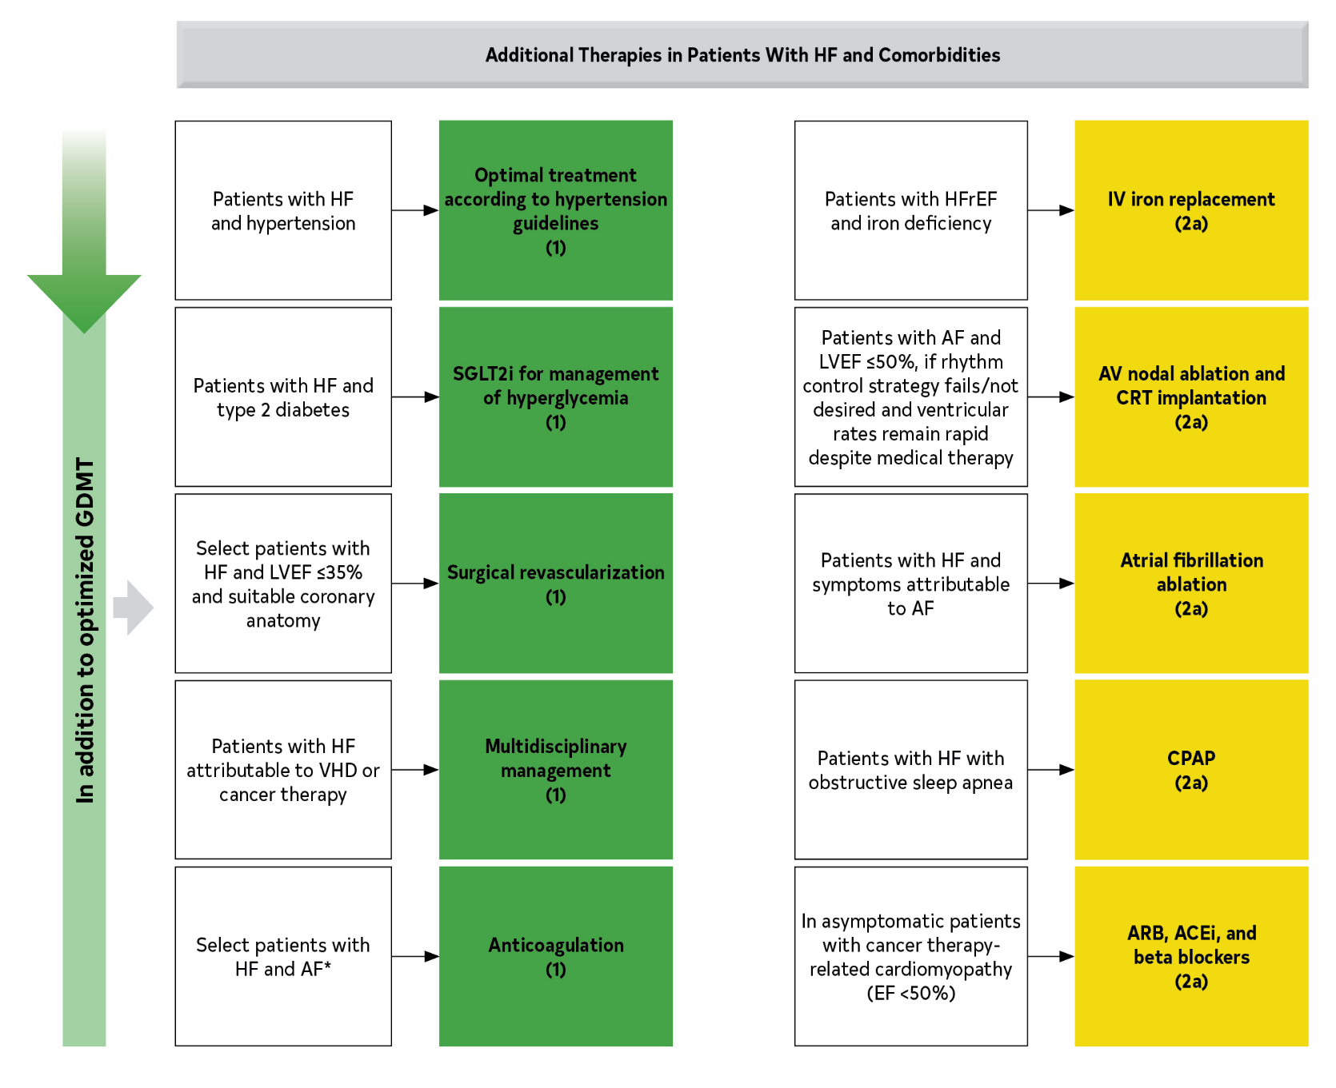
ACEi indicates angiotensin-converting enzyme inhibitor; AF, atrial fibrillation; ARB, angiotensin receptor blocker; AV, atrioventricular; CHA2DS2-VASc, congestive heart failure, hypertension, age ≥75 years, diabetes mellitus, stroke or transient ischemic attack [TIA], vascular disease, age 65 to 74 years, sex category; CPAP, continuous positive airway pressure; CRT, cardiac resynchronization therapy; EF, ejection fraction; GDMT, guideline-directed medical therapy; HF, heart failure; HFrEF, heart failure with reduced ejection fraction; IV, intravenous; LVEF, left ventricular ejection fraction; NYHA, New York Heart Association; SGLT2i, sodium-glucose cotransporter 2 inhibitor; and VHD, valvular heart disease.
Figure 14. Recommendations for Treatment of Patients With HF and Selected Comorbidities
Colors correspond to COR in Table 2.
Recommendations for treatment of patients with HF and select comorbidities are displayed.
*Patients with chronic HF with permanent-persistent-paroxysmal AF and a CHA2DS2-VASc score of ≥2 (for men) and ≥3 (for women).

Slide 162
Table 26. Most Common Co-Occurring Chronic Conditions Among Medicare Beneficiaries With HF (N=4,947,918), 2011
Beneficiaries Age ≥65 y (n=4,376,150)∗ |  |  | Beneficiaries Age <65 y (n=571,768)†
 | n | % |  | n | %
Hypertension | 3,685,373 | 84.2 | Hypertension | 461,235 | 80.7
Ischemic heart disease | 3,145,718 | 71.9 | Ischemic heart disease | 365,889 | 64.0
Hyperlipidemia | 2,623,601 | 60.0 | Diabetes | 338,687 | 59.2
Anemia | 2,200,674 | 50.3 | Hyperlipidemia | 325,498 | 56.9

Slide 163
Table 26. Most Common Co-Occurring Chronic Conditions Among Medicare Beneficiaries With HF (N=4,947,918), 2011
(con’t.)
Diabetes | 2,027,875 | 46.3 | Anemia | 284,102 | 49.7
Arthritis | 1,901,447 | 43.5 | CKD | 257,015 | 45.0
CKD | 1,851,812 | 42.3 | Depression | 207,082 | 36.2
COPD | 1,311,118 | 30.0 | Arthritis | 201,964 | 35.3
AF | 1,247,748 | 28.5 | COPD | 191,016 | 33.4
Alzheimer’s disease or dementia | 1,207,704 | 27.6 | Asthma | 88,816 | 15.5
AF indicates atrial fibrillation; CKD, chronic kidney disease; COPD, chronic obstructive pulmonary disease; and HF, heart failure.
∗Mean No. of conditions is 6.1; median is 6.
†Mean No. of conditions is 5.5; median is 5.

Slide 164
Management of AF in HF
Recommendations for Management of AF in HF Referenced studies that support the recommendations are summarized in the Online Data Supplements.
COR | LOE | Recommendations
1 | A | Patients with chronic HF with permanent-persistent-paroxysmal AF and a CHA₂DS₂-VASc score of ≥2 (for men) and ≥3 (for women) should receive chronic anticoagulant therapy.
1 | A | For patients with chronic HF with permanent-persistent-paroxysmal AF, DOAC is recommended over warfarin in eligible patients.

Slide 165
Management of AF in HF (con’t.)
2a | B-R | For patients with HF and symptoms caused by AF, AF ablation is reasonable to improve symptoms and QOL.
2a | B-R | For patients with AF and LVEF ≤50%, if a rhythm control strategy fails or is not desired, and ventricular rates remain rapid despite medical therapy, atrioventricular nodal ablation with implantation of a CRT device is reasonable .
2a | B-NR | For patients with chronic HF and permanent/persistent/paroxysmal AF, chronic anticoagulant therapy is reasonable for men and women without additional risk factors.

Slide 166
Special Populations

Slide 167
Disparities and Vulnerable Populations*
Recommendations for Disparities and Vulnerable Populations Referenced studies that support the recommendations are summarized in the Online Data Supplements.
COR | LOE | Recommendations
1 | C-LD | In vulnerable patient populations at risk for health disparities, HF risk assessments and multidisciplinary management strategies should target both known risks for CVD and social determinants of health, as a means toward elimination of disparate HF outcomes.
1 | C-LD | Evidence of health disparities should be monitored and addressed at the clinical practice and the health care system levels.

Slide 168
Table 27. Risk of HF and Outcomes in Special Populations
Vulnerable Population | Risk of HF | HF Outcomes
Women | The lifetime risk of HF is equivalent between sexes, but HFpEF risk is higher in women—in FHS participants with new-onset HF, odds of HFpEF (EF >45%) are 2.8-fold higher in women than in men. Sex-specific differences in the predictive value of cardiac biomarkers for incident HF. Nontraditional cardiovascular risk factors, including anxiety, depression, caregiver stress, and low household income may contribute more toward incident heart disease in women than men. | Overall, more favorable survival with HF than men. In the OPTIMIZE-HF registry, women with acute HF had a lower 1-y mortality (HR, 0.93; 95% CI, 0.89–0.97), although women are more likely not to receive optimal GDMT. Lower patient-reported quality of life for women with HFrEF, compared with men. Greater transplant waitlist mortality for women but equivalent survival after heart transplantation or LVAD implantation.

Slide 169
Table 27. Risk of HF and Outcomes in Special Populations (con’t.)
Older adults | Per FHS, at 40 y of age, the lifetime risk of incident HF is 20% for both sexes; at 80 y of age, the risk remains 20% for men and women despite the shorter life expectancy. LVEF is preserved in at least two-thirds of older adults with the diagnosis of HF. | Among 1233 patients with HF aged ≥80 y, 40% mortality during mean 27-mo follow-up; survival associated with prescription of GDMT.
Lower socioeconomic status populations | Among 27,078 White and Black adults of low income (70% earned <$15,000/y) participating from 2002–2009 in the Southern Community Cohort Study, a 1 interquartile increase in neighborhood deprivation index was associated with a 12% increase in risk of HF (adjusted HR, 1.12; 95% CI, 1.07–1.18). | Age-adjusted 1999–2018 HF mortality (deaths/100,000; mean and 95% CI) was higher with increasing quartiles of ADI, which is based on 17 indicators of employment, poverty, and education: Quartile 1, 20.0 (19.4–20.5); Quartile 2, 23.3 (22.6–24.0); Quartile 3, 26.4 (25.5–27.3); Quartile 4, 33.1 (31.8–34.4) .

Slide 170
Table 27. Risk of HF and Outcomes in Special Populations (con’t.)
Black populations | In MESA, patients of Black race had highest risk of incident HF (4.6/1000 person-years) and highest proportion of nonischemic incident HF. Higher prevalence of HF risk factors including hypertension, obesity, and diabetes, compared with White populations. | CDC data show race-based differences in HF mortality over time: Black men had a 1.16-fold versus 1.43-fold higher age-adjusted HF-related CVD death rate compared with White men in 1999 versus 2017; Black women had a 1.35-fold versus 1.54-fold higher age-adjusted HF-related CVD death rate compared with White women in 1999 versus 2017. Gap in outcomes is more pronounced among younger adults (35–64 y of age) versus older adults (65–84 y of age); age-adjusted HF-related CVD death rates were 2.60-fold and 2.97-fold higher in young Black versus White men and women, respectively. Higher rates of hospitalization and mortality among patients with HFpEF. Lower 5-year survival after heart transplant.

Slide 171
Table 27. Risk of HF and Outcomes in Special Populations (con’t.)
Hispanic populations | MESA study showed higher HF incidence in Hispanic compared with non-Hispanic White groups (3.5 versus 2.4 per 1000 person-years) but lower than for African Americans (4.6/1000 person-years). | Despite higher rates of hospitalization for HF compared with non-Hispanic Whites, Hispanic patients with HF have shown lower short-term mortality rates. In GWTG, Hispanic patients with HFpEF had lower mortality (OR, 0.50; 95% CI, 0.31–0.81) than non-Hispanic Whites, but this was not the case for Hispanic patients with HFrEF (OR, 0.94; 95% CI, 0.62–1.43). Lower risk of developing AF in the setting of HF, compared with White patients.

Slide 172
Table 27. Risk of HF and Outcomes in Special Populations (con’t.)
Asian and Pacific Islander populations | Limited population-specific data for Asian and pacific Islander subgroups in the United States. | High rates of preventable HF hospitalization observed in some Asian and Pacific Islander populations. Lower mortality rates from HF for Asian subgroups when listed as the primary cause of death, compared with non-Hispanic White groups.
Native American and Alaskan Native populations | Limited population-specific data, with cardiovascular risk factor trends best characterized by the Strong Heart Study and Strong Heart Family Study, demonstrating high rates of hypertension and diabetes. | Limited data suggest HF mortality rates in American Indians and Alaska Natives are similar to those in White populations.
CDC indicates Centers for Disease Control and Prevention; CVD, cardiovascular disease; FHS, Framingham Heart Study; GDMT, guideline-directed medical therapy; GWTG, Get With The Guidelines registry; HF, heart failure; HFpEF, heart failure with preserved ejection fraction; HFrEF, heart failure with reduced ejection fraction; HR, hazard ratio; LVAD, left ventricular assist device; LVEF, left ventricular ejection fraction; MESA, Multi-Ethnic Study of Atherosclerosis; OPTMIZE-HF, Organized Program To Initiate Lifesaving Treatment In Hospitalized Patients With Heart Failure; and OR, odds ratio.

Slide 173
Cardio-Oncology
Recommendations for Cardio-Oncology Referenced studies that support the recommendations are summarized in the Online Data Supplements.
COR | LOE | Recommendations
1 | B-NR | In patients who develop cancer therapy–related cardiomyopathy or HF, a multidisciplinary discussion involving the patient about the risk-benefit ratio of cancer therapy interruption, discontinuation, or continuation is recommended to improve management.
2a | B-NR | In asymptomatic patients with cancer therapy–related cardiomyopathy (EF <50%), ARB, ACEi, and beta blockers are reasonable to prevent progression to HF and improve cardiac function.

Slide 174
Cardio-Oncology (con’t.)
2a | B-NR | In patients with cardiovascular risk factors or known cardiac disease being considered for potentially cardiotoxic anticancer therapies, pretherapy evaluation of cardiac function is reasonable to establish baseline cardiac function and guide the choice of cancer therapy.
2a | B-NR | In patients with cardiovascular risk factors or known cardiac disease receiving potentially cardiotoxic anticancer therapies, monitoring of cardiac function is reasonable for the early identification of drug-induced cardiomyopathy.
2b | B-R | In patients at risk of cancer therapy–related cardiomyopathy, initiation of beta blockers and ACEi/ARB for the primary prevention of drug-induced cardiomyopathy is of uncertain benefit.

Slide 175
Cardio-Oncology (con’t.)
2b | C-LD | In patients being considered for potentially cardiotoxic therapies, serial measurement of cardiac troponin might be reasonable for further risk stratification.

Slide 176
Table 28. Cancer Therapies Known to Be Associated With Cardiomyopathy
Class | Agent(s) | Cardiac Function Monitoring Often Performed in Clinical Practice
 |  | Pretherapy | Serial
Anthracyclines | Doxorubicin, epirubicin | X | X
Alkylating agents | Cyclophosphamide, ifosfamide, melphalan | X
Antimicrotubule agents | Docetaxel
Antimetabolites | Fluorouracil, capecitabine, fludarabine, decitabine
Anti-HER2 agents | Trastuzumab, pertuzumab | X | X
Monoclonal antibodies | Rituximab

Slide 177
Table 28. Cancer Therapies Known to Be Associated With Cardiomyopathy (con’t.)
Tyrosine-kinase inhibitors | Dabrafenib, dasatinib, lapatinib, pazopanib, ponatinib, sorafenib, trametinib, sunitinib, vandetanib, imatinib, vandetanib
Immune checkpoint inhibitors | Nivolumab, ipilimumab, pembrolizumab
Protease inhibitors | Bortezomib, carfilzomib
Endocrine therapy | Goserelin, leuprolide, flutamide, bicalutamide, nilutamide
Chimeric antigen receptor T-cell therapy | Tisagenlecleucel, axicabtagene ciloleucel | X
Hematopoietic stem cell transplantation | Hematopoietic stem cell transplantation | X
Radiation | Chest

Slide 178
Table 29. Risk Factors for Cancer Therapy–Related Cardiomyopathy
Age ≥60 y
Black race
CAD
Hypertension
Diabetes
Preexisting cardiomyopathy
Previous exposure to anthracyclines
Previous chest radiation
Elevated troponin pretherapy
CAD indicates coronary artery disease.

Slide 179
HF and Pregnancy
Recommendations for HF and Pregnancy Referenced studies that support the recommendations are summarized in the Online Data Supplements.
COR | LOE | Recommendations
1 | C-LD | In women with a history of HF or cardiomyopathy, including previous peripartum cardiomyopathy, patient-centered counseling regarding contraception and the risks of cardiovascular deterioration during pregnancy should be provided.
2b | C-LD | In women with acute HF caused by peripartum cardiomyopathy and LVEF <30%, anticoagulation may be reasonable at diagnosis, until 6 to 8 weeks postpartum, although the efficacy and safety are uncertain.
3: Harm | C-LD | In women with HF or cardiomyopathy who are pregnant or currently planning for pregnancy, ACEi, ARB, ARNi, MRA, SGLT2i, ivabradine, and vericiguat should not be administered because of significant risks of fetal harm.

Slide 180
Table 30. HF Management Strategies Across the Pregnancy Continuum
 | Preconception | During Pregnancy | Postpartum
Nonpharmacological strategies | Preconception genetic counseling and testing for potentially heritable cardiac conditions. Use of pregnancy cardiovascular risk tools, and echocardiography for myocardial structure and function assessment, to provide information that facilitates informed counseling. For women planning a pregnancy, provide personalized counseling that promotes the autonomy and goals of the patient (and her partner, as applicable), the patient’s ability for self-care and risk awareness, and ensures adequate psychosocial support for decision-making. For women not currently planning a pregnancy but who might conceive, discuss HF-specific considerations regarding pregnancy and refer to gynecology or primary care for contraceptive counseling. | Close maternal monitoring for HF signs or symptoms or other cardiovascular instability by cardiology and obstetric and maternal-fetal medicine teams; close fetal monitoring by the obstetric and maternal-fetal medicine teams. Consideration of routine echocardiographic screening in the third trimester for reassessment of myocardial structure and function before labor; echocardiography for any significant changes in HF symptoms or signs during pregnancy, or if HF medications are reduced or discontinued. BNP or NT-proBNP monitoring during pregnancy may have some value for prediction of cardiovascular events. Close maternal monitoring by obstetrics and maternal-fetal medicine teams for preeclampsia, which has shared risk factors and pathogenesis with PPCM. For women presenting with decompensated HF or cardiogenic shock, hemodynamic monitoring and MCS, as appropriate, within a multidisciplinary collaborative approach that supports prompt decision-making about the timing and mechanism of delivery. | Multidisciplinary recommendations from obstetrics and neonatology and pediatrics teams and shared decision-making regarding the maternal and neonatal risks and benefits of breastfeeding. For women presenting with decompensated HF or cardiogenic shock, HF management should include hemodynamic monitoring and mechanical circulatory support as appropriate

Slide 181
Table 30. HF Management Strategies Across the Pregnancy Continuum (con’t.)
Pharmacological strategies | Review of all current medications. For women planning pregnancy imminently, modification of HF pharmacotherapy including. discontinuation of any ACEi, ARB, ARNi, MRA, or SGLT2i or ivabradine medications; within a construct of multidisciplinary shared decision-making, continuation of a beta blocker (most commonly metoprolol), hydralazine, and nitrates; adjustment of diuretic dosing to minimize the risk of placental hypoperfusion. Ideally, repeat echocardiography approximately 3 mo after preconception HF medication adjustments to ensure stability of myocardial structure and function before conception. | Close monitoring of maternal blood pressure, heart rate, and volume status, with adjustment of the modified HF regimen as appropriate to avoid hypotension (systemic vasodilation peaks in the second trimester) and placental hypoperfusion. For women with HF or cardiomyopathy presenting during pregnancy without preconception counseling and assessment, urgent discontinuation of any GDMT pharmacotherapies with fetal toxicities; within a construct of multidisciplinary shared decision-making, continuation of a beta blocker (most commonly metoprolol succinate), hydralazine, and nitrates; adjustment of diuretic dosing to minimize the risk of placental hypoperfusion. | For women with acute HF caused by PPCM and LVEF <30%, consideration of anticoagulation until 6–8 wk postpartum, although the efficacy and safety remain uncertain at this time. For postpartum women with severe acute HF caused by PPCM and LVEF <35%, in GDMT pharmacotherapy and prophylactic anticoagulation, to improve LVEF recovery; the efficacy and safety of bromocriptine for acute PPCM treatment remains uncertain at this time, particularly in the setting of contemporary HF GDMT and cardiogenic shock management.* For women who choose to breastfeed, review medications with neonatology and pediatrics teams for neonatal safety during lactation, ideally with pharmacist consultation if available. Within a construct of multidisciplinary shared decision-making, medications that may be appropriate during breastfeeding include ACEi (enalapril or captopril preferred, monitor neonatal weight), beta blockers (metoprolol preferred, monitor neonatal heart rate). Diuretics can suppress lactation, but with neonatal follow-up the use of furosemide may be appropriate.

Slide 182
Table 30. HF Management Strategies Across the Pregnancy Continuum (con’t.)
Multidisciplinary care beyond the cardiology team | Consultation with genetics, gynecology, and maternal-fetal medicine teams, as appropriate to the outcome of shared decision-making. | Multidisciplinary management with obstetrics and maternal-fetal medicine teams during pregnancy. For women with decompensated HF or evidence of hemodynamic instability antepartum, delivery planning will include obstetrics and maternal-fetal medicine, anesthesia, and neonatology teams. | Multidisciplinary management with obstetrics, maternal-fetal medicine, neonatology, and pediatrics teams, especially for multidisciplinary recommendations regarding lactation. Consultation with gynecology team for ongoing contraceptive planning.
ACEi indicates angiotensin-converting enzyme inhibitor; ARB, angiotensin receptor blocker; ARNi, angiotensin receptor-neprilysin inhibitor; BNP, B-natriuretic peptide; GDMT, guideline-directed medical therapy; HF, heart failure; LVEF, left ventricular ejection fraction; MCS, mechanical circulatory support; MRA, mineralocorticoid receptor antagonist; NT-proBNP, N-terminal prohormone of brain natriuretic peptide; PPCM, peripartum cardiomyopathy; RCT, randomized controlled trial; RV, right ventricular; and SGLT2i, sodium-glucose cotransporter-2 inhibitor.

Slide 183
Quality Metrics and Reporting

Slide 184
Quality Metrics and Reporting
Recommendations for Performance Measurement Referenced studies that support the recommendations are summarized in the Online Data Supplements.
COR | LOE | Recommendations
1 | B-NR | Performance measures based on professionally developed clinical practice guidelines should be used with the goal of improving quality of care for patients with HF.
2a | B-NR | Participation in quality improvement programs, including patient registries that provide benchmark feedback on nationally endorsed, clinical practice guideline–based quality and performance measures can be beneficial in improving the quality of care for patients with HF.

Slide 185
Table 31. ACC/AHA 2020 HF Clinical Performance, Quality, and Structural Measures
Measure No. | Measure Title | Care Setting | Attribution | Measure Domain
PM-1 | LVEF assessment | Outpatient | Individual practitioner Facility | Diagnostic
PM-2 | Symptom and activity assessment | Outpatient | Individual practitioner Facility | Monitoring
PM-3 | Symptom management | Outpatient | Individual practitioner Facility | Treatment
PM-4 | Beta-blocker therapy for HFrEF | Outpatient Inpatient | Individual practitioner Facility | Treatment
PM-5 | ACEi, ARB, or ARNi therapy for HFrEF | Outpatient Inpatient | Individual practitioner Facility | Treatment
PM-6 | ARNi therapy for HFrEF | Outpatient Inpatient | Individual practitioner Facility | Treatment

Slide 186
Table 31. ACC/AHA 2020 HF Clinical Performance, Quality, and Structural Measures (con’t.)
PM-7 | Dose of beta blocker therapy for HFrEF | Outpatient | Individual practitioner Facility | Treatment
PM-8 | Dose of ACEi, ARB, or ARNi therapy for HFrEF | Outpatient | Individual practitioner Facility | Treatment
PM-9 | MRA therapy for HFrEF | Outpatient Inpatient | Individual practitioner Facility | Treatment
PM-10 | Laboratory monitoring in new MRA therapy | Outpatient Inpatient | Individual practitioner Facility | Monitoring
PM-11 | Hydralazine and isosorbide dinitrate therapy for HFrEF in those patients self-identified as Black or African American | Outpatient Inpatient | Individual practitioner Facility | Treatment
PM-12 | Counseling regarding ICD placement for patients with HFrEF on GDMT | Outpatient | Individual practitioner Facility | Treatment

Slide 187
Table 31. ACC/AHA 2020 HF Clinical Performance, Quality, and Structural Measures (con’t.)
PM-13 | CRT implantation for patients with HFrEF on GDMT | Outpatient | Individual practitioner Facility | Treatment
QM-1 | Patient self-care education | Outpatient | Individual practitioner Facility | Self-Care
QM-2 | Measurement of patient-reported outcome-health status | Outpatient | Individual practitioner Facility | Monitoring
QM-3 | Sustained or improved health status in HF | Outpatient | Individual practitioner Facility | Outcome
QM-4 | Post-discharge appointment for patients with HF | Inpatient | Individual practitioner, facility | Treatment
SM-1 | HF registry participation | Outpatient Inpatient | Facility | Structure

Slide 188
Table 31. ACC/AHA 2020 HF Clinical Performance, Quality, and Structural Measures (con’t.)
Rehabilitation PMs Related to HF (From the 2018 ACC/AHA performance measures for cardiac rehabilitation (10))
Rehab PM-2 | Exercise training referral for HF from inpatient setting | Inpatient | Facility | Process
Rehab PM-4 | Exercise training referral for HF from outpatient setting | Outpatient | Individual practitioner Facility | Process
ACEi indicates angiotensin-converting enzyme inhibitor; ACC, American College of Cardiology; AHA, American Heart Association; ARB, angiotensin receptor blocker; ARNi, angiotensin receptor-neprilysin inhibitor; CRT, cardiac resynchronization therapy; GDMT, guideline-directed medical therapy; HF, heart failure; HFrEF, heart failure with reduced ejection fraction; ICD, implantable cardioverter-defibrillator; LVEF, left ventricular ejection fraction; MRA, mineralocorticoid receptor antagonist; PM, performance measure; QM, quality measure; and SM, structural measure.

Slide 189
Goals of Care

Slide 190
Palliative and Supportive Care, Shared Decision-Making, and End-of-Life
Recommendations for Palliative and Supportive Care, Shared Decision-Making, and End-of-Life Referenced studies that support the recommendations are summarized in the Online Data Supplements.
COR | LOE | Recommendations
1 | C-LD | For all patients with HF, palliative and supportive care—including high-quality communication, conveyance of prognosis, clarifying goals of care, shared decision-making, symptom management, and caregiver support—should be provided to improve QOL and relieve suffering.
1 | C-LD | For patients with HF being considered for, or treated with, life-extending therapies, the option for discontinuation should be anticipated and discussed through the continuum of care, including at the time of initiation, and reassessed with changing medical conditions and shifting goals of care.

Slide 191
Palliative and Supportive Care, Shared Decision-Making, and End-of-Life (con’t.)
2a | B-R | For patients with HF—particularly stage D HF patients being evaluated for advanced therapies, patients requiring inotropic support or temporary mechanical support, patients experiencing uncontrolled symptoms, major medical decisions, or multimorbidity, frailty, and cognitive impairment—specialist palliative care consultation can be useful to improve QOL and relieve suffering.
2a | C-LD | For patients with HF, execution of advance care directives can be useful to improve documentation of treatment preferences, delivery of patient-centered care, and dying in preferred place.
2a | C-LD | In patients with advanced HF with expected survival <6 months, timely referral to hospice can be useful to improve QOL.

Slide 192
Table 32. Palliative and Supportive Care Domains to Improve Processes of Care and Patient Outcomes
Palliative and Supportive Domains of Care | What Palliative Care Adds to Overall HF Management
High-quality communication | Central to palliative care approaches are communication and patient-caregiver engagement techniques.
Conveyance of prognosis | Palliative care specifically addresses patient and caregiver understanding of disease, treatment, and prognosis. Research suggests that patients tend to overestimate their survival and overestimate the potential benefits of treatment. Objective risk models can calibrate expectations, but discussion of uncertainty should accompany prognostic conversations, often summarized as “hope for the best, plan for the worst.”
Clarifying goals of care | Management of patients with HF as their disease becomes end-stage and death seems near includes decisions about when to discontinue treatments designed primarily to prolong life (e.g., ICD, hospitalization, tube feeding), decisions on when to initiate treatments to reduce pain and suffering that may hasten death (e.g., narcotics), and decisions about the location of death, home services, and hospice care. Exploring patients’ expressed preferences, values, needs, concerns, means and desires through clinician-led discussion can clarify values-treatment concordance and improve medical decision-making.

Slide 193
Table 32. Palliative and Supportive Care Domains to Improve Processes of Care and Patient Outcomes
Shared decision-making | Shared decision-making is a process by which patients and clinicians work together to make optimal health care decisions from medically reasonable options that align with what matters most to patients. Shared decision-making requires: unbiased medical evidence about the risks, benefits, and burdens of each alternative, including no intervention; clinician expertise in communication and tailoring that evidence for individual patients; and patient goals and informed preferences.
Symptom management | Dyspnea, fatigue, pain, nausea, depression, anxiety, and other symptoms of HF refractory to cardiovascular therapies can be partially remediated through palliative and supportive approaches in addition to GDMT.
Caregiver support | Care of the patient with heart failure should extend to their loved ones, including beyond their death, to offer support to families and help them cope with loss.
GDMT indicates guideline-directed medical therapy; HF, heart failure; and ICD, implantable cardioverter-defibrillator.

Slide 194
Figure 15. A Depiction of the Clinical Course of HF With Associated Types and Intensities of Available Therapies Over Time
CHF indicates congestive heart failure; HF, heart failure; and MCS, mechanical circulatory support.

Slide 195
Recommendation for Patient-Reported Outcomes and Evidence Gaps and Future Research Directions

Slide 196
Patient-Reported Outcomes
Recommendation for Patient-Reported Outcomes
COR | LOE | Recommendation
2a | C-LD | In patients with HF, standardized assessment of patient-reported health status using a validated questionnaire can be useful to provide incremental information for patient functional status, symptom burden, and prognosis.

Slide 197
Table 33. Evidence Gaps and Future Research Directions
Definition
Consensus on specific classifications of HFrEF, HFpEF, HFmrEF, and HFimpEF or whether a 2-category definition of HFrEF and HF with normal EF, or an additional category of HFimpEF is needed separately for HFpEF; and whether these approaches can be uniformly applied to clinical trials and practice.
Definitions, detection, and management of myocarditis and myocardial injury, especially in the context of rapidly evolving concepts, such as COVID-19 infection and cardiotoxicity.
Definition and classification of cardiomyopathies.
Screening
Cost-effectiveness of different strategies to screen for HF.
Prediction of higher risk for HF among patients with traditional risk factors (e.g., which patients with diabetes would be at a higher risk HF, warranting preventive treatment for HF).

Slide 198
Table 33. Evidence Gaps and Future Research Directions (con’t.)
Diagnostics and Monitoring
Individualized treatment targeting specific causes.
Advanced role of precision medicine with incorporation of genetic, personalized, and individualized factors in medical management of HF.
High-value methods to use biomarkers in the optimization of medical therapy.
Ability to use integrated systems biology models, including biomarkers, molecular markers, omics, diagnostic modalities, and genetic variables for diagnosis, prognosis, and targeting therapies.
Ability to monitor and adjust therapy to individual changes over time.
Nonmedical Strategies
Efficacy and safety of specific dietary interventions, sodium restriction, and fluid restriction to prevent and treat HF.
Efficacy and safety of cardiac rehabilitation in patients with HFpEF and HFmrEF.

Slide 199
Table 33. Evidence Gaps and Future Research Directions (con’t.)
Medical Therapies
Effective management strategies for patients with HFpEF.
Evidence for specific treatment strategies for HFmrEF.
Research on causes and targeted therapies for cardiomyopathies such as peripartum cardiomyopathy.
Treatment of asymptomatic LV dysfunction to prevent transition to symptomatic HF.
Therapies targeting different phenotypes of HF; patients with advanced HF, persistent congestion, patients with profiles excluded from clinical trials such as those with advanced kidney failure or hypotension.
Studies on targets for optimal decongestion; treatment and prevention of cardiorenal syndrome and diuretic resistance.
Diagnostic and management strategies of RV failure.
Efficacy and safety of hydralazine isosorbide in non–African American patients with HF and also in African American patients on GDMT including SGLT2i and ARNi.
Efficacy and safety of vericiguat in patients with HFrEF and markedly elevated natriuretic peptide levels.

Slide 200
Table 33. Evidence Gaps and Future Research Directions (con’t.)
Efficacy and safety of omecamtiv mecarbil in patients with stage D (advanced HF) HFrEF.
Additional efficacy and safety of SGLT2i therapies in patients with HFpEF or patients with HFmrEF, efficacy and safety of combined SGLT2i and SGLT1i in HFrEF, HFmrEF, or HFpEF.
Additional efficacy and safety of SGLT2i studies in hospitalized patients with acute decompensated HF with and without diabetes.
Efficacy and safety of nonsteroidal, selective MRA in patients with HF.
Efficacy and safety of ARNi in pre-HF stage (stage B).
Effective management strategies for combined post- and precapillary pulmonary hypertension.
Novel treatments for ATTR cardiomyopathy.
Treatment strategies targeting downstream processes such as fibrosis, cardiac metabolism or contractile performance in dilated cardiomyopathies and HFpEF.
Comparative effectiveness and safety of different initiation and titration of GDMT at the same time or in different sequences, optimal strategies for sequencing and titration of therapies for HFrEF and HFpEF.

Slide 201
Table 33. Evidence Gaps and Future Research Directions (con’t.)
Studies on prediction of patient response; studies on how to incorporate patient preferences.
Efficacy and safety of optimal BP target in patients with established HF and hypertension.
Optimal BP target while optimizing GDMT in patients with HFrEF and HFpEF.
Appropriate management of electrolyte abnormalities in HF (e.g., hyperkalemia or hypokalemia).
Role of potassium binders in optimization of GDMT and clinical outcomes in patients with HF.
Efficacy and safety of pirfenidone and other targeted treatment strategies for maladaptive fibrosis in patients with HFpEF.
AF risk in patients treated with PUFA for patients at risk for HF or with HF.
Device Management and Advanced Therapies
Optimal and timely selection of candidates for percutaneous interventions, MCS, or cardiac transplantation.
Interventional approaches to recurrent, life-threatening ventricular tachyarrhythmias.
Comparative effectiveness of His-bundle pacing or multisite pacing to prevent progression of HF.

Slide 202
Table 33. Evidence Gaps and Future Research Directions (con’t.)
Safety and efficacy of cardiac contractility modulation, vagal nerve stimulation, autonomic modulation, and renal denervation in patients with HF.
Safety and efficacy of splanchnic nerve ablation splanchnic nerve ablation to reduce splanchnic vasoconstriction and volume redistribution in HF.
Safety and efficacy of interatrial shunt, pericardiectomy, baroreceptor and neuromodulation, and renal denervation in HFpEF.
Safety and efficacy of percutaneous or surgical interventions for tricuspid regurgitation.
Clinical Outcomes
Impact of therapies in patient-reported outcomes, including symptoms and QOL.
Studies addressing patient goals about care and care intensity as it intersects with disease trajectory.
Real-world evidence data to characterize generalization of therapies in HF populations who may not have been represented in trials.

Slide 203
Table 33. Evidence Gaps and Future Research Directions (con’t.)
Systems of Care and Social Determinants of Health
Implementation studies on how to develop a structured approach to patient participation in informed decision-making and goal setting through the continuum of HF care.
Implementation science for adoption and optimization of GDMT by clinicians on how to initiate multiple or sequenced GDMT, how to integrate these into learning health systems and networks, and how to increase patient education and adherence.
Pragmatic studies on multidisciplinary new care models (e.g., cardiac teams for structural and valve management, shock teams, cardiometabolic clinics, telemedicine, digital health, cardiac rehabilitation at home or postdischarge, and palliative care).
Studies on strategies to eliminate structural racism, disparities, and health inequities in HF care.
Studies addressing evidence gaps in women, racial, and ethnic populations.
Management strategies for palliative care.
Identification of factors that lead to unwarranted variations in HF care.
Identify characteristics of systems of care (e.g., disciplines and staffing, electronic health records, and models of care) that optimize GDMT before and after the discharge of hospitalized patients.

Slide 204
Table 33. Evidence Gaps and Future Research Directions (con’t.)
Comorbidities
Further studies on rhythm control versus ablation in AF.
Appropriate patient selection in evolving percutaneous approaches in VHD (e.g., timing and appropriate patient selection for TAVI, Mitraclip, tricuspid valve interventions).
Effective and safe treatment options in CKD, sleep-disordered breathing, chronic lung disease, diabetes, depression, cognitive disorders, and iron deficiency.
Efficacy and safety of transvenous stimulation of the phrenic nerve or role of nocturnal supplemental oxygen for treatment of central sleep apnea in patients with HF.
Efficacy and safety of weight loss management and treatment strategies in patients with HF and obesity.
Efficacy and safety of nutritional and food supplementation in patients with HF and frailty and malnutrition.
Efficacy and safety of GDMT in end-stage renal disease or in patients with eGFR <30 mL/min/1.73 m².

Slide 205
Table 33. Evidence Gaps and Future Research Directions (con’t.)
Future/Novel Strategies
Pharmacological therapies targeting novel pathways and endophenotypes.
New device therapies, including percutaneous and durable mechanical support devices.
Invasive (e.g., pulmonary artery pressure monitoring catheter) or noninvasive remote monitoring.
Studies on telehealth, digital health, apps, wearables technology, and artificial intelligence.
Role of enrichment trials, adaptive trials, umbrella trials, basket trials, and machine learning–based trials.
Therapies targeting multiple cardiovascular, cardiometabolic, renovascular, and pathobiological mechanisms.
Novel dissemination and implementation techniques to identify patients with HF (e.g., natural language processing of electronic health records and automated analysis of cardiac imaging data) and to test and monitor proven interventions.
AF indicates atrial fibrillation; ARNi, angiotensin receptor-neprilysin inhibitor; ATTR, transthyretin amyloidosis; BP, blood pressure; CKD, chronic kidney disease; COVID-19, coronavirus disease 2019; eGFR, estimated glomerular filtration rate; GDMT, guideline-directed medical therapy; HF, heart failure; HFimpEF, heart failure with improved ejection fraction; HFmrEF, heart failure with mildly reduced ejection fraction; HFpEF, heart failure with preserved ejection fraction; HFrEF, heart failure with reduced ejection fraction; LV, left ventricular; MCS, mechanical circulatory support; MRA, mineralocorticoid receptor antagonist; PUFA, polyunsaturated fatty acid; QOL, quality of life; RV, right ventricular; SGLT1i, sodium-glucose cotransporter-1 inhibitors; SGLT2i, sodium-glucose cotransporter-2 inhibitors; TAVI, transcatheter aortic valve implantation; and VHD, valvular heart disease.

Slide 206
Abbreviations
Abbreviation | Meaning/Phrase
ACEi | angiotensin-converting enzyme inhibitor
ACS | acute coronary syndrome
ARNi | angiotensin receptor-neprilysin inhibitor
ARB | angiotensin (II) receptor blocker
AF | atrial fibrillation
AL-CM | immunoglobulin light chain amyloid cardiomyopathy
ATTR-CM | transthyretin amyloid cardiomyopathy
ATTRv | variant transthyretin amyloidosis
ATTRwt | wild-type transthyretin amyloidosis

Slide 207
Abbreviations
BNP | B-type natriuretic peptide
CABG | coronary artery bypass graft
CAD | coronary artery disease
CCM | cardiac contractility modulation
CHF | congestive heart failure
CKD | chronic kidney disease
CMR | cardiovascular magnetic resonance
COVID-19 | coronavirus disease 2019
CPET | cardiopulmonary exercise test
CRT | cardiac resynchronization therapy
CRT-D | cardiac resynchronization therapy with defibrillation
CRT-P | cardiac resynchronization therapy with pacemaker
CT | computed tomography
CVD | cardiovascular disease
CVP | central venous pressure

Slide 208
Abbreviations
DOAC | direct-acting oral anticoagulants
DPP-4 | dipeptidyl peptidase-4
ECG | electrocardiogram
EF | ejection fraction
eGFR | estimated glomerular filtration rate
FDA | U.S. Food and Drug Administration
FLC | free light chain
GDMT | guideline-directed medical therapy
HF | heart failure
HFimpEF | heart failure with improved ejection fraction
HFmrEF | heart failure with mildly reduced ejection fraction
HFpEF | heart failure with preserved ejection fraction
HFrEF | heart failure with reduced ejection fraction
ICD | implantable cardioverter-defibrillator

Slide 209
Abbreviations
IFE | immunofixation electrophoresis
LBBB | left bundle branch block
LV | left ventricular
LVAD | left ventricular assist device
LVEDV | left ventricular end-diastolic volume
LVEF | left ventricular ejection fraction
LVH | left ventricular hypertrophy
MCS | mechanical circulatory support
MI | myocardial infarction
MR | mitral regurgitation
MRA | mineralocorticoid receptor antagonist
MV | mitral valve
NSAID | nonsteroidal anti-inflammatory drug

Slide 210
Abbreviations
NSVT | nonsustained ventricular tachycardia
NT-proBNP | N-terminal prohormone of B-type natriuretic peptide
NYHA | New York Heart Association
QALY | quality-adjusted life year
QOL | quality of life
PA | pulmonary artery
PCWP | pulmonary capillary wedge pressure
PET | positron emission tomography
PPAR-γ | peroxisome proliferator-activated receptor gamma
PUFA | polyunsaturated fatty acid
RA | right atrial
RAASi | renin-angiotensin-aldosterone system inhibitor
RCT | randomized controlled trial
RV | right ventricular

Slide 211
Abbreviations
SCD | sudden cardiac death
SGLT2i | sodium-glucose cotransporter-2 inhibitors
SPECT | single photon emission CT
99mTc-PYP | technetium pyrophosphate
TEE | transesophageal echocardiogram
TEER | transcatheter mitral edge-to-edge repair
TTE | transthoracic echocardiogram
VA | ventricular arrhythmia
VF | ventricular fibrillation
VHD | valvular heart disease
VO₂ | oxygen consumption/oxygen uptake
VT | ventricular tachycardia

