Slide 1
2014 AHA/ACC/HRS Guideline for the Management of Patients With Atrial Fibrillation
0415582040
Developed in Collaboration with the Society of Thoracic Surgeons
© American College of Cardiology Foundation and American Heart Association

Slide 2
Citation
This slide set is adapted from the 2014 AHA/ACC/HRS Guideline for the Management of Patients With Atrial Fibrillation. Published on March 22, 2014, available at: Journal of the American College of Cardiology (http://content.onlinejacc.org/article.aspx?articleid=1854231) and Circulation (http://circ.ahajournals.org/content/early/2014/04/10/CIR.0000000000000041)
The full-text guidelines are also available on the following Web sites:
ACC (www.cardiosource.org) and AHA (my.americanheart.org)

Slide 3
Guideline on the Management of Patients
With Atrial Fibrillation
Craig T. January, MD, PhD, FACC, Chair
L. Samuel Wann, MD, MACC, FAHA, Vice Chair*
Joseph S. Alpert, MD, FACC, FAHA*†
Hugh Calkins, MD, FACC, FAHA, FHRS*‡§
Joaquin E. Cigarroa, MD, FACC†
Jamie B. Conti, MD, FACC, FHRS*†
Joseph C. Cleveland, Jr, MD, FACC║
Patrick T. Ellinor, MD, PhD, FAHA‡
Michael E. Ezekowitz, MB, ChB, FACC, FAHA*†
Michael E. Field, MD, FACC, FHRS†
Katherine T. Murray, MD, FACC, FAHA, FHRS†
Ralph L. Sacco, MD, FAHA†
William G. Stevenson, MD, FACC, FAHA, FHRS*¶
Patrick J. Tchou, MD, FACC‡
Cynthia M. Tracy, MD, FACC, FAHA†
Clyde W. Yancy, MD, FACC, FAHA†
*Writing committee members are required to recuse themselves from voting on sections to which their specific relationships with industry and other entities may apply. †ACC/AHA Representative. ‡Heart Rhythm Society Representative. §ACC/AHA Task Force on Performance Measures Liaison. ║Society of Thoracic Surgeons Representative. ¶ACC/AHA Task Force on Practice Guidelines Liaison. **Former Task Force member; current member during the writing effort.

Slide 4
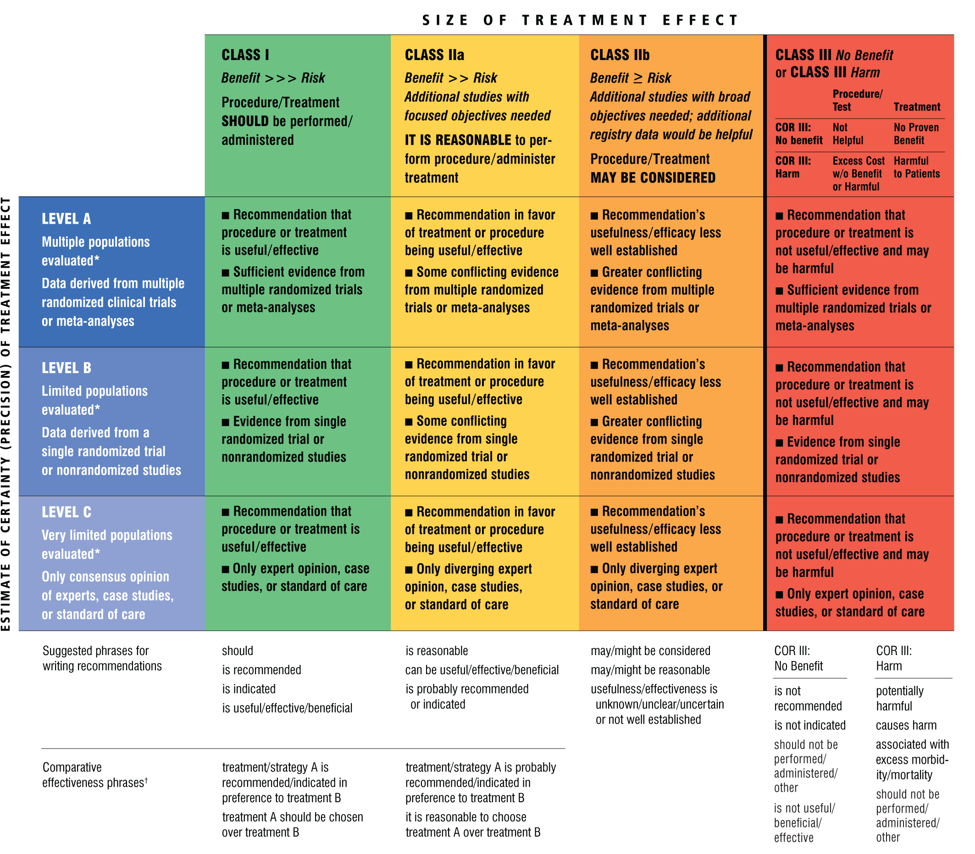
Applying Classification of Recommendations and
Levels of Evidence
A recommendation with Level of Evidence B or C does not imply that the recommendation is weak. Many important clinical questions addressed in the guidelines do not lend themselves to clinical trials. Although randomized trials are unavailable, there may be a very clear clinical consensus that a particular test or therapy is useful or effective.
*Data available from clinical trials or registries about the usefulness/ efficacy in different subpopulations, such as sex, age, history of diabetes, history of prior myocardial infarction, history of heart failure, and prior aspirin use.
†For comparative effectiveness recommendations (Class I and IIa; Level of Evidence A and B only), studies that support the use of comparator verbs should involve direct comparisons of the treatments or strategies being evaluated.

Slide 5
10 Most Common Comorbid Chronic Conditions Among Medicare Beneficiaries With AF
Beneficiaries ≥65 y of Age (N=2,426,865) |  |  |  | Beneficiaries <65 y of Age (N=105,878)
(Mean Number of Conditions=5.8; Median=6) |  |  |  | (Mean Number of Conditions=5.8; Median=6)
 | N | % |  |  | N | %
Hypertension | 2,015,235 | 83.0 |  | Hypertension | 85,908 | 81.1
Ischemic heart disease | 1,549,125 | 63.8 |  | Ischemic heart disease | 68,289 | 64.5
Hyperlipidemia | 1,507,395 | 62.1 |  | Hyperlipidemia | 64,153 | 60.6
HF | 1,247,748 | 51.4 |  | HF | 62,764 | 59.3
Anemia | 1,027,135 | 42.3 |  | Diabetes mellitus | 56,246 | 53.1
Arthritis | 965,472 | 39.8 |  | Anemia | 48,252 | 45.6
Diabetes mellitus | 885,443 | 36.5 |  | CKD | 42,637 | 40.3
CKD | 784,631 | 32.3 |  | Arthritis | 34,949 | 33.0
COPD | 561,826 | 23.2 |  | Depression | 34,900 | 33.0
Cataracts | 546,421 | 22.5 |  | COPD | 33,218 | 31.4
Reproduced with permission from the Centers for Medicare and Medicaid Services.

Slide 6
Definitions of AF: A Simplified Scheme
Term | Definition
Paroxysmal AF | AF that terminates spontaneously or with intervention within 7 d of onset. Episodes may recur with variable frequency.
Persistent AF | Continuous AF that is sustained >7 d.
Long-standing persistent AF | Continuous AF >12 mo in duration.
Permanent AF | The term “permanent AF” is used when the patient and clinician make a joint decision to stop further attempts to restore and/or maintain sinus rhythm. Acceptance of AF represents a therapeutic attitude on the part of the patient and clinician rather than an inherent pathophysiological attribute of AF. Acceptance of AF may change as symptoms, efficacy of therapeutic interventions, and patient and clinician preferences evolve.
Nonvalvular AF | AF in the absence of rheumatic mitral stenosis, a mechanical or bioprosthetic heart valve, or mitral valve repair.
AF indicates atrial fibrillation.

Slide 7
Atrial Tachycardias
Diagram summarizing types of atrial tachycardias often encountered in patients with a history of AF, including those seen after catheter or surgical ablation procedures. P-wave morphologies are shown for common types of atrial flutter; however, the P-wave morphology is not always a reliable guide to the re-entry circuit location or the distinction between common atrial flutter and other macroreentrant atrial tachycardias.
*Exceptions to P-wave morphology and rate are common in scarred atria.

Slide 8
Mechanisms of AF

Slide 9
Guideline for the Management of Patients
With Atrial Fibrillation
Clinical Evaluation

Slide 10
Clinical Evaluation
Recommendations | COR | LOE
ECG documentation is recommended to establish the diagnosis of AF. | I | C

Slide 11
Guideline for the Management of Patients
With Atrial Fibrillation
Prevention of Thromboembolism

Slide 12
Risk-Based Antithrombotic Therapy
Recommendations | COR | LOE
In patients with AF, antithrombotic therapy should be individualized based on shared decision making after discussion of the absolute risks and RRs of stroke and bleeding and the patient’s values and preferences. | I | C
Selection of antithrombotic therapy should be based on the risk of thromboembolism irrespective of whether the AF pattern is paroxysmal, persistent, or permanent. | I | B
In patients with nonvalvular AF, the CHA₂DS₂-VASc* score is recommended for assessment of stroke risk. | I | B
For patients with AF who have mechanical heart valves, warfarin is recommended, and the target INR intensity (2.0 to 3.0 or 2.5 to 3.5) should be based on the type and location of the prosthesis. | I | B
*CHA₂DS₂-VASc indicates Congestive heart failure, Hypertension, Age ≥75 years (doubled), Diabetes mellitus, Prior Stroke or TIA or thromboembolism (doubled), Vascular disease, Age 65 to 74 years, Sex category.

Slide 13
Risk-Based Antithrombotic Therapy (cont’d)
Recommendations | COR | LOE
For patients with nonvalvular AF with prior stroke, transient ischemic attack, or a CHA₂DS₂-VASc score of 2 or greater, oral anticoagulants are recommended. Options include:
warfarin (INR 2.0 TO 3.0), or | I | A
dabigatran, or | I | B
rivaroxaban, or | I | B
apixaban. | I | B
Among patients treated with warfarin, the INR should be determined at least weekly during initiation of antithrombotic therapy and at least monthly when anticoagulation (INR in range) is stable. | I | A
For patients with nonvalvular AF unable to maintain a therapeutic INR level with warfarin, use of a direct thrombin or factor Xa inhibitor (dabigatran, rivaroxaban, or apixaban) is recommended. | I | C
Re-evaluation of the need for and choice of antithrombotic therapy at periodic intervals is recommended to reassess stroke and bleeding risks. | I | C

Slide 14
Risk-Based Antithrombotic Therapy (cont’d)
Recommendations | COR | LOE
Bridging therapy with UFH or LMWH is recommended for patients with AF and a mechanical heart valve undergoing procedures that require interruption of warfarin. Decisions on bridging therapy should balance the risks of stroke and bleeding. | I | C
For patients with AF without mechanical heart valves who require interruption of warfarin or new anticoagulants for procedures, decisions about bridging therapy (LMWH or UFH) should balance the risks of stroke and bleeding and the duration of time a patient will not be anticoagulated. | I | C
Renal function should be evaluated before initiation of direct thrombin or factor Xa inhibitors and should be re-evaluated when clinically indicated and at least annually. | I | B
For patients with atrial flutter, antithrombotic therapy is recommended according to the same risk profile used for AF. | I | C

Slide 15
Risk-Based Antithrombotic Therapy (cont’d)
Recommendations | COR | LOE
For patients with nonvalvular AF and a CHA₂DS₂-VASc score of 0, it is reasonable to omit antithrombotic therapy. | IIa | B
For patients with nonvalvular AF with a CHA₂DS₂-VASc score of 2 or greater and who have end-stage CKD (CrCl <15 mL/min) or are on hemodialysis, it is reasonable to prescribe warfarin (INR 2.0 to 3.0) for oral anticoagulation. | IIa | B
For patients with nonvalvular AF and a CHA₂DS₂-VASc score of 1, no antithrombotic therapy or treatment with an oral anticoagulant or aspirin may be considered. | IIb | C
For patients with nonvalvular AF and moderate-to-severe CKD with CHA₂DS₂-VASc scores of 2 or greater, treatment with reduced doses of direct thrombin or factor Xa inhibitors may be considered (e.g., dabigatran, rivaroxaban, or apixaban), but safety and efficacy have not been established. | IIb | C

Slide 16
Risk-Based Antithrombotic Therapy (cont’d)
Recommendations | COR | LOE
In patients with AF undergoing percutaneous coronary intervention,† bare-metal stents may be considered to minimize the required duration of dual antiplatelet therapy. Anticoagulation may be interrupted at the time of the procedure to reduce the risk of bleeding at the site of peripheral arterial puncture. | IIb | C
Following coronary revascularization (percutaneous or surgical) in patients with AF and a CHA₂DS₂-VASc score of 2 or greater, it may be reasonable to use clopidogrel (75 mg once daily) concurrently with oral anticoagulants but without aspirin. | IIb | B
The direct thrombin inhibitor dabigatran and the factor Xa inhibitor rivaroxaban are not recommended in patients with AF and end-stage CKD or on dialysis because of the lack of evidence from clinical trials regarding the balance of risks and benefits. | III: No Benefit | C
The direct thrombin inhibitor dabigatran should not be used in patients with AF and a mechanical heart valve. | III: Harm | B
†See the 2011 percutaneous coronary intervention guideline for type of stent and duration of dual antiplatelet therapy recommendations.

Slide 17
Comparison of the CHADS₂ and CHA₂DS₂-VASc Risk Stratification Scores for Subjects With Nonvalvular AF
Definition and Scores for CHADS₂ and CHA₂DS₂-VASc |  |  | Stroke Risk Stratification With the CHADS₂ and CHA₂DS₂-VASc Scores
 | Score |  |  | Adjusted stroke rate (% per y)
CHADS₂ |  |  | CHADS₂*
Congestive HF | 1 |  | 0 | 1.9
Hypertension | 1 |  | 1 | 2.8
Age ≥75 y | 1 |  | 2 | 4.0
Diabetes mellitus | 1 |  | 3 | 5.9
Stroke/TIA/TE | 2 |  | 4 | 8.5
Maximum score | 6 |  | 5 | 12.5
CHA₂DS₂-VASc |  |  | 6 | 18.2
Congestive HF | 1 |  | CHA₂DS₂-VASc†
Hypertension | 1 |  | 0 | 0
Age ≥75 y | 2 |  | 1 | 1.3
Diabetes mellitus | 1 |  | 2 | 2.2
Stroke/TIA/TE | 2 |  | 3 | 3.2
Vascular disease (prior MI, PAD, or aortic plaque) | 1 |  | 4 | 4.0
Age 65–74 y | 1 |  | 5 | 6.7
Sex category (i.e., female sex) | 1 |  | 6 | 9.8
Maximum score | 9 |  | 7 | 9.6
 |  |  | 8 | 6.7
 |  |  | 9 | 15.20

Slide 18
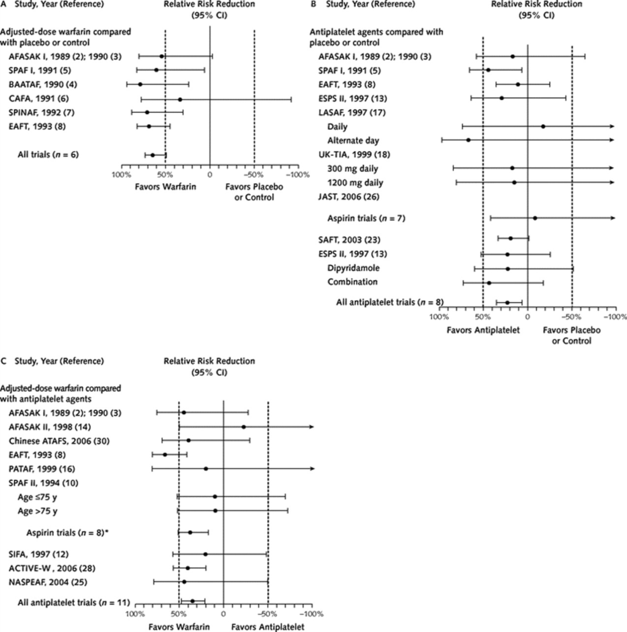


Antithrombotic Therapy to Prevent Stroke in Patients who Have Nonvalvular AF (Meta-Analysis)
Adjusted-dose warfarin compared with placebo or control
Antiplatelet agents compared with placebo or control
Adjusted-dose warfarin compared with antiplatelet agents
Adapted with permission from Hart et al.

Slide 19
Coagulation Cascade
Adapted with permission from Nutescu et al.

Slide 20
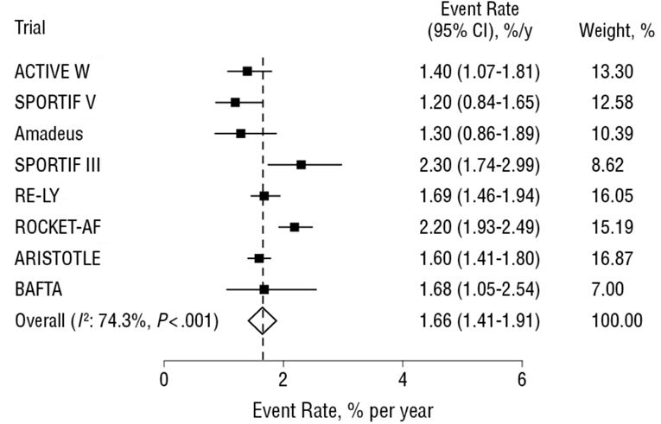
Pooled Estimates of Stroke or Systemic Embolism in Patients With AF Treated With Warfarin
Adapted with permission from Agarwal et al.

Slide 21
Dose Selection of Oral Anticoagulant Options for Patients With Nonvalvular AF and CKD
(Based on Prescribing Information for the United States)*
Renal Function | Warfarin | Dabigatran† | Rivaroxaban† | Apixaban†
Normal/mild impairment | Dose adjusted for INR 2.0–3.0 | 150 mg BID (CrCl >30 mL/min) | 20 mg QD with the evening meal (CrCl >50 mL/min) | 5.0 or 2.5 mg BID‡
Moderate impairment | Dose adjusted for INR 2.0–3.0 | 150 mg BID (CrCl >30 mL/min) | 15 mg QD with the evening meal (CrCl 30–50 mL/min) | 5.0 or 2.5 mg BID‡
Severe impairment | Dose adjusted for INR 2.0–3.0§ | 75 mg BID║ (CrCl 15–30 mL/min) | 15 mg QD with the evening meal (CrCl 15–30 mL/min) | No recommendation¶
End-stage CKD not on dialysis | Dose adjusted for INR 2.0–3.0§ | Not recommended¶ (CrCl <15 mL/min) | Not recommended¶ (CrCl <15 mL/min) | No recommendation¶
End-stage CKD on dialysis | Dose adjusted for INR 2.0–3.0§ | Not recommended¶ (CrCl <15 mL/min) | Not recommended¶ (CrCl <15 mL/min) | No recommendation¶#

Slide 22
Dose Selection of Oral Anticoagulant Options for Patients With Nonvalvular AF and CKD
(Based on Prescribing Information for the United States)* (cont’d)
*Renal function should be evaluated before initiation of direct thrombin or factor Xa inhibitors and should be re-evaluated when clinically indicated and at least annually. CrCl should be measured using the Cockcroft-Gault method.
†The concomitant use of P-glycoprotein inducers or inhibitors with dabigatran or the concomitant use of dual P-glycoprotein and strong CYP3A4 inducers or inhibitors with either rivaroxaban or apixaban, particularly in the setting of CKD, may require dosing adjustment or avoidance of concomitant drug use (see the FDA drug label at http://www.accessdata.fda.gov/drugsatfda_docs/label/2014/202155s002lbl.pdf).
‡Use apixaban 2.5 mg BID if any 2 patient characteristics are present: Cr ≥1.5 mg/dL, ≥80 y of age, body weight ≤60 kg. Apixaban is not recommended in patients with severe hepatic impairment.
§Dose-adjusted warfarin has been used, but observational data on safety and efficacy are conflicting.
║Modeling studies suggest that dabigatran 75 mg BID might be safe for patients with CrCl 15–30 mL/min, but this has not been validated in a prospective cohort. Some countries outside the United States use 110 mg BID.
¶No published studies support a dose for this level of renal function.
#In patients with end-stage CKD on stable hemodialysis, prescribing information indicates the use of apixaban 5 mg BID with dose reduction to 2.5 mg BID if the patient is ≥80 y of age or body weight is ≤60 kg.

Slide 23
Cardiac Surgery—LAA Occlusion/Excision
Recommendation | COR | LOE
Surgical excision of the LAA may be considered in patients undergoing cardiac surgery. | IIb | C

Slide 24
Guideline for the Management of Patients
With Atrial Fibrillation
Rate Control

Slide 25
Rate Control
Recommendations | COR | LOE
Control of the ventricular rate using a beta blocker or nondihydropyridine calcium channel antagonist is recommended for patients with paroxysmal, persistent, or permanent AF. | I | B
Intravenous administration of a beta blocker or nondihydropyridine calcium channel blocker is recommended to slow the ventricular heart rate in the acute setting in patients without pre-excitation. In hemodynamically unstable patients, electrical cardioversion is indicated. | I | B
In patients who experience AF-related symptoms during activity, the adequacy of heart rate control should be assessed during exertion, adjusting pharmacological treatment as necessary to keep the ventricular rate within the physiological range. | I | C

Slide 26
Rate Control (cont’d)
Recommendations | COR | LOE
A heart rate control (resting heart rate <80 bpm) strategy is reasonable for symptomatic management of AF. | IIa | B
Intravenous amiodarone can be useful for rate control in critically ill patients without pre-excitation. | IIa | B
AV nodal ablation with permanent ventricular pacing is reasonable to control heart rate when pharmacological therapy is inadequate and rhythm control is not achievable. | IIa | B
A lenient rate-control strategy (resting heart rate <110 bpm) may be reasonable as long as patients remain asymptomatic and LV systolic function is preserved. | IIb | B
Oral amiodarone may be useful for ventricular rate control when other measures are unsuccessful or contraindicated. | IIb | C
AV nodal ablation with permanent ventricular pacing should not be performed to improve rate control without prior attempts to achieve rate control with medications. | III: Harm | C

Slide 27
Rate Control (cont’d)
Recommendations | COR | LOE
Nondihydropyridine calcium channel antagonists should not be used in patients with decompensated HF as these may lead to further hemodynamic compromise. | III: Harm | C
In patients with pre-excitation and AF, digoxin, nondihydropyridine calcium channel antagonists, or intravenous amiodarone should not be administered as they may increase the ventricular response and may result in ventricular fibrillation. | III: Harm | B
Dronedarone should not be used to control the ventricular rate in patients with permanent AF as it increases the risk of the combined endpoint of stroke, MI, systemic embolism, or cardiovascular death. | III: Harm | B

Slide 28
Approach to Selecting Drug Therapy for Ventricular Rate Control*

Slide 29
Approach to Selecting Drug Therapy for Ventricular Rate Control* (cont’d)
*Drugs are listed alphabetically.
†Beta blockers should be instituted following stabilization of patients with decompensated HF. The choice of beta blocker (e.g., cardioselective) depends on the patient’s clinical condition.
‡Digoxin is not usually first-line therapy. It may be combined with a beta blocker and/or a nondihydropyridine calcium channel blocker when ventricular rate control is insufficient and may be useful in patients with HF.
§In part because of concern over its side-effect profile, use of amiodarone for chronic control of ventricular rate should be reserved for patients who do not respond to or are intolerant of beta blockers or nondihydropyridine calcium antagonists.

Slide 30
Guideline for the Management of Patients
With Atrial Fibrillation
Rhythm Control

Slide 31
Prevention of Thromboembolism
Recommendations | COR | LOE
For patients with AF or atrial flutter of 48 hours’ duration or longer, or when the duration of AF is unknown, anticoagulation with warfarin (INR 2.0 to 3.0) is recommended for at least 3 weeks before and 4 weeks after cardioversion, regardless of the CHA₂DS₂-VASc score and the method (electrical or pharmacological) used to restore sinus rhythm. | I | B
For patients with AF or atrial flutter of more than 48 hours’ duration or unknown duration that requires immediate cardioversion for hemodynamic instability, anticoagulation should be initiated as soon as possible and continued for at least 4 weeks after cardioversion unless contraindicated. | I | C
For patients with AF or atrial flutter of less than 48 hours’ duration and with high risk of stroke, intravenous heparin or LMWH, or administration of a factor Xa or direct thrombin inhibitor, is recommended as soon as possible before or immediately after cardioversion, followed by long-term anticoagulation therapy. | I | C

Slide 32
Prevention of Thromboembolism (cont’d)
Recommendations | COR | LOE
Following cardioversion for AF of any duration, the decision about long-term anticoagulation therapy should be based on the thromboembolic risk profile. | I | C
For patients with AF or atrial flutter of 48 hours’ duration or longer or of unknown duration who have not been anticoagulated for the preceding 3 weeks, it is reasonable to perform TEE before cardioversion and proceed with cardioversion if no LA thrombus is identified, including in the LAA, provided that anticoagulation is achieved before TEE and maintained after cardioversion for at least 4 weeks. | IIa | B
For patients with AF or atrial flutter of 48 hours’ duration or longer or when duration of AF is unknown, anticoagulation with dabigatran, rivaroxaban, or apixaban is reasonable for at least 3 weeks before and 4 weeks after cardioversion. | IIa | C

Slide 33
Prevention of Thromboembolism (cont’d)
Recommendations | COR | LOE
For patients with AF or atrial flutter of less than 48 hours’ duration who are at low thromboembolic risk, anticoagulation (intravenous heparin, LMWH, or a new oral anticoagulant) or no antithrombotic therapy may be considered for cardioversion, without the need for postcardioversion oral anticoagulation. | IIb | C

Slide 34
Direct-Current Cardioversion
Recommendations | COR | LOE
In pursuing a rhythm-control strategy, cardioversion is recommended for patients with AF or atrial flutter as a method to restore sinus rhythm. If cardioversion is unsuccessful, repeated attempts at direct-current cardioversion may be made after adjusting the location of the electrodes, applying pressure over the electrodes or following administration of an antiarrhythmic medication. | I | B
Cardioversion is recommended when a rapid ventricular response to AF or atrial flutter does not respond promptly to pharmacological therapies and contributes to ongoing myocardial ischemia, hypotension, or HF. | I | C
Cardioversion is recommended for patients with AF or atrial flutter and pre-excitation when tachycardia is associated with hemodynamic instability. | I | C

Slide 35
Direct-Current Cardioversion (cont’d)
Recommendations | COR | LOE
It is reasonable to perform repeated cardioversions in patients with persistent AF, provided that sinus rhythm can be maintained for a clinically meaningful period between cardioversion procedures. Severity of AF symptoms and patient preference should be considered when embarking on a strategy requiring serial cardioversion procedures. | IIa | C

Slide 36
Pharmacological Cardioversion
Recommendations | COR | LOE
Flecainide, dofetilide, propafenone, and intravenous ibutilide are useful for pharmacological cardioversion of AF or atrial flutter, provided contraindications to the selected drug are absent. | I | A
Administration of oral amiodarone is a reasonable option for pharmacological cardioversion of AF. | IIa | A
Propafenone or flecainide (“pill-in-the-pocket”) in addition to a beta blocker or nondihydropyridine calcium channel antagonist is reasonable to terminate AF outside the hospital once this treatment has been observed to be safe in a monitored setting for selected patients. | IIa | B
Dofetilide therapy should not be initiated out of hospital because of the risk of excessive QT prolongation that can cause torsades de pointes. | III: Harm | B

Slide 37
Antiarrhythmic Drugs to Maintain Sinus Rhythm
Recommendations | COR | LOE
Before initiating antiarrhythmic drug therapy, treatment of precipitating or reversible causes of AF is recommended. | I | C
The following antiarrhythmic drugs are recommended in patients with AF to maintain sinus rhythm, depending on underlying heart disease and comorbidities: Amiodarone Dofetilide Dronedarone Flecainide Propafenone Sotalol | I | A
The risks of the antiarrhythmic drug, including proarrhythmia, should be considered before initiating therapy with each drug. | I | C

Slide 38
Antiarrhythmic Drugs to Maintain Sinus Rhythm (cont’d)
Recommendations | COR | LOE
Because of its potential toxicities, amiodarone should only be used after consideration of risks and when other agents have failed or are contraindicated. | I | C
A rhythm-control strategy with pharmacological therapy can be useful in patients with AF for the treatment of tachycardia-induced cardiomyopathy. | IIa | C
It may be reasonable to continue current antiarrhythmic drug therapy in the setting of infrequent, well-tolerated recurrences of AF when the drug has reduced the frequency or symptoms of AF. | IIb | C
Antiarrhythmic drugs for rhythm control should not be continued when AF becomes permanent,… | III: Harm | C
…including dronedarone. |  | B

Slide 39
Antiarrhythmic Drugs to Maintain Sinus Rhythm (cont’d)
Recommendations | COR | LOE
Dronedarone should not be used for treatment of AF in patients with New York Heart Association class III and IV HF or patients who have had an episode of decompensated HF in the past 4 weeks. | III: Harm | B

Slide 40
Upstream Therapy
Recommendations | COR | LOE
An ACE inhibitor or angiotensin-receptor blocker is reasonable for primary prevention of new-onset AF in patients with HF with reduced LVEF. | IIa | B
Therapy with an ACE inhibitor or ARB may be considered for primary prevention of new-onset AF in the setting of hypertension. | IIb | B
Statin therapy may be reasonable for primary prevention of new-onset AF after coronary artery surgery. | IIb | A
Therapy with an ACE inhibitor, ARB, or statin is not beneficial for primary prevention of AF in patients without cardiovascular disease. | III: No Benefit | B

Slide 41
AF Catheter Ablation to Maintain Sinus Rhythm
Recommendations | COR | LOE
AF catheter ablation is useful for symptomatic paroxysmal AF refractory or intolerant to at least 1 class I or III antiarrhythmic medication when a rhythm-control strategy is desired. | I | A
Before consideration of AF catheter ablation, assessment of the procedural risks and outcomes relevant to the individual patient is recommended. | I | C
AF catheter ablation is reasonable for some patients with symptomatic persistent AF refractory or intolerant to at least 1 class I or III antiarrhythmic medication. | IIa | A
In patients with recurrent symptomatic paroxysmal AF, catheter ablation is a reasonable initial rhythm-control strategy before therapeutic trials of antiarrhythmic drug therapy, after weighing the risks and outcomes of drug and ablation therapy. | IIa | B

Slide 42
AF Catheter Ablation to Maintain Sinus Rhythm (cont’d)
Recommendations | COR | LOE
AF catheter ablation may be considered for symptomatic long-standing (>12 months) persistent AF refractory or intolerant to at least 1 class I or III antiarrhythmic medication when a rhythm-control strategy is desired. | IIb | B
AF catheter ablation may be considered before initiation of antiarrhythmic drug therapy with a class I or III antiarrhythmic medication for symptomatic persistent AF when a rhythm-control strategy is desired. | IIb | C
AF catheter ablation should not be performed in patients who cannot be treated with anticoagulant therapy during and after the procedure. | III: Harm | C
AF catheter ablation to restore sinus rhythm should not be performed with the sole intent of obviating the need for anticoagulation. | III: Harm | C

Slide 43
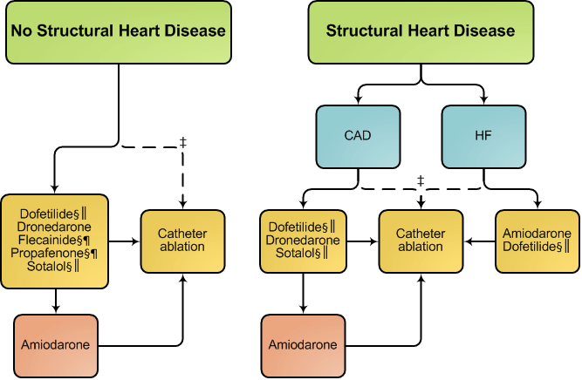
Strategies for Rhythm Control in Patients with Paroxysmal* and persistent AF†

Slide 44
Strategies for Rhythm Control in Patients with Paroxysmal* and persistent AF† (cont’d)
*Catheter ablation is only recommended as first-line therapy for patients with paroxysmal AF (Class IIa recommendation).
†Drugs are listed alphabetically.
‡Depending on patient preference when performed in experienced centers.
§Not recommended with severe LVH (wall thickness >1.5 cm).
║Should be used with caution in patients at risk for torsades de pointes ventricular tachycardia.
¶Should be combined with AV nodal blocking agents.

Slide 45
Surgical Maze Procedures
Recommendations | COR | LOE
An AF surgical ablation procedure is reasonable for selected patients with AF undergoing cardiac surgery for other indications. | IIa | C
A stand-alone AF surgical ablation procedure may be reasonable for selected patients with highly symptomatic AF not well managed with other approaches. | IIb | B

Slide 46
Guideline for the Management of Patients
With Atrial Fibrillation
Specific Patient Groups and AF

Slide 47
Hypertrophic Cardiomyopathy
Recommendations | COR | LOE
Anticoagulation is indicated in patients with HCM with AF independent of the CHA₂DS₂-VASc score. | I | B
Antiarrhythmic medications can be useful to prevent recurrent AF in patients with HCM. Amiodarone or disopyramide combined with a beta blocker or nondihydropyridine calcium channel antagonists are reasonable for therapy. | IIa | C
AF catheter ablation can be beneficial in patients with HCM in whom a rhythm-control strategy is desired when antiarrhythmic drugs fail or are not tolerated. | IIa | B
Sotalol, dofetilide, and dronedarone may be considered for a rhythm-control strategy in patients with HCM. | IIb | C

Slide 48
AF Complicating ACS
Recommendations | COR | LOE
Urgent direct-current cardioversion of new-onset AF in the setting of ACS is recommended for patients with hemodynamic compromise, ongoing ischemia, or inadequate rate control. | I | C
Intravenous beta blockers are recommended to slow a rapid ventricular response to AF in patients with ACS who do not display HF, hemodynamic instability, or bronchospasm. | I | C
For patients with ACS and AF with a CHA₂DS₂-VASc score of 2 or greater, anticoagulation with warfarin is recommended unless contraindicated. | I | C
Administration of amiodarone or digoxin may be considered to slow a rapid ventricular response in patients with ACS and AF associated with severe LV dysfunction and HF or hemodynamic instability. | IIb | C
Administration of nondihydropyridine calcium antagonists might be considered to slow a rapid ventricular response in patients with ACS and AF only in the absence of significant HF or hemodynamic instability. | IIb | C

Slide 49
Hypothyroidism
Recommendations | COR | LOE
Beta blockers are recommended to control ventricular rate in patients with AF complicating thyrotoxicosis unless contraindicated. | I | C
In circumstances in which a beta blocker cannot be used, a nondihydropyridine calcium channel antagonist is recommended to control the ventricular rate. | I | C

Slide 50
Pulmonary Disease
Recommendations | COR | LOE
A nondihydropyridine calcium channel antagonist is recommended to control the ventricular rate in patients with AF and chronic obstructive pulmonary disease. | I | C
Direct-current cardioversion should be attempted in patients with pulmonary disease who become hemodynamically unstable as a consequence of new-onset AF. | I | C

Slide 51
WPW and Pre-Excitation Syndromes
Recommendations | COR | LOE
Prompt direct-current cardioversion is recommended for patients with AF, WPW syndrome, and rapid ventricular response who are hemodynamically compromised. | I | C
Intravenous procainamide or ibutilide to restore sinus rhythm or slow the ventricular rate is recommended for patients with pre-excited AF and rapid ventricular response who are not hemodynamically compromised. | I | C
Catheter ablation of the accessory pathway is recommended in symptomatic patients with pre-excited AF, especially if the accessory pathway has a short refractory period that allows rapid antegrade conduction. | I | C
Administration of intravenous amiodarone, adenosine, digoxin (oral or intravenous), or nondihydropyridine calcium channel antagonists (oral or intravenous) in patients with WPW syndrome who have pre-excited AF is potentially harmful because these drugs accelerate the ventricular rate. | III: Harm | B

Slide 52
Heart Failure
Recommendations | COR | LOE
Control of resting heart rate using either a beta blocker or nondihydropyridine calcium channel antagonist is recommended for patients with persistent or permanent AF and compensated HF with preserved ejection fraction (HFpEF). | I | B
In the absence of pre-excitation, intravenous beta-blocker administration (or a nondihydropyridine calcium channel antagonist in patients with HFpEF) is recommended to slow the ventricular response to AF in the acute setting, with caution needed in patients with overt congestion, hypotension, or HF with reduced LVEF. | I | B
In the absence of pre-excitation, intravenous digoxin or amiodarone is recommended to control heart rate acutely in patients with HF. | I | B

Slide 53
Heart Failure (cont’d)
Recommendations | COR | LOE
Assessment of heart rate control during exercise and adjustment of pharmacological treatment to keep the rate in the physiological range is useful in symptomatic patients during activity. | I | C
Digoxin is effective to control resting heart rate in patients with HF with reduced EF. | I | C
A combination of digoxin and a beta blocker (or a nondihydropyridine calcium channel antagonist for patients with HFpEF) is reasonable to control resting and exercise heart rate in patients with AF. | IIa | B
It is reasonable to perform AV node ablation with ventricular pacing to control heart rate when pharmacological therapy is insufficient or not tolerated. | IIa | B
Intravenous amiodarone can be useful to control heart rate in patients with AF when other measures are unsuccessful or contraindicated. | IIa | C

Slide 54
Heart Failure (cont’d)
Recommendations | COR | LOE
For patients with AF and rapid ventricular response causing or suspected of causing tachycardia-induced cardiomyopathy, it is reasonable to achieve rate control by either AV nodal blockade or a rhythm-control strategy. | IIa | B
For patients with chronic HF who remain symptomatic from AF despite a rate-control strategy, it is reasonable to use a rhythm-control strategy. | IIa | C
Oral amiodarone may be considered when resting and exercise heart rate cannot be adequately controlled using a beta blocker (or a nondihydropyridine calcium channel antagonist in patients with HFpEF) or digoxin, alone or in combination. | IIb | C
AV node ablation may be considered when the rate cannot be controlled and tachycardia-mediated cardiomyopathy is suspected. | IIb | C

Slide 55
Heart Failure (cont’d)
Recommendations | COR | LOE
AV node ablation should not be performed without a pharmacological trial to achieve ventricular rate control. | III: Harm | C
For rate control, intravenous nondihydropyridine calcium channel antagonists, intravenous beta blockers, and dronedarone should not be administered to patients with decompensated HF. | III: Harm | C

Slide 56
Familial (Genetic) AF
Recommendation | COR | LOE
For patients with AF and multigenerational family members with AF, referral to a tertiary care center for genetic counseling and testing may be considered. | IIb | C

Slide 57
Postoperative Cardiac and Thoracic Surgery
Recommendations | COR | LOE
Treating patients who develop AF after cardiac surgery with a beta blocker is recommended unless contraindicated. | I | A
A nondihydropyridine calcium channel blocker is recommended when a beta blocker is inadequate to achieve rate control in patients with postoperative AF. | I | B
Preoperative administration of amiodarone reduces the incidence of AF in patients undergoing cardiac surgery and is reasonable as prophylactic therapy for patients at high risk for postoperative AF. | IIa | A
It is reasonable to restore sinus rhythm pharmacologically with ibutilide or direct-current cardioversion in patients who develop postoperative AF, as advised for nonsurgical patients. | IIa | B
It is reasonable to administer antiarrhythmic medications in an attempt to maintain sinus rhythm in patients with recurrent or refractory postoperative AF, as advised for other patients who develop AF. | IIa | B

Slide 58
Postoperative Cardiac and Thoracic Surgery (cont’d)
Recommendations | COR | LOE
It is reasonable to administer antithrombotic medication in patients who develop postoperative AF, as advised for nonsurgical patients. | IIa | B
It is reasonable to manage well-tolerated, new-onset postoperative AF with rate control and anticoagulation with cardioversion if AF does not revert spontaneously to sinus rhythm during follow-up. | IIa | C
Prophylactic administration of sotalol may be considered for patients at risk of developing AF after cardiac surgery. | IIb | B
Administration of colchicine may be considered for patients postoperatively to reduce AF after cardiac surgery. | IIb | B

